Slide 1
LUNG-MAP
Updates
SWOG
April 2022

Slide 2
Introduction of New Lung Committee Chair
Jhanelle E. gray, MD
April 8, 2022
Swog Lung-MAP Update meeting

Slide 3
My Vision for Leading the SWOG Lung Committee
Ushering in new treatment paradigms.
Reaching more diverse patient populations, by initially gaining an understanding of current state and then in turn identifying what opportunities exist for expanding our reach.
Cultivating the careers and ideas from our Junior investigators with an intentional focus on underrepresented minority researchers.

Slide 4
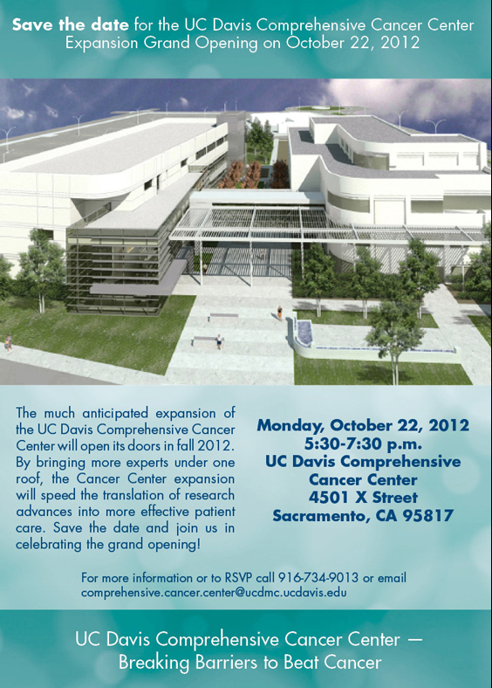
Lung MAP –A Master Protocol in Advanced NSCLC:
Accomplishments
David R. Gandara, MD
University of California Davis
Comprehensive Cancer Center

Slide 5
Disclosures
Commercial Interest | Relationship(s)
Amgen | Research Grant (Institutional)
Astex | Research Grant (Institutional)
Genentech | Research Grant (Institutional)
Adagene | Consultant (Institutional)
Astra Zeneca | Consultant (Institutional)
IO Biotech | Consultant (Institutional)
Guardant Health | Consultant (Institutional)
Oncocyte | Consultant (Institutional)
Roche Genentech | Advisory Board
Merck | Advisory Board
Novartis | Advisory Board
Boehringer Ingelheim | Advisory Board
Regeneron | Advisory Board
Sanofi | Advisory Board
Amgen | Advisory Board

Slide 6
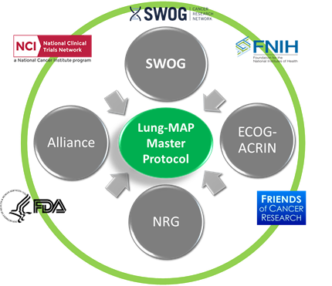












Lung-MAP: A Unique Public-Private Partnership

Slide 7
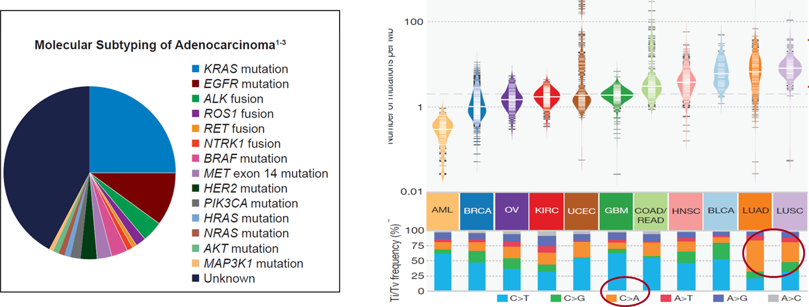
Advanced NSCLC as an Ideal Tumor Type for a Master Protocol
Genomically complex
Immunologically Well Suited
Goals of the Lung MAP Master Protocol:
Test new anti-cancer therapies in uncommon-rare genotypes of NSCLC?
Test new anti-cancer therapies in NSCLC patients refractory to IO
Apply broad-based molecular screening (NGS) in the clinic
Achieve an acceptable turn-around time for molecular testing in the clinic (<2 weeks)
Expedite the clinical trials process (through a public-private partnership)
Bring Lung MAP to NCTN community sites nationwide (“bring the trials to the patient”)
Create “New Science” from Lung MAP resources

Slide 10
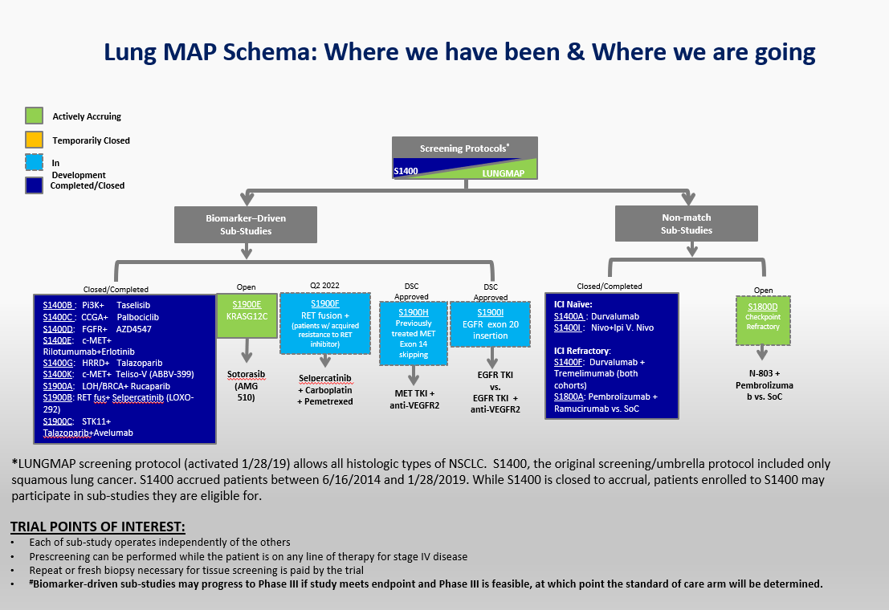

Slide 11
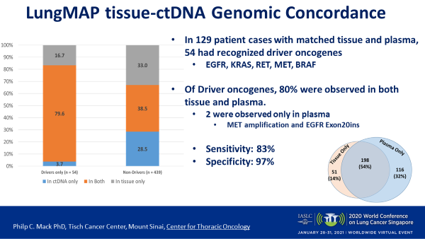
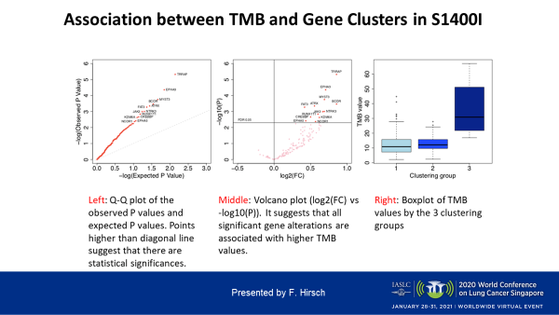
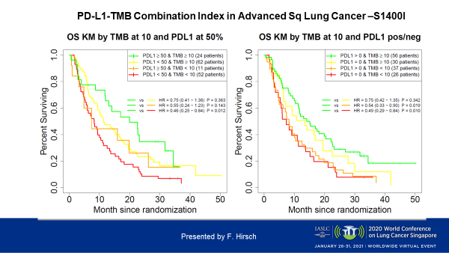
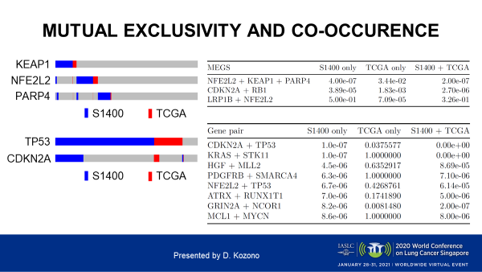
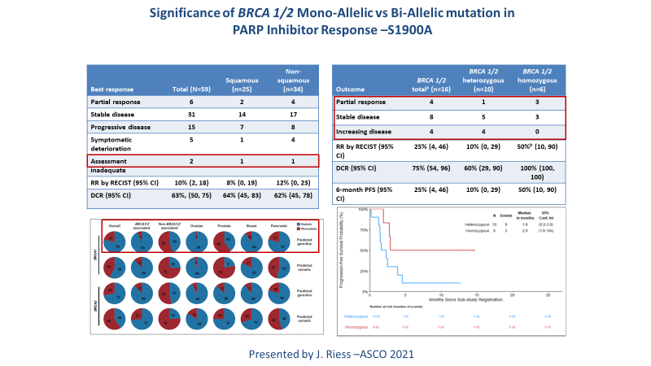
Creating “New Science” from the Lung MAP Resource
Lung-MAP Composite Signature
for Immune Checkpoint Inhibitor (ICI) Efficacy
in Advanced Squamous Cell Lung Cancer (SCC)
Coming Soon!
Submitted IASLC WCLC 2022

Slide 12

Manuscript Update
April 2022
Roy S. Herbst
Ensign Professor of Medicine
Professor of Pharmacology
Chief of Medical Oncology
Director, Thoracic Oncology Research Program
Associate Cancer Center Director for Translational Research

Slide 13
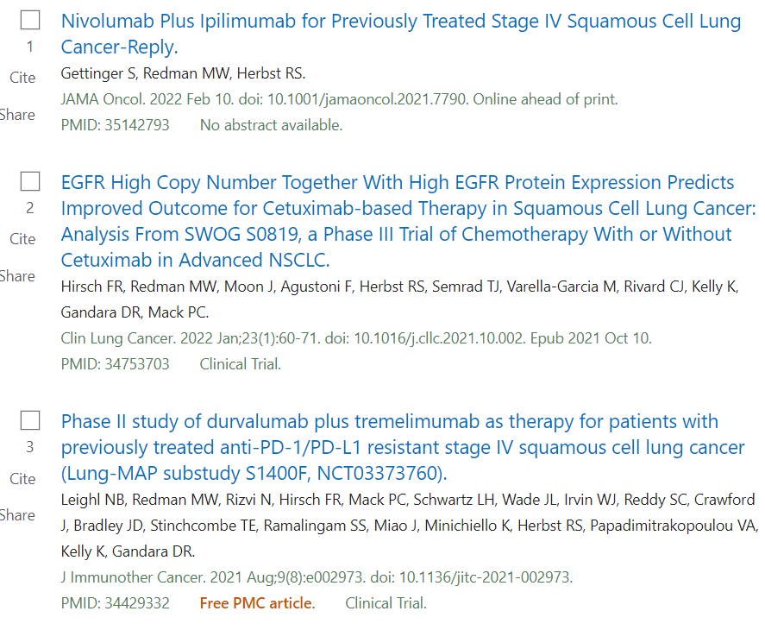

Slide 14
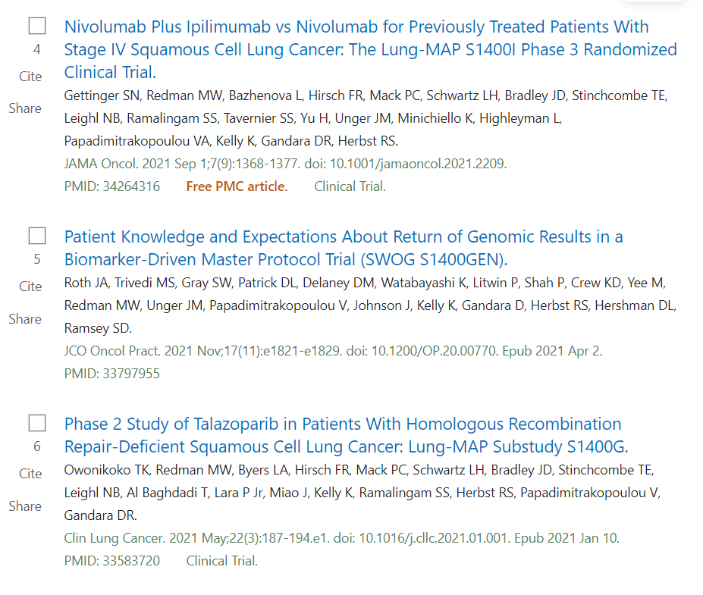

Slide 15
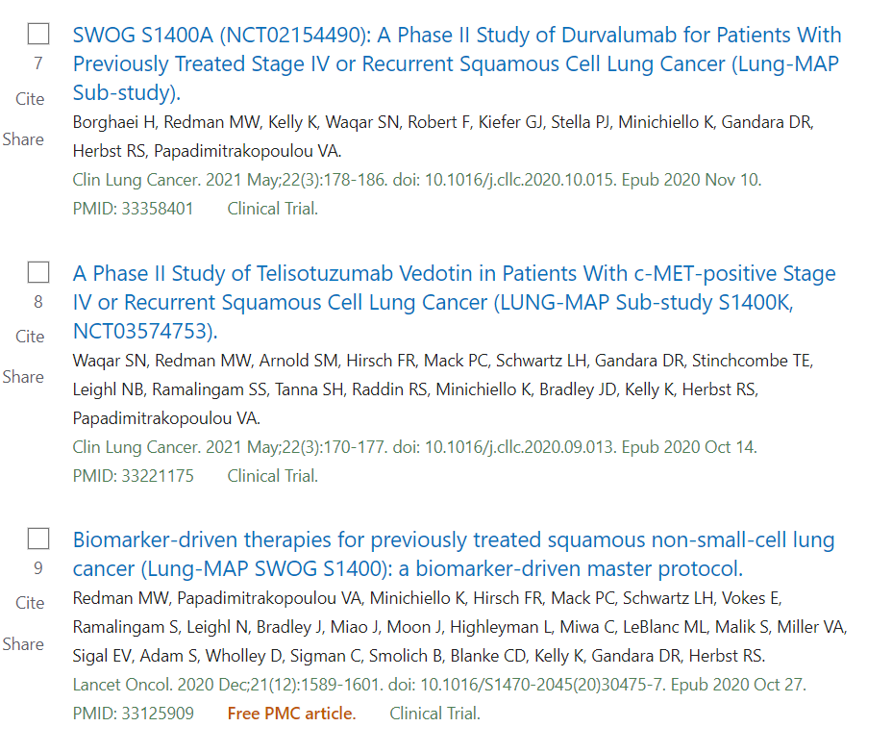

Slide 16


1800A: ASCO Oral and manuscript in preparation
Numerous Correlative science Papers and Abstracts

Slide 17
Lung-MAP Translational Medicine
David Kozono
April 8, 2022

Slide 18
Disclosures
Commercial Interest | Relationship(s)
Genentech/Roche | Consultant
RefleXion | Honorarium

Slide 19
Purpose of the TM committee
Bring together expertise in translational medicine
Assist in biomarker selection and definitions and sample collection decisions for sub-studies under development
Review proposals for prospective and retrospective translational research
Assist in analysis and publication of sequencing and other correlative science data

Slide 20
Members/attendees
Lung-MAP
  Hoss Borghaei, Jeff Bradley, Afshin Dowlati, Konstantin Dragnev, Marty Edelman, David Gandara, Roy Herbst, Fred Hirsch, Leora Horn, Karen Kelly, Phil Mack, Joel Neal, Jyoti Patel, James Rae, Suresh Ramalingam, Christian Rolfo, Robert Samstein, Tom Stinchcombe, Saiama Waqar, Ignacio Wistuba
  Xing Hua, Katie Minichiello, Mary Redman, Mike Wu (Stats)
  Stacey Adam, Dana Connors (FNIH), Taqwa El-Hussein (FNIH), Mariah Norman (SWOG)
  David Kozono (Chair, 2020-)
FMI: Lindsay Chan, Jennifer Mills, Jennifer Newsome, Lynn Sullivan, Khaled Tolba, Jeff Venstrom
Nationwide/Biobank: Erin Grundy, Yvonne Moyer, Nilsa Ramirez, Kae Tegtmeier

Slide 21
Areas of expertise
Therapeutics
  Immuno-Oncology
  Targeted therapies
  DNA repair
  Anti-angiogenic therapy
Biospecimen banking and processing
Pathology
Clinical genomics

Slide 22
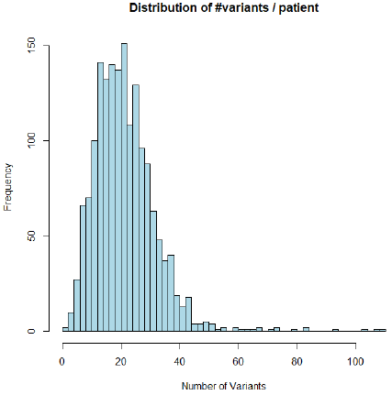
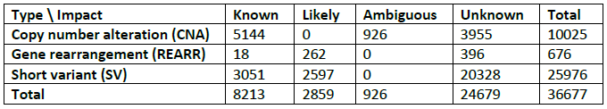
Lung-MAP TM resources
Sequencing data from S1400 (Jun 16, 2014 – Jan 28, 2019)
  Enrolled 1864 patients with stage IV or recurrent squamous cell lung cancer
  Next Generation Sequencing (NGS) data available for 1672 patients using the FoundationOne T5 research platform
  T5 = exons and/or introns of 313 cancer-related genes
  36,677 variants identified
  Largest NGS dataset of advanced squamous cell lung
  cancers of previously treated patients

Slide 23
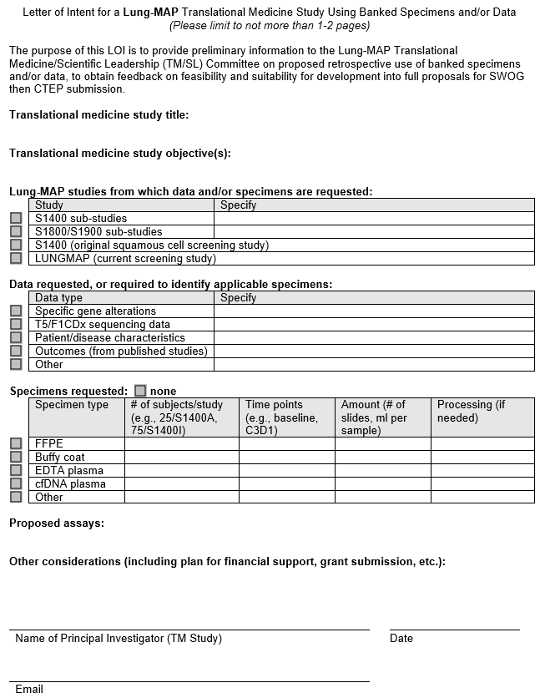
Letter of Intent
Goal: to promote TM research by simplifying initial inquiries
One to two pages
Preliminary information on proposed retrospective use of banked specimens and/or data
Send to TM committee chair for review and advice: lungmaptm@gmail.com

Slide 24
1. Pre-proposal discussion
1
Translational Medicine
Principal Investigator
Translational Medicine & Scientific Leadership Committee
2. Provide TM Proposal Template Form
SWOG Ops
Protocol Project Manager
Review
ok
Pre-proposal discussions

Slide 25
Translational Medicine
Principal Investigator
3. Submit completed TM Proposal Form to
TM/SL Committee + Stats.
Present at TM/SL meeting.
Translational Medicine & Scientific Leadership Committee
Statistician/
Stats PRC
cc
SWOG Ops
Protocol Project Manager
Review
2
Review
4. TM/SL voting outcome sent
&
Comments/Suggestions to PI from:
TM/SL scientific reviewers, statistician, Protocol PM
Review
Vote
TM Proposal Form Completion, Review, and Comments

Slide 26
Translational Medicine
Principal Investigator
5. Send updated proposal
SWOG Ops
Protocol Project Manager
forward
3
Final Vote
TM Approval Committee
Finalized Proposal and Voting

Slide 27
Protocol Amendment, Contract, & Budget
6. Approval
Final Vote
4
Protocol Amendment
7. Protocol Amendment submitted to PIO
Contracts and funding are in place
TM analysis begins
SWOG Ops
Protocol Project Manager
CTEP & CIRB
Review
approval
Contracts & Budgets Team
Data transfer or
ship specimens to lab

Slide 28
1. Pre-proposal discussion
1
Translational Medicine
Principal Investigator
3. Submit completed TM Proposal Form to
TM/SL Committee + Stats.
Present at TM/SL meeting.
Translational Medicine & Scientific Leadership Committee
5. Send updated proposal
cc
2. Provide TM Proposal Template Form
Statistician/
Stats PRC
SWOG Ops
Protocol Project Manager
approve
Review/Vote
approve
2
requires modification/
disapprove
Review
4. TM/SL voting outcome sent
&
Comments/Suggestions to PI from:
TM/SL scientific reviewers, statistician, Protocol PM
Review
forward
3
6. Approval
Final Vote
TM Approval Committee
4
Protocol Amendment
7. Protocol Amendment submitted to PIO
Contracts and funding are in place
TM analysis begins
SWOG Ops
Protocol Project Manager
CTEP & CIRB
Review
approval
Contracts & Budgets Team
Data transfer or
ship specimens to lab

Slide 29
TM proposals and funding
Priority for use of biospecimens: validation studies and hypothesis-based research vs. exploratory analyses
Secondary use of data (genomic, digital pathology, etc.) has a lower bar since resources are not being exhausted
Proposals with funding secured or available are favored
  Example funding opportunity: NIH/NCI FOA PAR-20-313 and 314

Slide 30
FOA PAR-20-313 and 314
Assay Validation of High-Quality Markers for Clinical Studies in Cancer (UH2/UH3 Clinical Trial Not Allowed)
  UH2 phase (analytical validation): up to $200K DC/year, up to $275K DC/total over 2 years
  UH3 phase (clinical validation): up to $250K DC/year x up to 3 years
Application dates: 7/11/22, 10/11/22, 2/14/23, 7/10/23, 10/10/23

Slide 31
UH2/3 project characteristics
Assays whose marker/classifier is likely to be used in treatment trials
Technologies already in use or soon to be approved for use in clinical laboratories
Applications to improve standardization or harmonization of assays among laboratories for use in clinical trials are appropriate
Must have a working assay(s) using human specimens

Slide 32
S1900A TM analyses (J. Riess)
Amendment submitted to CTEP to analyze:
  Frequency of reversion mutations in BRCA1/2 and other homologous recombination deficiency (HRD) genes
  Concordance of BRCA1/2 and other HRD gene mutations in plasma and tissue
  Clinical outcomes of homozygous or heterozygous BRCA1/2 and other HRD gene mutations detected by ctDNA
  Association of reversion mutations with de novo or acquired resistance to rucaparib
  Changes in ctDNA variant allele frequency
  Association of clinical outcomes with the FM HRDv2 signature and gene mutations

Slide 33
Other analyses…stay tuned
Lung-MAP composite signature for immune checkpoint inhibitor efficacy in advanced squamous cell lung cancer (D. Gandara)
Genomic Landscape of Smoking-Associated vs. Non-Smoking-Associated KRAS Mutation Subtypes in NSCLC from LUNGMAP (S. Padda)

Slide 34
Thank you

Slide 35




LungMap S1900E
Sukhmani K. Padda MD (Chair)
Associate Professor of Medicine
Director of Thoracic Medical Oncology
Cedars-Sinai Medical Center
David Gerber MD (Co-Chair)
Professor of Internal Medicine and Population & Data Sciences
David Bruton, Jr. Professor in Clinical Cancer Research
Associate Director of Clinical Research
UT Southwestern Medical Center
SWOG Meeting
April 8, 2022, Seattle/Hybrid
Notes:
S1900E, A PHASE II STUDY OF SOTORASIB (AMG 510) IN PARTICIPANTS WITH PREVIOUSLY TREATED STAGE IV OR RECURRENT KRAS G12C MUTATED NON-SQUAMOUS NON-SMALL CELL LUNG CANCER (ECOG-ACRIN LUNG-MAP SUB-STUDY)
2:30-4 pm meeting- estimated to present at 3 pm

Slide 36
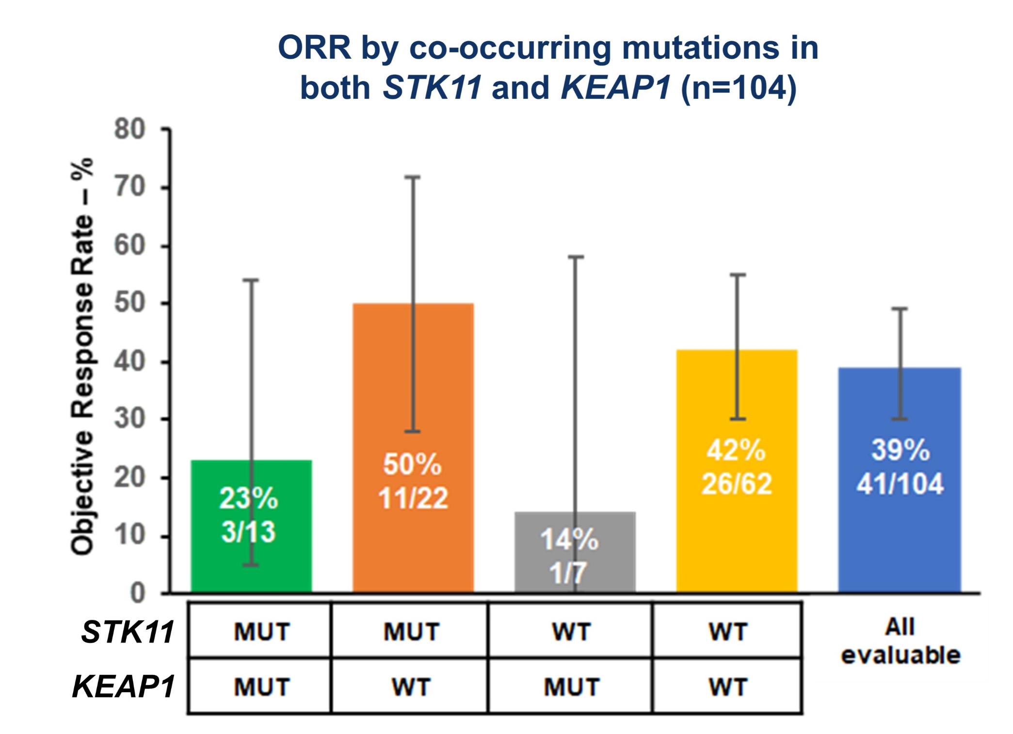
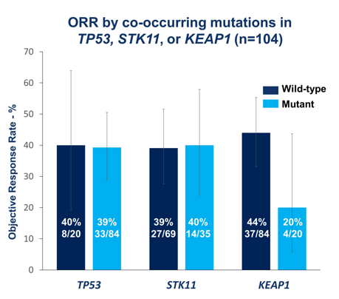

Sotorasib efficacy across KRAS G12C co-mutation subsets
Sotorasib: ORR 37.1% DCR 80.6% mDOR 11.1 mo
mPFS 6.8 mo, mOS 12.5 mo
FDA approved May 2021
F Skoulidis et al. ASCO 2021. N Engl J Med 2021;384:2371-2381.
Notes:
124 pts at 960 mg po qd and median f/u 15.3 months
Median f/u 15.3 months. 81% prior platinum-based chemo & PD-1/PD-L1 inhibitors
Median best percentage decrease from baseline in tumor burden (defined as the sum of the longest diameters of all target lesions) was 60%
PD rate was 16.1% (20 pts)
Median TTR 1.4 mo (1.2-10.1)
71.7% (33 pts) had a response at first assessment at 6 weeks
57.3% responding at 9 months
PFS at 6 mo 52.2%, at 9 months 37.5%
PD-L1 expression doesn’t predict for response: ORR 48% (95% CI, 32 to 63) PD-L1–negative group (tumor proportion score, <1%) and ORR 42% (95% CI, 31 to 53) of the overall population of patients who could be evaluated (86 pts assessed)
TMB doesn’t predict for response: 42% (95% CI, 30 to 55) low tumor mutational burden (<10 mutations per megabase) and in 40% (95% CI, 16 to 68) high tumor mutational burden (≥10 mutations per megabase)
ORR 37.1% (95% CI 28.6-46.2); DCR 80.6% (95% CI 72.6-87.2); mDOR 11.1 mo (95% CI 6.9-NE); mPFS 6.8 mo (95% CI 5.1-8.2); mOS 12.5 mo (95% CI 10.0-NE); FDA approved May 2021

Slide 37
S1900E Schema
KRAS^{G12C}/TP53^{MUT}
Target N=40
AMG 510/Sotorasib
960 mg QD
S1900E Substudy
Recurrent or metastatic KRAS^{G12C} mutated non-squamous NSCLC
Received at least one prior systemic therapy
No uncontrolled brain metastasis
KRAS^{G12C}/STK11^{MUT}
Target N=25
AMG 510/Sotorasib
960 mg QD
End of Treatment
Enrollment
KRAS^{G12C}/Other ª
Target N=40
AMG 510/Sotorasib
960 mg QD
Primary Endpoint
Objective response rate
Secondary Endpoints
Duration of response
Progression free survival
Overall survival
Safety
Treatment Period
until disease progression, intolerance, or consent withdrawal
Clinic visits/labs every 3 weeks
Imaging every 6 weeks
If Progression
Liquid biopsy to determine resistance mechanism
ªother co-mutations (e.g., KEAP1, NFE2L2, CUL3), double or triple co-mutations (e.g., STK11/TP53, STK11/TP53/KEAP1), or no co-mutations

Slide 38
Ongoing importance of S1900E
Doubles Amgen CodeBreaK100 sample size
Rigorous upfront co-mutation biomarker definitions - accounts for co-occurring mutations
Expected 95% CI narrower around point estimates of ORR
Enhanced diversity
Notes:
CB100 126 // S1900E 105
Co-occurring co-mutations: 32% TP53 (46/142) and 78% (62/80) – LUNGMAP cutoff 09/2021
Amgen:
STK11 MUT/KEAP1 WT 95% CI 28-72
KEAP1 MUT/STK11 WT 95% CI 0-58
LUNGMAP (cutoff 09/2021): White 1776 (86%), Black 189 (9%), Asian 48 (2%), Pacific Islander 7 (0%), Native American 4 (0%), Multi-Racial 4 (0%), UNK 26 (1%)
CodeBreaK 100 (n=126): White 81.7%, Black 1.6%, Asian 15.1%, Other 1.6%

Slide 39
Accrual & Amendment Update
58/105 participants enrolled (24/40 TP53, 13/25 STK11, 21/40 Others) since 04/02/2021 activation
  6 in last 30 days; 1 in last 7 days as of 04/04/2022
Revision #3 Amendment CIRB & NCI CTEP Approved
  Allows pts with untreated asymptomatic brain mets
  Shorter washouts for prior anti-cancer systemic treatments & radiation
  Shorter washout & clarification of DDI
  Eligibility lab thresholds liberalized (e.g., ANC, Cr)
  Removal of interim analysis
Notes:
Accrual Timelines:
TP53: Accrual 15-25 pts/year
STK11: 6-11 pts/year
All others: 14-24 pts/year
Interim at 20 pt mark in cohort 1/3 and 15 in cohort 2

Slide 40
S1800D
A Phase II/III Study of N-803 (ALT-803) plus Pembrolizumab versus Standard of Care in Participants with Stage IV or Recurrent Non-Small Cell Lung Cancer Previously Treated with Anti-PD-1 or Anti-PD-L1 Therapy (Lung-MAP Non-Match Sub-Study)
John Wrangle, MD, MPH, Study Chair
Hatim Husain, MD, Study Co-ChaiR

Slide 41
S1800D Schema
Prior Anti-PD-(L)1 and
disease progression
PD on prior treatment
≤ 12 weeks
PD on prior treatment
> 12 weeks
Primary Resistance
Cohort
Acquired Resistance
Cohort
Stand-alone Phase II
Phase II/III
N = 144 total
N = 334 total
N-803+Pembrolizumab
Standard of Care
N-803+Pembrolizumab
Standard of Care
Primary Endpoint: Overall Survival
Comparison: Weighted Log-rank test
Minimum Follow-up requirements for all analyses (interim and final)
Primary Endpoint: Overall Survival
Comparison: Standard Log-rank test
Minimum Follow-up requirements for all analyses (interim and final)
Standard of Care Options: Docetaxel + Ramucirumab, Docetaxel, Gemcitabine, Pemetrexed

Slide 42
Study Objectives
Primary Objective
The primary objective is to compare overall survival (OS) between participants randomized to N-803 (ALT-803) + pembrolizumab versus standard of care therapy.
Secondary Objectives
Progression-free survival
Response rates
Duration of response (DoR) among responders
To evaluate the frequency and severity of toxicities within each treatment arm

Slide 43
Overview of Treatment(s)
N-803 (ALT-803) injected subcutaneously every 3 weeks
Pembrolizumab given IV every 3 weeks

Slide 44
Enrollment Updates
Number of sites with CIRB approval: 170
Number of patients assigned to study: 263
Number of Patients Registered: 3

Slide 45
Acknowledgements
Participating Patients
National Institutes of Health – 1R01CA222817-01A1
Hollings Cancer Center, Medical University of South Carolina
Mark Rubinstein, Ph.D.

Slide 46
S1900F A Phase II Study of Selpercatinib (LOXO-292), Carboplatin and Pemetrexed in Patients with RET Fusion-Positive Stage IV Non-Small Cell Lung Cancer and Progression of Disease on Prior RET Directed Therapy (LUNGMAP Sub-Study)
Jhanelle E. gray, MD and YASIR ELAMIN, MD

Slide 47
S1900F: A Phase II Study of Selpercatinib (LOXO-292), Carboplatin and Pemetrexed in Patients with RET Fusion-Positive Stage IV Non-Small Cell Lung Cancer and Progression of Disease on Prior RET Directed Therapy (LUNGMAP Sub-Study)
Patient Population
RET-Fusion-Positive NSCLC as determined by Common Broad Platform CLIA Biomarker Profiling
Received and Developed Disease Progression During or After a Selective anti-RET inhibitor treatment
Must Have Not Received Cytotoxic Chemotherapy for Metastatic Disease for 1-Year Prior to Study Treatment
Arm A:
Carboplatin
Pemetrexed
Selpercatinib (LOXO-292)
Progression
Patient may continue protocol treatment after progression if the patient is continuing to clinically benefit in the opinion of the treating investigator
Arm B:
Carboplatin
Pemetrexed
Accrual (eligible) goal: 74 (66 eligible)
Primary Endpoint: IA-PFS
Secondary Endpoint: IA-PFS; IA-Best Response; OS; DoR; Toxicity (CTCAE 5.0); LungMAP ctDNA Assay by FMI

Slide 48
S1900F Projected Protocol Startup Timeline
CIRB Review | 4/21/22
Receive Comments from CIRB | Estimated 5/5/22
Submit Responses to CIRB | Estimated 5/12/22
CIRB Approval | Estimated 5/26/22
CTEP Full Approval | Estimated June 2022
Earliest Possible Activation | June 2022

Slide 49
LungMap
Drug Selection Committee
Hossein Borghaei, MS, DO
Professor and Chief, Thoracic Oncology
The Gloria and Edmund M. Dunn Chair in Thoracic Oncology
April 2022

Slide 50

Disclosures
Research Support (Clinical Trials):
  Millennium, Merck/Celgene, BMS/Lilly
Advisory Board/Consultant:
  BMS, Lilly, Genentech, Celgene, Pfizer, Merck, EMD-Serono, Boehringer Ingelheim, Astra Zeneca, Novartis, Genmab, Regeneron, BioNTech, Cantargia AB, Amgen, Abbvie, Axiom, PharmaMar, Takeda, Huya Bio, GLG, Daiichi, Guardant, Natera, Oncocyte, Beigene
Scientific Advisory Board:
  Sonnetbio (Shares), Rgenix (Shares), Nucleai (Shares)
Data and Safety Monitoring Board:
  University of Pennsylvania, CAR T Program, Takeda, Incyte
Employment:
  Fox Chase Cancer Center

Slide 51
Drug Selection Committee
Sources
  Investigators/Drug Selection Committee Initiated
  Pharmaceutical company initiated
Initial Qualification
  Investigational drug/biomarker combination with preclinical & clinical data supporting safety & potential efficacy as a targeted therapy or “non-match” therapy in lung SCC.
  Ready or near ready to enter the Lung-MAP phase 2 clinical protocol
Candidates are evaluated by the Lung-MAP Drug Selection Committee (DSC), comprised of:
  Key investigators & clinical researchers
  Biomarker & molecular target experts from academia, NCI & FDA
  Non-conflicted industry-based drug developers
Candidates are scored based on:
  Target appropriateness for Lung-MAP
  Drug/Biomarker preclinical & clinical data
  PK/PD data

Slide 52
Process
Sub-study suggestions come from Lung-MAP PIs, outside investigators, or pharma
Initial discussions are internal with a PIs, followed by informal presentation from investigator/pharma to internal drug selection committee
Next step is decision to proceed to full Drug Selection Committee (DSC)
  Completion of Drug Selection application, summarizing preclinical and PK/PD data, prior human experience and safety profile, especially in lung cancer, and status of assay if proposed sub-study includes biomarker selection
  DSC presentation by investigator/pharma, Q&A, and committee closed session discussion
Formal voting by DSC members; 6 criteria for evaluation, each scored on 1-9 scale
  Target/target appropriateness to NSCLC; Drug/biomarker understanding; Preclinical data; PK/PD; Toxicity; Clinical data
PIs have final decision if vote is close or issues are brought up
Acceptance/deferral letters sent to pharma
Upon acceptance, kick-off call and regular teleconferences are set up with FNIH and SWOG Operations, for concept/protocol development, including regulatory aspects and FDA requirements, confirmation of drug supply, and contractual agreements

Slide 53
Studies Under Development
SCREENING PROTOCOL
BIOMARKER-DRIVEN SUB-STUDIES
(Targeted Therapies)
NON-MATCH SUB-STUDIES

Slide 54
Studies under development
Targeted therapies and the VEGF Pathway
VEGF pathway inhibition can augment the activity of many of the available drugs/targets
Ramucirumab is an FDA approved agent with good safety profile
VEGF inhibition is being explored in many different settings
LungMap’s reach allows us to conduct studies in rare populations and answer clinically important questions
A randomized phase II study of EGFR EX20 TKI with or without Ramucirumab in Patients with Previously Treated EGFR Exon 20 Insertion Mutated Non-Small-Cell Lung Cancer
  Unmet need
  Rare population
  Single agent drug activity is good but needs improving
A phase II study of MET TKI and Ramucirumab in Patients with Previously Treated EGFR Mutated Non-Small-Cell Lung Cancer with MET Amplification
  Another rare population
  MET amplification after EGFR TKI therapy is detected by repeat biopsy and NGS testing
A phase II study of MET TKI and Ramucirumab in Patients with Previously Treated MET Exon 14 skipping Non-Small-Cell Lung Cancer
  Rare population
  MET TKI with good clinical activity in treatment naïve setting

Slide 55
Studies under development
Non-Matched Arm
A Randomized phase II/III study of Docetaxel and Ramuciramab with or without Cemiplimab in patients with stage IV or recurrent NSCLC previously treated with chemotherapy and anti-PD-(L)1 therapy
  Limited options after chemotherapy plus IO or IO alone
  Builds on a prior protocol
  Continues a checkpoint inhibitor
A study of vibostolimab+pembrolizumab+lenvatinib in patients with stage IV or recurrent NSCLC previously treated with chemotherapy and anti-PD-(L)1 therapy
  Novel checkpoint inhibitor (TIGIT)
  Some evidence of activity in other malignancies
  Same population as above

Slide 56
Summary
Significant potential for benefiting patients
A unique opportunity to explore drugs or combinations in patients with metastatic non-small cell lung cancer
Ability to explore efficacy in rare patient populations
Great support from NCI, FDA and industry
Significant opportunity to collect biosample for correlative studies
Opportunity for participation of all thoracic oncologists, translational scientists and other interested parties around the country

Slide 57
Accrual Enhancement Committee Updates
Jennifer Pope
Yale cancer Center

Slide 58
AEC Members
Stacey J. Adam, PhD
Associate Vice President - Research Partnerships,
Foundation for the National Institutes of Health
Andrea Denicoff, MS, RN
Head of Clinical Trial Operations,
NCI’s NCTN (National Clinical Trials Network)
Frank DeSanto
Communications Manager,
SWOG Cancer Research Network
Taqwa El-Hussein
Associate Scientific Project Manager,
Cancer Research Partnerships,
Foundation for the National Institutes of Health
Ryan M. Hohman, JD
Vice President – Public Affairs
Friends of Cancer Research
Judy Johnson
Lung Committee Research Advocate,
SWOG Cancer Research Network
Jennifer Newsome, MS
Scientific Project Manager, Cancer Research Partnerships,
Foundation for the National Institutes of Health
Jennifer Pope, CCRP
Clinical Trials Team Manager - Thoracic Oncology
Yale Cancer Center, Clinical Trials Office
Caroline Sigman, PhD
President, CCS Associates

Slide 59
AEC Goals
The AEC works collaboratively with study leadership, NCI, SWOG Ops/Stats, Study Coordinator Committee, lung cancer advocates, collaborating cooperative groups, and pharmaceutical company partners.
The committee aims to increase awareness of, enthusiasm for and engagement in Lung-MAP among clinical investigators and site staff, advocates, and patients by fostering educational efforts around the trial to maximize accrual to the treatment sub-studies.

Slide 60
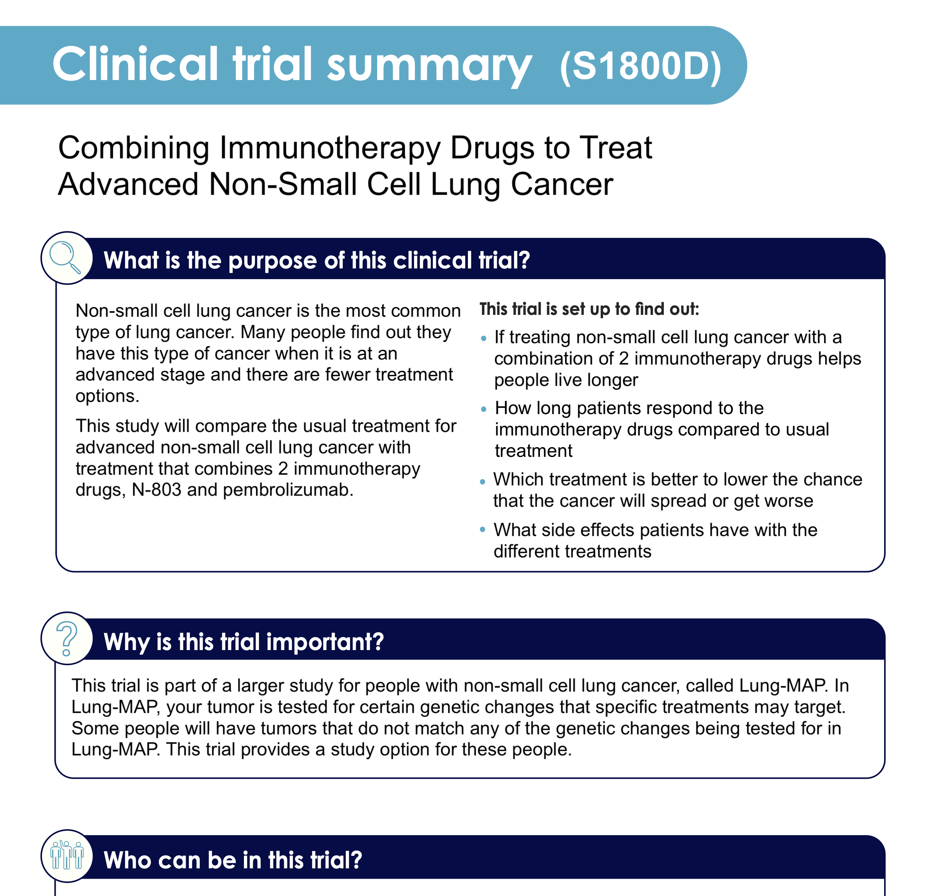
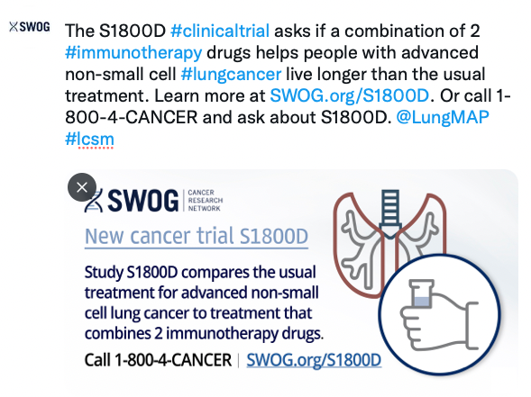
Patient Engagement
Developing patient-friendly trial summaries for new sub-studies
  Help patients decide whether to learn more about Lung-MAP
Developing social media toolkits for new sub-studies
  Include patient-directed messages and graphics
First sets drafted and will soon go to CIRB for review

Slide 61
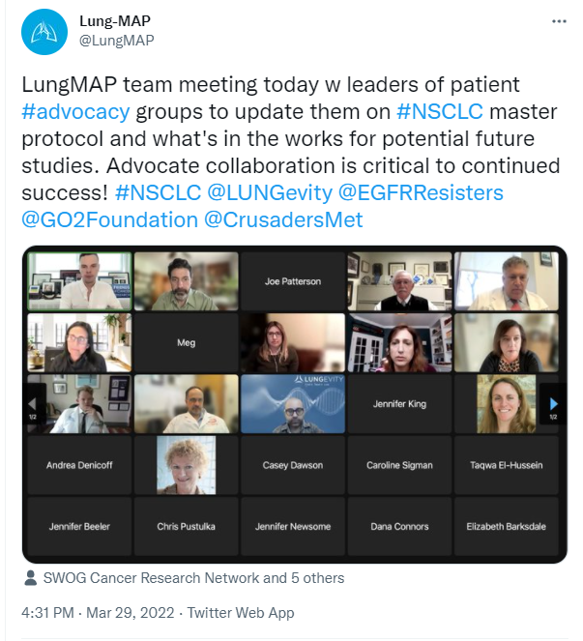
Patient Advocate Re-Engagement
First Patient Advocacy Webinar held on March 29th
  Discussed the important role that Lung-MAP plays; particularly in reaching community treatment centers
  Lung-MAP leaders presented on the historical context of Lung-MAP and the critical role advocates play as well as future treatment options
Patient Advocacy Webinars will continue on a Quarterly basis
  These will be a key venue for fielding advocate input on Lung-MAP priorities

Slide 62
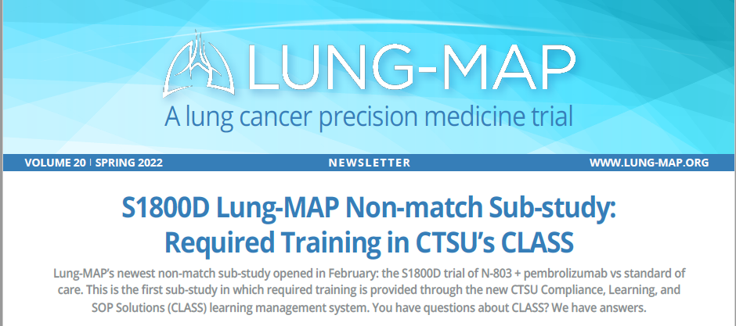
Investigator and Site Engagement
Lung-MAP Newsletters are distributed to sites quarterly and available on CTSU
Thank you emails go to site PIs at 1, 5, & 10 accruals
Email blast goes to PIs and head CRAs when new sub-study opens
Provider-directed tweets in social media toolkit for each new sub-study
The AEC partners with the Site Coordinator Committee to develop content most relevant to sites
The AEC is re-engaging more regularly with the SCC to maintain the site perspective on our efforts

Slide 63
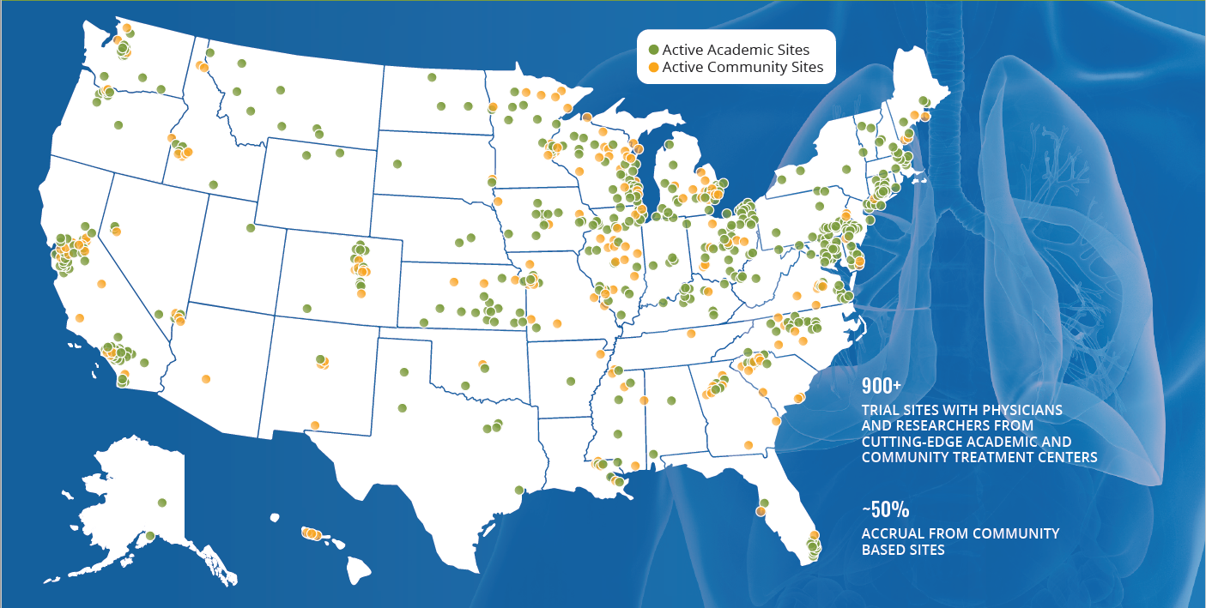

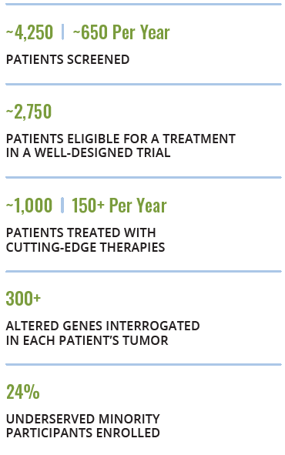
Lung-MAP’s Patient Diversity
Notes:
Some ways the AEC is currently contributing to the continued success as enrolling a diverse patient population are:
Outreach to sites and the Study Coordinators Committee to collect and share success stories on recruiting underrepresented groups
We will publicize findings of Stat Cetr analysis of Lung-MAP diversity when published

Slide 64
Questions?
Please reach out to AEC members at lungmapAEC@swog.org

Slide 65
The Future of
LUNG-MAP
Jyoti D. Patel, MD

Slide 66
The Future is Robust
Opportunities to understand and overcome resistance to immunotherapy
Opportunities to refine targeted therapies
Utilization of tissue and blood molecular signatures to improve our understanding of best therapies
Collaboration and opportunities for development for clinical trialists
Patients remain at the center of our mission
  Right Drug at the Right Time in the Right Place
  Study population more accurately mirrors lung cancer patients

