Slide 1
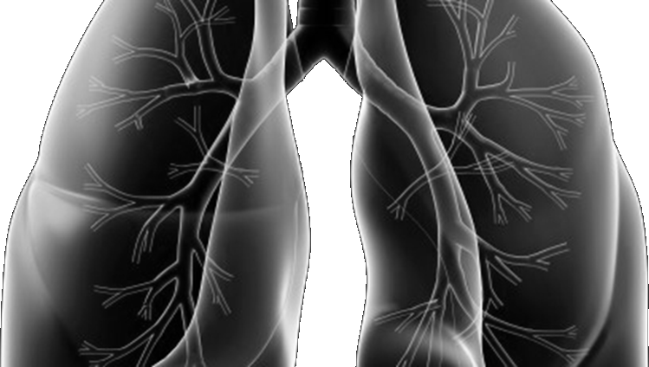







Lung-MAP Update Meeting
SWOG FAll meeting
October 21, 2022

Slide 2
Agenda
There will be a Q & A session at the end of the presentation.
Welcome & Leadership Update Announcement – Jhanelle E. Gray, MD
Lung-MAP Accomplishments– Roy Herbst, MD, PhD
Manuscript Updates– Mary Redman, PhD
Accrual Review & Update on Future Direction of S1800A– Karen Reckamp, MD, MS
S1900G Site Initiation Training – Sarah Goldberg, MD, MPH
LUNGMAP Revision #7 – Jyoti Patel, MD
S1900F Update – Jhanelle E. Gray, MD
S1800D Update – John Wrangle, MD
S1900E Update – Sukhmani Padda, MD
Translational Medicine Committee Updates –David Kozono, MD, PhD
Drug Selection Committee Updates – Hossein Borghaei, DO, MS & Saiama Waqar, MD

Slide 3
Welcome & Leadership Announcement
Jhanelle E. Gray, MD
Lung Committee Chair
swog

Slide 4
Lung-MAP Accomplishments
Roy Herbst, MD, PhD
LUNGMAP Emeritus Study Chair & Senior Advisor
SWOG

Slide 5
Lung-MAP Publications:
Manuscripts, Abstracts, and Presentations
Mary Redman, PhD
Lead Statistician
SWOG

Slide 6
Lung-MAP Publications Fall 2021-2022
S1800A: A Phase II Randomized Study of Ramucirumab and Pembrolizumab Versus Standard of Care in Advanced Non-Small-Cell Lung Cancer Previously Treated With Immunotherapy-Lung-MAP S1800A. Reckamp KL, Redman MW, Dragnev KH, Minichiello K, Villaruz LC, Faller B, Al Baghdadi T, Hines S, Everhart L, Highleyman L, Papadimitrakopoulou V, Gandara DR, Kelly K, Herbst RS. J Clin Oncol 2022
  Presented at ASCO and co-published in JCO, June 2022.

Slide 7
Lung-MAP Presentations and Pending Publications
S1900A A phase II study of rucaparib in patients with high genomic LOH and/or BRCA 1/2 mutated stage IV non-small cell lung cancer Jonathan W. Riess, Mary Weber Redman, Paul Wheatley-Price, Bryan A. Faller, Liza C. Villaruz, Larry R. Corum, Aruna C. Gowda, Gordan Srkalovic, Raymond U. Osarogiagbon, Megan Ann Baumgart, Lu Qian, Katherine Minichiello, David R. Gandara, Roy S. Herbst, Karen Kelly
  Presented at ASCO 2021. Study team finalizing manuscript
S1900C: A Phase II Study of avelumab and talazoparib in Patients with STK11/LKB1-MUTANT positive STAGE IV Non-small Lung Cancer Ferdinandos Skoulidis, Mary Weber Redman, Jennifer Marie Suga, Tareq Al Baghdadi, John L. Villano, Sarah B. Goldberg, Liza C Villaruz, Katherine Minichiello, David R. Gandara, Roy S. Herbst, Karen Kelly
  Presented at ASCO 2022. Study team finalizing manuscript

Slide 8
S1400 Series Publications
Sub-study ID | Biomarker/ Population | Investigational Therapy | SoC/Control Arm | Publication, 1st author
S1400 | All patients: screening study | N/A | N/A | Lancet 12/2020, Redman
S1400A | Non-Match, immunotherapy naïve | Durvalumab | Docetaxel | Clinical Lung Cancer 2020, Borghaei
S1400B | PI3KCA alteration by FMI | Taselisib | Docetaxel | JTO 2019, Edelman
S1400C | Cell Cycle Gene Alterations by FMI | Palbociclib | Docetaxel | JTO 2019, Langer
S1400D | FGFR Alteration by FMI | AZD4547 | Docetaxel | JTO 2019, Aggarwal
S1400F | Non-Match, immunotherapy exposed | Durvalumab + Tremelimumab | N/A | Journal for Immunotherapy of Cancer 2021, Leighl
S1400G | Homologous recombinant repair deficiency (HRRD) genes by FMI | Talazoparib | N/A | Clinical Lung Cancer 2021, Owonikoko
S1400I | Non-Match, immunotherapy naïve | Nivolumab + Ipilimumab | Nivolumab | JAMA Oncology 2021, Gettinger
S1400K | c-MET by IHC (Ventana Rabbit SP44 Antibody c-MET Assay) | ABBV-399 | N/A | Clinical Lung Cancer 2020, Waqar
S1400GEN | N/A ancillary study for physician and patients thoughts on genomic screening | N/A | N/A | JCO Oncol. Practice 2021, Roth

Slide 9
Lung-MAP Translational Medicine Efforts
Lung Master Protocol (Lung-MAP) Next Generation Sequencing Analysis of Advanced Squamous Cell Cancers (SWOG S1400) D. Kozono, X. Hua,2 M. Wu, K. Tolba, S. Waqar, K. Dragnev, H. Cheng, F. Hirsch, P. Mack,7 K. Kelly, R. Herbst, D. Gandara, M. Redman
  World Conference on Lung Cancer 2020 January 28-31, 2021. Manuscript under preparation for submission.
LUNGMAP Master Protocol (LUNGMAP): Concordance Between Plasma ctDNA and Tissue Molecular Analysis
P. Mack, K. Minichiello, M. Redman, K. Tolba, D. Kozono, S. Waqar, A. Chowdhury, A. Dowlati, J. Neal, K. Dragnev, C. Aggarwal, F. Hirsch, K. Kelly, D. Gandara, R. Herbst
  World Conference on Lung Cancer 2020 January 28-31, 2021. Updating analyses underway and manuscript anticipated for 2022
Tumor Mutation Burden (TMB) by Next Generation Sequencing (NGS) Associates with Survival (OS) in
Lung-MAP Immunotherapy Trials S1400I and S1400A F. Hirsch,X. Hua, M. Wu, J. Neal, H. Cheng, S. Gettinger, L. Bazhenova, V. Papadimitrakopoulou, H. Borghaei, P. Mack, K. Kelly, R. Herbst, D. Gandara, Redman, D. Kozono
  World Conference on Lung Cancer 2020 January 28-31, 2021. Manuscript being finalized for submission.
CIMAC projects on S1400I
  Dynamic changes in circulating protein levels reveal an association between ipilimumab and nivolumab combination treatment (SWOG Lung-MAP S1400I trial) with outcomes in squamous cell lung cancer
  Immune gene expression signatures associated clinical benefit from nivolumab and ipilimumab for previously treated patients with stage IV squamous cell lung cancer: An immune biomarker analysis of phase III SWOG LungMAP S1400I trial
  Infiltration and spatial distribution of immune cells are associated clinical benefit from Nivolumab and Ipilimumab for previously treated patients with stage IV squamous cell lung cancer: an immune biomarker analysis of Phase III SWOG LungMAP S1400I trial
  Multiomics profiling reveals molecular and immune features associated with benefit from immunotherapy for Previously Treated Stage IV or recurrent Squamous Cell Lung Cancer patients from the Phase III SWOG LungMAP S1400I trial
  Presented at AACR and ASCO 2022 and publications are underway, led by the Mt. Sinai and MDACC CIMAC groups

Slide 10
Accrual review &
Future direction for S1800A
Karen Reckamp, MD, MS
LUNGMAP Vice Chair (SWOG)
Division Director, Medical Oncology
Cedars-Sinai

Slide 11
Lung MAP Accrual (as of September 2022)

Slide 12
Future direction for S1800A

Slide 13
S1800A—Overall survival
HR= 0.69; SLR p-value 0.05
Median OS for RP 14.5 months v. SOC 11.6 months
Standard of care therapy received:
Docetaxel + Ramucirumab (n = 45)
Docetaxel (n = 3)
Gemcitabine (n = 12)
Pemetrexed (n = 1)
No treatment (n = 6)
Reckamp KL et al ASCO 2022; J Clin Oncol 2022
Notes:
log-rank p-value is < 0.1 , and study met overall threshold < 10% type I error

Slide 14
S1800A Overall survival—subgroup analysis
All subgroup HRs < 1
HRs by PD-L1 does not appear to vary
Pronounced benefit in SCC/mixed histology
Benefit seen with PS 0 and 1
Co-mutations did not affect OS improvement
Reckamp KL et al ASCO 2022; J Clin Oncol 2022

Slide 15
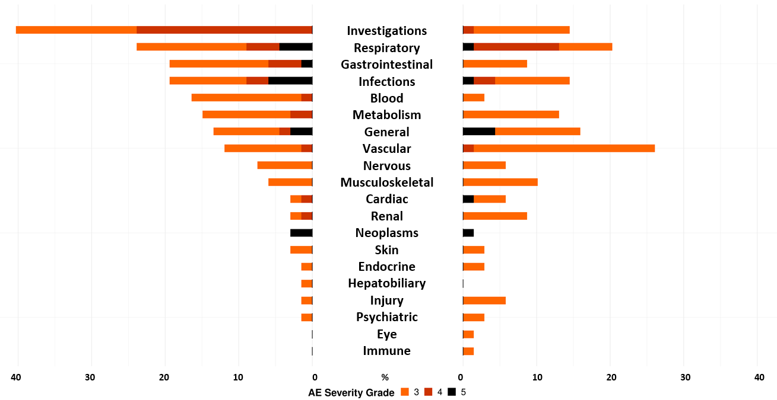
S1800A Safety summary—Percentage of patients with Grade 3-5 AEs
Ramucirumab/Pembrolizumab
SoC
RP
Standard Care
Grade ≥3 TRAEs: 42% on RP; 60% on SOC
Nine (31%) Grade 3–5 irAEs on RP
Reckamp KL et al ASCO 2022; J Clin Oncol 2022

Slide 16
Phase III Rationale
Springboard from Lung MAP and unique partnership with FDA to provide a platform for NCTN to perform registrational trials in collaboration with industry.
Effective therapy following frontline ICI for NSCLC is needed with limited FDA-approved options.
We propose a pragmatic clinical trial design to promote diversity and inclusion in clinical trials.
The aim of the trial is to validate the improvement in overall survival demonstrated in S1800A.
The purpose is to empower investigators to treat patients as would be done in real world practice.
The design is novel and potentially paradigm-changing to decrease barriers to enrollment and minimize the data collection burden.

Slide 17
S2302 Project Pragmatica Treatment/Schema
A PROSPECTIVE RANDOMIZED STUDY OF RAMUCIRUMAB (NSC 749128) PLUS PEMBROLIZUMAB (MK-3475; NSC 776864) VERSUS STANDARD OF CARE FOR PARTICIPANTS PREVIOUSLY TREATED WITH IMMUNOTHERAPY FOR STAGE IV OR RECURRENT NON-SMALL CELL LUNG CANCER
Chair: Karen Reckamp, MD; Co-chairs: Konstantin Dragnev, MD; Wade Iams, MD
Statistician: Mary Redman PhD, Jieling Miao, M.S.
Lung community engagement subcommittee representative: Daniel Carrizosa, MD, MS
N= 700
patients
*SoC treatment is to be determined by the treating investigator and participant. It is recommended that the choice of SoC drug(s) is based on NCCN guidelines for a “systemic therapy for advanced or metastatic disease-subsequent.”
Primary endpoint: OS
Randomization
ARM A
Standard of Care (SoC)*
ARM B
Ramucirumab
+
Pembrolizumab
Stratified by:
Zubrod PS (0/1 v 2)
Most recent therapy ICI (yes v no)

Slide 18
Objectives
Primary study objective: To compare overall survival (OS) between participants previously treated with platinum-based chemotherapy and immunotherapy for Stage IV or recurrent NSCLC randomized to pembrolizumab and ramucirumab versus SOC.
Secondary study objective: To summarize reports of serious and unexpected high-grade (≥ Grade 3) treatment-related adverse events determined by the treating physician within each treatment arm.

Slide 19
Eligibility
The eligibility criteria are notable for items that have been removed from historical eligibility lists to increase inclusion and generalizability.
Stage IV or recurrent non-small cell lung cancer
Received at least one line of anti-PD-1 or anti-PD-L1 therapy for any stage of NSCLC, alone or combination therapy
No more than one line of anti-PD-1 or anti-PD-L1 for Stage IV or recurrent disease
Disease progression (in the opinion of the treating physician) more than (>) 84 days following initiation (Cycle 1 Day 1) of their most recent anti-PD-1 or PD-L1 therapy
Best response on anti-PD-1 or anti-PD-L1 therapy of stable, partial response or complete response for stage IV/recurrent NSCLC (in the opinion of the treating physician)
Disease progression within (<=) 365 days from initiation (Cycle 1 Day 1) of anti-PD-1 or PD-L1 therapy as neoadjuvant, adjuvant, and/or consolidation if only line of anti-PD-1 or anti-PD-L1 therapy
Received platinum-based chemotherapy and experienced disease progression (in the opinion of the treating physician) during or after this regimen
Known sensitizing mutation for which an FDA-approved targeted therapy for NSCLC exists (e.g., EGFR, ALK, ROS1, BRAF, RET, NTRK, KRAS, HER2 and MET sensitizing mutations), must have previously received at least one of the approved therapy(s)
Ability to safely receive the investigational drug combination and the investigator’s choice of standard of care regimens per the current FDA-approved package insert(s), treating investigator’s discretion, and institutional guidelines
Zubrod Performance Status of 0-2

Slide 20
Statistical Considerations
  Sample Size Justification
Accrual goal—700 participants
Based on a design with 85% power to detect a hazard ratio of 0.77, using a 1-sided 2.5% level log-rank test.
Total number of OS events is 526 events
Estimated duration of accrual: 24 months (~ 29 participants/month)
Primary analysis ~ 12 months after completion of accrual
  Analysis Plan
Primary analysis will include all randomized patients (ITT, includes those not meeting eligibility)
Analyses:
  1st interim evaluating early stopping for futility alone at 210 OS events (40% information)
  2nd interim evaluating early stopping for futility or efficacy at 315 events (60% information)
  Primary analysis at 526 events.
If study reaches full accrual/information – statistical significance associated with observed ~ HR = 0.84 or 19% improvement in median OS.

Slide 21
S1900G
A Randomized Phase II Study of Capmatinib plus Osimertinib with or without Ramucirumab in Participants with EGFR-Mutant, MET-Amplified Stage IV or Recurrent Non-Small Cell Lung Cancer (Lung-MAP Sub-Study)
Activation Anticipated
Q1 2023
Sarah Goldberg, MD, MPH
Study Chair (SWOG)
Ross Camidge, MD, PhD
Study Co-chair (SWOG)
Jhanelle E. Gray, MD
Lung Committee Chair
(SWOG)
Jyoti D. Patel, MD
LUNGMAP Study Champion Lead
(Alliance)
Mary Redman, PhD
Lead Statistician
(SWOG)
Confidentiality Disclosure: Information provided in this presentation is confidential and provided solely for the purposes of site consideration of activation and initiation activities.

Slide 22
S1900G Schema
KEY ELIGIBILITY
Advanced EGFR-mutant NSCLC
MET amplification*
At least 1 prior EGFR TKI, including osimertinib as the most recent prior treatment (alone or in combination with other agents)
Chemotherapy +/- immunotherapy is allowed but not required
No prior MET or VEGF-pathway inhibitor
Untreated, asymptomatic brain metastases allowed
Primary Endpoints:
Progression-free survival
Capmatinib at 400 mg BID** plus osimertinib 80mg QD plus ramucirumab 10mg/kg Q2w
Secondary Endpoints:
Toxicity by CTCAE
Response
Duration of response
Overall survival
Randomize
1:1
Capmatinib at 400 mg BID** plus osimertinib 80mg QD
N = 60 eligible (66 total)
Stratification factors: Brain metastases and 2L vs 3+L prior lines of therapy
* MET amplification as determined by tissue-based or blood-based (ctDNA) NGS assay obtained at the time of progression on osimertinib. Tissue testing may be done by FMI through the LUNGMAP screening protocol or using testing results completed outside of the study.
** The study will include a safety run-in on the 1st 10 participants in each arm; if too toxic, regimen will include capmatinib at 200mg BID
Lead Group: SWOG

Slide 23
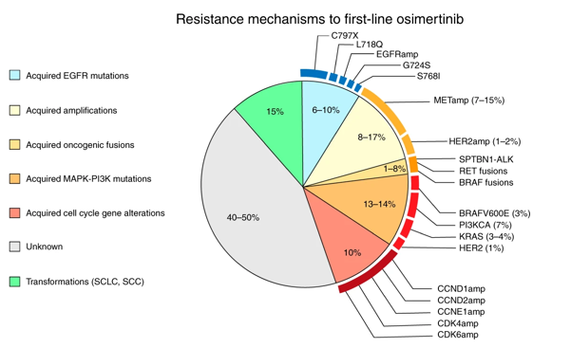
Background/Overview
Participants with advanced EGFR-mutant NSCLC often respond well to EGFR inhibitors but resistance eventually develops
One mechanism of resistance to EGFR inhibitors is MET amplification
Combining a MET inhibitor with an EGFR inhibitor can overcome resistance to EGFR TKIs driven by MET amplification
The addition of a VEGF or VEGFR2 inhibitor can increase the progression-free survival when added to an EGFR TKI in EGFR-mutant lung cancer
Preclinical data demonstrates the crosstalk between VEGF and MET signaling, and the dual inhibition of VEGFR and MET may be able to delay or overcome resistance to EGFR TKIs

Slide 24
Primary Objectives
To compare investigator-assessed progression-free survival (IA-PFS) between participants with EGFR mutated, MET amplified NSCLC randomized to capmatinib and osimertinib with or without ramucirumab

Slide 25
Secondary Objectives
To evaluate if the combination of capmatinib, osimertinib and ramucirumab or capmatinib and osimertinib during the first cycle of treatment has an acceptable toxicity rate.
To evaluate the frequency and severity of toxicities within the arms.
To compare IA-PFS between the arms, in the following subsets:
  Participants with centrally-confirmed MET amplification in tissue
  Participants with centrally-confirmed MET amplification based on ctDNA
  Participants with and without history of brain metastases
  Participants who have received only 1 prior line of therapy and those who have received 2 or more prior lines of therapy
To compare the objective response rate between the arms among participants with measurable disease at baseline.
To evaluate duration of response among responders within each arm.
To compare overall survival between the arms.

Slide 26
Translational Medicine Objectives
To collect, process, and bank cell-free deoxyribonucleic acid (ctDNA) prior to treatment and throughout treatment for future development of a proposal to evaluate comprehensive next-generation sequencing of circulating tumor deoxyribonucleic acid (ctDNA).
To establish a tissue/blood repository from participants with refractory non-small cell lung cancer (NSCLC).

Slide 27
Overview of Treatments
Osimertinib is an EGFR tyrosine kinase inhibitor.
  Approved for first-line treatment of participants with EGFR-mutant NSCLC.
Capmatinib is a kinase inhibitor that targets MET.
  FDA-approved for participants with MET exon 14 skipping mutations.
Ramucirumab is a VEGFR2 antagonist that results in inhibition of angiogenesis.
  FDA-approved in combination with erlotinib or docetaxel.
Concomitant therapy:
  No concomitant systemic cancer therapies are permitted while on trial.
  Radiation for symptomatic metastases (e.g. bone) is permitted.
Recommended pre-medication:
  Pre-medication associated with standard drug administration and supportive care (including anti-diarrheals, antibiotics, diuretics, growth factors, or other medications) may be given as indicated by the current ASCO guidelines.
  Pre-medication with a histamine H1 antagonist such as diphenhydramine hydrochloride is recommended prior to infusion of ramucirumab.

Slide 28
Treatment Administration
 | Osimertinib | Capmatinib | Ramucirumab
Route: | PO | PO | IV
Dose: | 80mg | 400mg | 10 mg/kg
Cycle duration: | 28 days | 28 days | 28 days
Administration: | Daily | Twice daily | Day 1 and 15
Premedication: | None | None | Histamine H1 antagonist recommended
Supportive care: | See Section 8 of the protocol |  | N/A
Disease assessment: | CT scans +/- brain MRI every 8 weeks
Prohibited medications: | Strong inducers of CYP3A4 (including herbal supplements such as St. John’s Wort); CYP3A4 inhibitors; CYP1A2 substrates; P-gp and BCRP substrates; sensitive substrates of MATE1 and MATE2K; or drugs that are known to prolong QT interval.

Slide 29
Key Eligibility (1)
Documentation of NSCLC with a sensitizing EGFR mutation and have radiologically or clinically progressed (in the opinion of the treating physician) on osimertinib, alone or in combination with other agent(s), as their most recent line of therapy. Any number of prior lines of therapy is allowed.
MET amplification determined by tissue-based or blood-based (circulating tumor DNA [ctDNA]) NGS assay. MET amplifications may have been determined based on tissue submitted for testing by FMI through the LUNGMAP screening protocol or using test results completed outside of the study. Tissue or blood must be obtained after disease progression on osimertinib. The testing must be done within a laboratory with CLIA, ISO/IEC, CAP, or similar certification.
Participants must have either measurable disease or non-measurable disease documented by CT or MRI.
Participants with symptomatic CNS metastasis (brain metastases or leptomeningeal disease) must be neurologically stable and have a stable or decreasing corticosteroid requirement for at least 5 days before sub-study randomization.

Slide 30
Key Eligibility (2)
Participants must not have received an anti-VEGF or VEGFR inhibitor or MET inhibitor.
Zubrod performance status must be 0-1.
ECG performed, with a QTcF ≤ 470 msec.
Participant must have a urinary protein ≤1+ on dipstick or routine urinalysis (UA).
Participants must have adequate cardiac function.
Participants must not have received strong inducers of CYP3A4 (including herbal supplements such as St. John’s Wort); CYP3A4 inhibitors; CYP1A2 substrates; P-gp and BCRP substrates; sensitive substrates of MATE1 and MATE2K; or drugs that are known to prolong QT interval within 7 days prior to sub-study registration and must not be planning to use any of these throughout protocol treatment.
Participants must not have uncontrolled blood pressure and hypertension.

Slide 31
Anticipated Adverse Events/
Serious Adverse Events
All study drugs are FDA-approved and not anticipated to result in toxicity outside of what is typically expected.

Slide 32
Dose Modifications/Interruptions
Dose reductions of ramucirumab are allowed for proteinuria only.
Osimertinib and capmatinib may be dose-reduced as necessary.
The maximum dose delay for any treatment-related toxicity or unforeseen circumstance unrelated to toxicity is 28 days.
Missed doses will not be made up.
Dose interruptions and discontinuations are allowed to manage toxicity.
If multiple toxicities are experienced, dose modifications will be based on the toxicity requiring the largest dose reduction.
Reductions are based on the dose being given at the end of the preceding cycle and are based on toxicities observed since the prior toxicity evaluation.
If osimertinib or capmatinib must be permanently discontinued, the participant must be removed from protocol therapy. If ramucirumab must be discontinued the participant may remain on osimertinib and capmatinib as long as they are well tolerated and according to the treatment physician, the participant is still deriving clinical benefit.

Slide 33
Dose Modifications Table
DRUG | DOSE LEVEL | DOSE
osimertinib
 | Full | 80 mg
 | -1 Level | 40 mg
INC280 (capmatinib)
 | Full | 400 mg BID
 | -1 Level | 300 mg BID
 | -2 Level | 200 mg BID
Ramucirumab
 | Full | 10 mg/kg
 | -1 Level | 6 mg/kg

Slide 34
Criteria for Removal from Treatment
Progression of disease or symptomatic deterioration. However, a participant may continue protocol treatment as long as the participant is continuing to clinically benefit form treatment in the opinion of the treating investigator.
Unacceptable toxicity.
Treatment delay > 28 days.
Participants may withdraw from protocol treatment at any time for any reason.

Slide 35
LUNGMAP Registration (Screening Step): Identification of MET amplification
This will occur during LUNGMAP screening prior to sub-study assignment to S1900G:
THREE POSSIBLE SCENARIOS:
Note: The specimen that identifies MET amplification must have been obtained after radiographic or clinical progression on osimertinib as the most recent line of therapy.
Participant with EGFR-mutant NSCLC progressing on osimertinib (alone or in combination with another therapy) and repeat molecular testing at progression has not yet been performed:
    Submit new biopsy material for on-study biomarker profiling on LUNGMAP
    (standard LUNGMAP procedure)

Slide 36
LUNGMAP Registration (Screening Step): Identification of MET amplification cont.
Participant with EGFR-mutant NSCLC progressing on osimertinib (alone or in combination with another therapy) and MET amplification was detected at the time of progression using commercial FoundationOne CDx tissue-based (not liquid) tumor testing:
    Submit request for reanalysis of commercial FoundationOne CDx results via the SWOG Specimen Tracking System (standard LUNGMAP procedure)
    Additional submission of tissue on LUNGMAP is not needed.

Slide 37
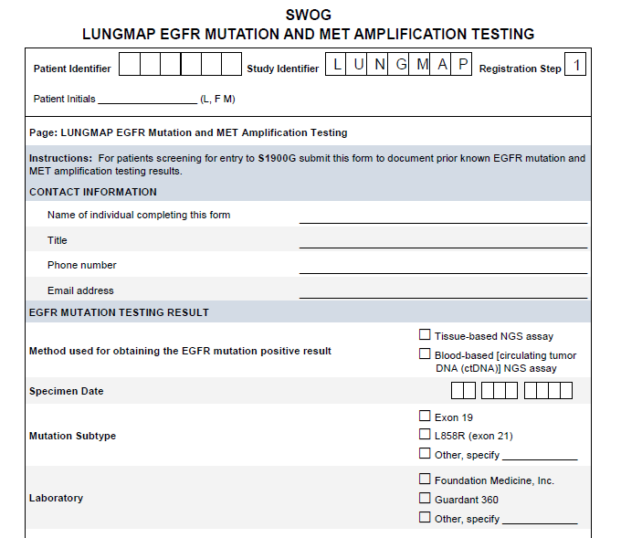
LUNGMAP Registration (Screening Step): Identification of MET amplification cont.
Participant with EGFR-mutant NSCLC progressing on osimertinib (alone or in combination with another therapy) and MET amplification was detected at the time of progression using other tissue OR blood-based assay results
Acceptable assays:
  Tissue-based: Any assay performed in a laboratory with CLIA, ISO/IEC, CAP or similar certification
  Note: If results are from commercial FoundationOne CDx (tissue) assay, refer to #2 on the previous slide.
  Blood-based: Foundation Medicine or Guardant 360 cfDNA assays only
Indicate this during LUNGMAP registration and then submit results in LUNGMAP Rave EDC on the EGFR Mutation and MET Amplification Testing Form (new with activation of S1900G)
Submit tissue if available (not required)
Email LungMAPquestion@crab.org or call 206-652-2267 with questions

Slide 38
Tissue Submission for LUNGMAP – if using known test results
Participants must submit tumor tissue if available when screening on the LUNGMAP protocol with known test results.
The tissue must be from a biopsy performed at the time of disease progression on the most recent line of therapy.
An additional biopsy is not required to obtain this tissue if it is not already available.
Participants with prior commercial FoundationOne CDx tissue-based (not liquid) tumor test results [obtained after radiographic or clinical disease progression on osimertinib] do not need to submit tumor tissue

Slide 39
Registration for S1900G
The LUNGMAP screening protocol has a Protocol Specific Requirement (PSR) as noted in Section 13.2 of LUNGMAP.
The S1900G sub-study has additional optional training materials available through the Compliance, Learning, and SOP Solutions (CLASS) website. Online training is not required to register participants to S1900G.
A Delegation Task Log is required for this sub-study.

Slide 40
Data Submission
Data must be submitted according to the protocol requirements for ALL participants registered, whether or not assigned treatment is administered, including participants deemed to be ineligible. Participants for whom documentation is inadequate to determine eligibility will generally be deemed ineligible. See Protocol Section 14.0 for Data Submission Requirements, Procedures and Timepoints.

Slide 41
Specimen Submission on S1900G
ctDNA Assay – Peripheral Whole Blood (Required for Participants)
  Sites must contact Foundation Medicine, Inc. – Blood Samples, Lab #232, to order kits
    Kits include: two Roche Cell-Free DNA blood collection tubes, collection instructions, FedEx return bags, and pre-printed FedEx airway bills.
  Collection timepoints: Cycle 1 Day 1 (prior to treatment); Cycle 1 Day 15; Cycle 3 Day 1; First Progression
  The translational medicine proposal to use these specimens will be submitted as a revision to CTEP for approval, prior to the SWOG Statistical and Data Management Center review of assay results.
Buffy Coat and Plasma Banking (Required If Participant Consents)
  Participants must be offered the opportunity to participate in banking of specimens for future research.
  Collection timepoints: Pre-treatment, Cycles 2-4 (same day as other labs), first progression.
  Collect approximately 8-10 mL of blood in EDTA tubes.
  See Protocol Section 15.5 for additional specimen processing instructions.
  Frozen plasma and buffy coat specimens must be shipped to the SWOG Biospecimen Bank – Solid Tissue, Myeloma and Lymphoma Division, Lab #201.
  Specimen collection kits are not being provided for this submission; sites must use institutional supplies.

Slide 42
Quality Control – Routine Data Monitoring
S1900G includes routine SWOG Centralized Data Coordinator Monitoring and Safety-specific monitoring (standard for all SWOG trials, Lung-MAP and Lung-MAP substudies), including:
Data submission review for missing data, submission errors and protocol deviations.
Institutional Performance Review processes.
Source data (pathology, radiology and lab reports) review for confirmation of disease classification and response assessment.
Routine monitoring of SAE reporting.
S1900G substudy does NOT have potential to be utilized for FDA registration.
Herein, S1900G does NOT require:
Participating site maintenance of a Trial Master File,
Upload of documents into the Source Document Portal (SDP), or
Central Monitoring Review by the SDMC Monitors
Blinded independent central review of response and Progression-Free Survival (PFS) Endpoint.

Slide 43
Quality Control –
Additional On-Site Monitoring
Consistent with Lung-MAP Protocol Section 18.2 and all Lung-MAP substudies, S1900G includes On-Site Monitoring, as follows:
First on-site monitoring visit at each institution within 3 months of first patient registration to a LUNGMAP sub-study.
Subsequent on-site visits for all sites with patients registered to a sub-study twice per year. Additional visits may be scheduled in response to several factors such as high rate of accrual, previous monitoring visit results, centralized monitoring outcome, change in staff, etc.
  An exception to the onsite audit requirement may be allowed in the following circumstances:
    Sites that use a centralized pharmacy and data management team may be monitored at this central location.
      Sites that had an acceptable on-site pharmacy audit in the last year may be audited off site.
      Covid visitor restrictions

Slide 44
Funding
Capmatinib and ramucirumab will be provided; osimertinib is commercially available and should be purchased by a third party.
Available site payments are included in the table below. Payments to offset the cost of research-directed laboratory tests are pending. Complete and detailed funding information, including Study-Specific Notes, will be available in the approved funding memorandum posted via CTSU.org at time of activation.
Funding Source and Study Component |  | Collect Type | Enter Date in Open? | NCTN Funding per Patient Std/HP LAPS | NCORP Funding per Patient Std/HP
Federal | Base Intervention – Standard / High Performance LAPS & NCORP | Mandatory | No | $2,500/$4,100 | $2,500/$4,100
Federal | Biospecimen – Whole Blood Whole blood for ctDNA at multiple timepoints | Mandatory | Yes | $200 | $200
Federal | Biospecimen – Blood (Multiple) Buffy coat and plasma collections at multiple timepoints | Mandatory Request | Yes | $200 | $200
Total Potential Federal Funds |  |  |  | $2,900/$4,500 | $2,900/$4,500
Non-Federal | Additional capitation resources from industry partners | Mandatory | No | $2,610/$1,010 | $2,610/$1,010
Total Potential Non-Federal Funds |  |  |  | $2,610/$1,010 | $2,610/$1,010
Total Potential Funds |  |  |  | $5,510/$5,510 | $5,510/$5,510
Additional Support for Site Auditing
Non-Federal | Additional capitation resources from industry partners for additional site auditing /monitoring. | Mandatory Event | No | $1,333 (per audit) | $1,333 (per audit)
All sites will be audited a minimum of twice per year as recommended by the FDA for this study. Sites will be reimbursed for any extra effort associated with increased auditing at $1,333 per additional audit above the FDA recommendation.

Slide 45
Resources and Materials
S1900G patient-friendly plain language trial summary and accompanying social media toolkit (tweets and graphics).
  The patient-friendly trial summary and social media toolkit will be available for participating site use on SWOG.org and via the S1900G protocol abstract page on CTSU.org.

Slide 46
S1900G Contacts
Study Chairs:
Dr. Sarah Goldberg (SWOG)
  Yale School of Medicine
Dr. Ross Camidge (SWOG)
  University of Colorado School of Medicine
Questions:
Medical Questions for Study Chairs:
S1900GMedicalQuery@swog.org
Eligibility/Specimen/Data Submissions: LUNGMAPquestion@crab.org
General Protocol/Regulatory: lgildner@swog.org

Slide 47
LUNGMAP
Revision #7
Jyoti Patel, MD
LUNGMAP Medical Oncology Chair/Champion
Alliance

Slide 48
S1900F
A Randomized Phase II Study of Carboplatin and Pemetrexed with or without Selpercatinib (LY3527723) in Participants with Non-Squamous RET Fusion-Positive Stage IV Non-Small Cell Lung Cancer and Progression of Disease on Prior RET Directed Therapy (Lung-MAP Sub-Study)
Jhanelle Gray, MD
Study Chair (SWOG)
Lung Committee Chair
Yasir Elamin, MD
Study Co-chair (SWOG)
David Gandara, MD
LUNGMAP Study Champion Lead
(SWOG)
Mary Redman, PhD
Lead Statistician
(SWOG)

Slide 49
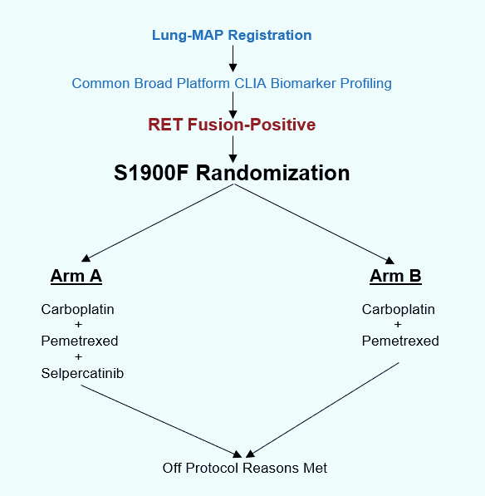
S1900F Schema

Slide 50
S1900F Contacts
Study Chairs:
Dr. Jhanelle E. Gray (SWOG)
  Moffit Cancer Center
Dr. Yasir Y. Elamin (SWOG)
  UT/MD Anderson Cancer Center
Questions:
Medical Questions for Study Chairs:
S1900FMedicalQuery@swog.org
Eligibility/Specimen/Data Submissions: LUNGMAPquestion@crab.org
General Protocol/Regulatory: jbeeler@swog.org

Slide 51
S1800D
A Phase II/III Study of N-803 (ALT-803) plus Pembrolizumab versus Standard of Care in Participants with Stage IV or Recurrent Non-Small Cell Lung Cancer Previously Treated with Anti-PD-1 or Anti-PD-L1 Therapy (Lung-MAP Non-Match Sub-Study)
John Wrangle, MD, MPH
Study Chair (SWOG)
Hatim Husain, MD
Study Co-chair (SWOG)
Jhanelle E. Gray, MD
Lung Committee Chair
(SWOG)
Roy Herbst, MD, PhD
LUNGMAP Study Champion Lead
(SWOG)
Mary Redman, PhD
Lead Statistician
(SWOG)

Slide 52
S1800D Schema
Prior Anti-PD-(L)1 and
disease progression
PD on prior treatment
≤ 12 weeks
PD on prior treatment
> 12 weeks
Primary Resistance
Cohort
Acquired Resistance
Cohort
Stand-alone Phase II
Phase II/III
N = 130
N = 300
N-803+Pembrolizumab
Standard of Care
N-803+Pembrolizumab
Standard of Care
Primary Endpoint: Overall Survival
Primary Endpoint: Overall Survival
Standard of Care Options: Docetaxel + Ramucirumab, Docetaxel, Gemcitabine, Pemetrexed

Slide 53
Accrual Update October 16, 2022
43 Total
7 in the las 30 days
5 to Primary Resistance Cohort

Slide 54
S1800D Contacts
Study Chairs:
Dr. John Wrangle (SWOG)
  Medical University of South Carolina
Dr. Hatim Husain (SWOG)
  University of California San Diego
Questions:
Medical Questions for Study Chairs:
S1800DMedicalQuery@swog.org
Eligibility/Specimen/Data Submissions: LUNGMAPquestion@crab.org
General Protocol/Regulatory: lgildner@swog.org

Slide 55
S1900E
A Phase II Study Of Sotorasib (AMG 510) In Participants With Previously Treated Stage IV Or Recurrent KRAS G12C Mutated Non-squamous Non-small Cell Lung Cancer (ECOG-ACRIN Lung-MAP Sub-study)
Sukhmani K. Padda, MD
Study Chair (ECOG-ACRIN)
David Gerber, MD
Study Co-chair (ECOG-ACRIN)
Julie R. Brahmer, MD
Lung Committee Chair
(ECOG-ACRIN)
Joel Neal, MD, PhD
LUNGMAP Study Champion Lead
(ECOG-ACRIN)
Mary Redman, PhD
Lead Statistician
(SWOG)

Slide 56
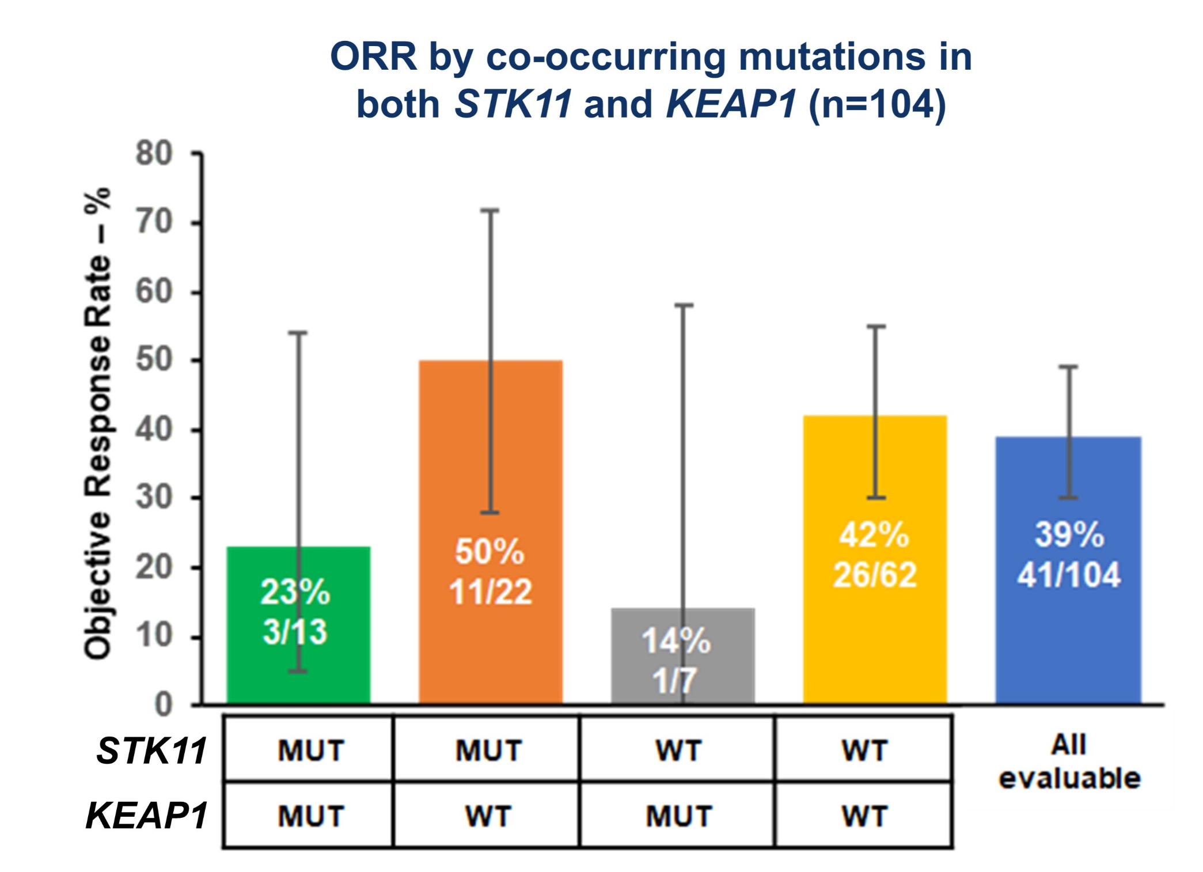
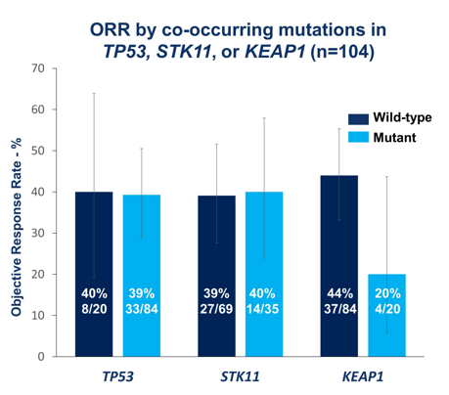

Sotorasib efficacy across KRAS G12C co-mutation subsets
FDA accelerated approval May 2021
CodeBreaK 100 (n=126): ORR 37.1%, DCR 80.6% mDOR 11.1 mo, mPFS 6.8 mo, mOS 12.5 mo
F Skoulidis et al. ASCO 2021. N Engl J Med 2021;384:2371-2381.
Notes:
124 pts at 960 mg po qd and median f/u 15.3 months
Median f/u 15.3 months. 81% prior platinum-based chemo & PD-1/PD-L1 inhibitors
Median best percentage decrease from baseline in tumor burden (defined as the sum of the longest diameters of all target lesions) was 60%
PD rate was 16.1% (20 pts)
Median TTR 1.4 mo (1.2-10.1)
71.7% (33 pts) had a response at first assessment at 6 weeks
57.3% responding at 9 months
PFS at 6 mo 52.2%, at 9 months 37.5%
PD-L1 expression doesn’t predict for response: ORR 48% (95% CI, 32 to 63) PD-L1–negative group (tumor proportion score, <1%) and ORR 42% (95% CI, 31 to 53) of the overall population of patients who could be evaluated (86 pts assessed)
TMB doesn’t predict for response: 42% (95% CI, 30 to 55) low tumor mutational burden (<10 mutations per megabase) and in 40% (95% CI, 16 to 68) high tumor mutational burden (≥10 mutations per megabase)
ORR 37.1% (95% CI 28.6-46.2); DCR 80.6% (95% CI 72.6-87.2); mDOR 11.1 mo (95% CI 6.9-NE); mPFS 6.8 mo (95% CI 5.1-8.2); mOS 12.5 mo (95% CI 10.0-NE); FDA approved May 2021

Slide 57
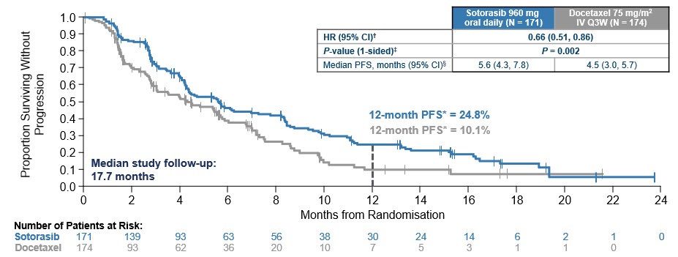
CodeBreaK 200 RP3 Study Sotorasib vs. Docetaxel
Previously Treated KRAS G12C NSCLC
PRIMARY ENDPOINT: PFS by BICR
ORR 28.1% vs. 13.2%
DCR 82.5% vs. 60.3%
mDOR 8.6 mo vs. 6.8 mo
No difference in OS sotorasib vs. docetaxel
HR 1.01 (95% CI 0.77-1.33); P=0.53
Median 10.6 mo vs. 11.3 mo
34% Crossover docetaxel to sotorasib
Johnson ML et al. ESMO 2022.
Notes:
Subsequent therapy similar 36% sotorasib vs. 42% docetaxel
Subsequent chemo 21% sotorasib, 12% docetaxel
Subsequent IO 9% sotorasib, 6% docetaxel.
Tumor shrinkage 80.4% pts with sotorasib (158 evaluable) with median of 58.8%, 62.8% pts with docetaxel (129 evaluable) with median of 48.7%
Median TTR was also faster with sotorasib 1.4 mo (1.2, 8.3) vs. 2.8 mo (1.3, 11.3) docetaxel
Sotorasib vs. Docetaxel
TEAEs Grade > 3 71.6% vs. 60.3%
TRAEs Grade > 3 33.1% vs. 40.4% ---------------→ sotorasib less TRAE grade >= 3 AEs
Serious AEs 10.7% vs. 22.%% -------------→ sotorasib less serious AEs
Dose interruption 35.5% vs. 15.2%
Dose reduction 15.4% vs. 26.5% ------------→ less dose reductions with sotoraisb
Dose d/c 9.5% vs. 11.3% ------------→ similar dose discontinuation rate.
Fatal TRAE 0.5% vs. 1.3%
Duration of Treatment 20 mo vs 12. mo
Summary: Even with longer duration of treatment, less TRAE grade >= 3 AEs and serious AEs along with less dose reductions; similar dose d/c rate

Slide 58
S1900E Schema
KRAS^{G12C}/TP53^{MUT}
Target N=40
AMG 510/Sotorasib
960 mg QD
S1900E Substudy
Recurrent or metastatic KRAS^{G12C} mutated non-squamous NSCLC
Received at least one prior systemic therapy
No uncontrolled brain metastasis
KRAS^{G12C}/STK11^{MUT}
Target N=25
AMG 510/Sotorasib
960 mg QD
End of Treatment
Enrollment
KRAS^{G12C}/Other ª
Target N=40
AMG 510/Sotorasib
960 mg QD
Primary Endpoint
Objective response rate
Secondary Endpoints
Duration of response
Progression free survival
Overall survival
Safety
Treatment Period
until disease progression, intolerance, or consent withdrawal
Clinic visits/labs every 3 weeks
Imaging every 6 weeks
If Progression
Liquid biopsy to determine resistance mechanism
ªother co-mutations (e.g., KEAP1, NFE2L2, CUL3), double or triple co-mutations (e.g., STK11/TP53, STK11/TP53/KEAP1), or no co-mutations

Slide 59
Status Update
72/116 participants enrolled (32 TP53, 16 STK11, 24 Others) since 04/02/2021 activation
  4 in last 30 days; 0 in last 7 days as of 10/04/2022
  TP53 & STK11- meeting accrual goals (15-25 pts/year & 6-11 pts/year)
  Others- meeting conservative accrual goals (14-24 pts/year)
Re-assessment…
  Re-examining further liberalization of protocol after Revision #3 Amendment (CIRB & NCI CTEP Approved)
  Social media tool kit & patient language friendly handouts
    Led by Amanda Stamplis and Frank DeSanto (SWOG Communications)
    Also partner with Upal Basu Roy PhD from LUNGevity and Kim Norris from Lung Cancer Foundation of America
  Seeking further input on pt concerns from Judy Johnson (Patient Advocate SWOG)
  Review by SWOG ops office and SWOG Site Coordinators Committee to address any logistical issues
Notes:
Accrual Timelines:
TP53: Accrual 15-25 pts/year – if hitting top of this accrual goal we would be at around 38 patients- almost there
STK11: 6-11 pts/year – if hitting top of this accrual around 16 pts – right there
All others: 14-24 pts/year - – if hitting top of this accrual around 36 pts – behind
Interim at 20 pt mark in cohort 1/3 and 15 in cohort 2 – removed
Amendment 3
Allows pts with untreated asymptomatic brain mets
Shorter washouts for prior anti-cancer systemic treatments & radiation
Shorter washout & clarification of DDI
Eligibility lab thresholds liberalized (e.g., ANC, Cr)
Removal of interim analysis
Prior to Revision 3, the average accrual rate was 4-5 patients/month. Since April, the average rate has been 2-3 patients/month.
Rationale
Doubles Amgen CodeBreaK100 sample size
Rigorous upfront co-mutation biomarker definitions - accounts for co-occurring mutations
Expected 95% CI narrower around point estimates of ORR
Enhanced diversity

Slide 60
S1900E Contacts
Study Chairs:
Dr. Sukhmani K. Padda (ECOG-ACRIN)
  Cedars-Sinai Medical Center
Dr. David E. Gerber (ECOG-ACRIN)
  UT Southwestern Medical Center
Questions:
Medical Questions for Study Chairs:
S1900EMedicalQuery@swog.org
Eligibility/Specimen/Data Submissions: LUNGMAPquestion@crab.org
General Protocol/Regulatory: jbeeler@swog.org

Slide 61
Lung-MAP Translational Medicine
David Kozono, Md, PhD
Translational Medicine & Scientific Leadership Committee Chair
Alliance

Slide 62
Teleconferences
Monthly, 3rd Tuesday at 11 am PT / 2 pm ET
  Recent topics: FoundationOne CDx Tissue Baitset Update (June), S1900F biomarker definitions update (March), prevalence of co-mutations (Jan)
  Sub-study discussions: S1900G study team (May), S1900C study team (April)
  Guests: Ionpath: proteomic assays/IO benefit (July), GenPro: immuno-methylome epimarkers (Feb), Nucleai: H&E slide image analysis (Jan)
Smaller meetings to discuss specific initiatives, projects, and publications

Slide 63
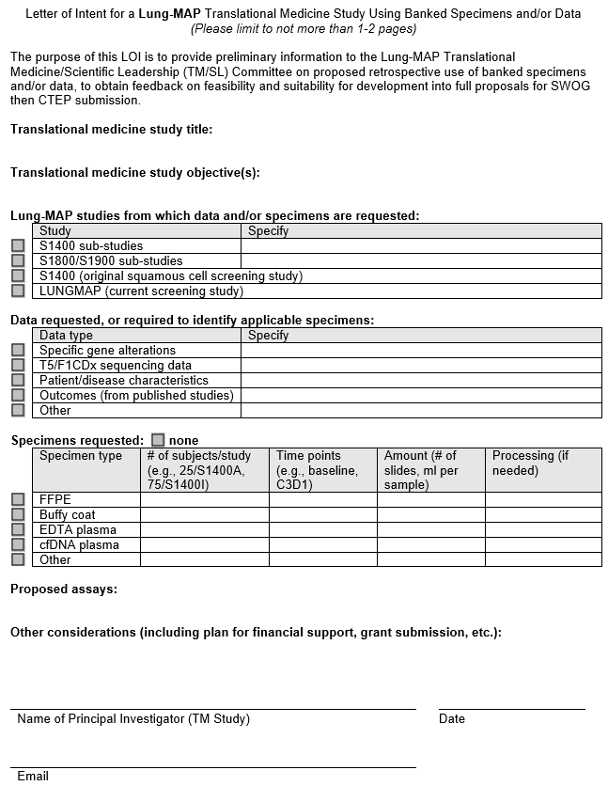
Letter of Intent
Goal: to promote TM research by simplifying initial inquiries
One to two pages
Preliminary information on proposed retrospective use of banked specimens and/or data
Send to TM committee chair for review and advice: lungmaptm@gmail.com

Slide 64
1. Pre-proposal discussion
1
Translational Medicine
Principal Investigator
3. Submit completed TM Proposal Form to
TM/SL Committee + Stats.
Present at TM/SL meeting.
Translational Medicine & Scientific Leadership Committee
5. Send updated proposal
cc
2. Provide TM Proposal Template Form
Statistician/
Stats PRC
SWOG Ops
Protocol Project Manager
approve
Review/Vote
approve
2
requires modification/
disapprove
Review
4. TM/SL voting outcome sent
&
Comments/Suggestions to PI from:
TM/SL scientific reviewers, statistician, Protocol PM
Review
forward
3
6. Approval
Final Vote
TM Approval Committee
4
Protocol Amendment
7. Protocol Amendment submitted to PIO
Contracts and funding are in place
TM analysis begins
SWOG Ops
Protocol Project Manager
CTEP & CIRB
Review
approval
Contracts & Budgets Team
Data transfer or
ship specimens to lab

Slide 65
TM proposals and funding
Priority for use of biospecimens: validation studies and hypothesis-based research vs. exploratory analyses
Secondary use of data (genomic, digital pathology, etc.) has a lower bar since resources are not being exhausted
Proposals with funding secured or available are favored
  Example funding opportunity: NIH/NCI FOA PAR-20-313 and 314

Slide 66
Proposed Projects
Tumor fraction and ctDNA in LM sub-studies (Gandara, Mack) –CTEP/CIRB approval needed for ctDNA analyses in sub-studies
ctDNA in S1900C (Nandos Skoulidis) – protocol amendment pending
H&E slide image analysis in LM IO Sub-Studies: Predicting IO therapy responses by analyzing spatial arrangement of immune cells using deep learning (Ori Zelichov @Nucleai) – TM proposal pending

Slide 67
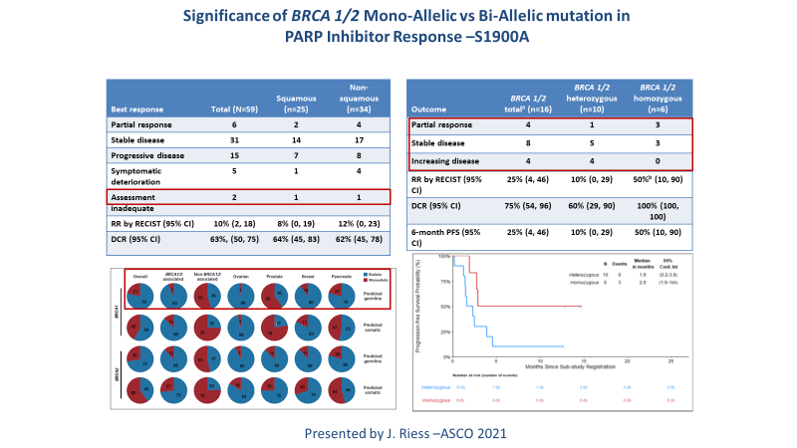
Approved: S1900A TM analyses (J. Riess)
CTEP approved amendment to analyze:
  Frequency of reversion mutations in BRCA1/2 and other homologous recombination deficiency (HRD) genes
  Concordance of BRCA1/2 and other HRD gene mutations in plasma and tissue
  Clinical outcomes of homozygous or heterozygous BRCA1/2 and other HRD gene mutations detected by ctDNA
  Association of reversion mutations with de novo or acquired resistance to rucaparib
  Changes in ctDNA variant allele frequency
  Association of clinical outcomes with the FM HRDv2 signature and gene mutations
Met on 7/26/22 to discuss analyses

Slide 68
Approved: KRAS in LUNGMAP
Evaluation of KRAS mutation sub-types and co-mutation detected by NGS in the LUNGMAP screening protocol (S. Padda)
Abstract submitted to ASCO, but only given online presentation and therefore withdrawn
Next step is to characterize rare KRAS and driver mutations, DNA repair and MAPK/PI3K/AKT alterations for additional analyses

Slide 69
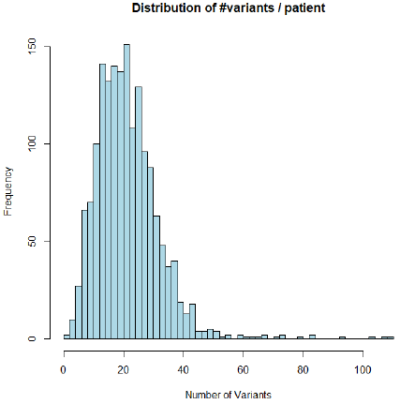
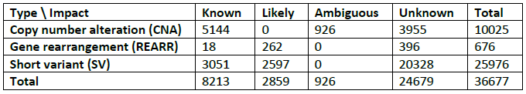
Lung-MAP TM resources
Sequencing data from S1400 (Jun 16, 2014 – Jan 28, 2019)
  Enrolled 1864 patients with stage IV or recurrent squamous cell lung cancer
  Next Generation Sequencing (NGS) data available for 1672 patients using the FoundationOne T5 research platform
  T5 = exons and/or introns of 313 cancer-related genes
  36,677 variants identified
  Largest NGS dataset of advanced squamous cell lung
  cancers of previously treated patients

Slide 70
Samples for liquid biopsy analyses
ctDNA in LUNGMAP
  277 registrations to submit ctDNA, 25 in most recent 12 months – being removed in next protocol revision
  166 with ctDNA and matched tissue results
Studies with plasma collection at multiple timepoints:
  S1900B (RET fusion, LOXO-292): baseline, progression, end of treatment
  S1900C (STK11m+, talazoparib + avelumab): baseline, C3D1, progression, end of treatment
  S1800A (non-match, pembro + ramucirumab): baseline, relapse/progression

Slide 71
Composite ICI Signature (D. Gandara)
Composite Immune Checkpoint Inhibitor (ICI) Signature for Efficacy of ICI Therapy in Advanced Squamous Cell Lung Cancer (SCC)
Accepted at WCLC 2022 for poster presentation
Resubmitted for SITC 2022 Nov 8-12

Slide 72
Upcoming priorities
Adding ctDNA analyses to Lung-MAP sub-study protocols
  S1900C, S1900E, S1800A: protocol-specific
  Generalized template for future sub-studies
Streamlining TM research in Lung-MAP
  While maintaining required regulatory oversight and high quality scientific, statistical and operations review

Slide 73
LungMap
Drug Selection Committee
Hossein Borghaei, MS, DO
Professor and Chief, Thoracic Oncology
The Gloria and Edmund M. Dunn Chair in Thoracic Oncology
Fox Chase Cancer Center
Saiama Waqar, MBBS, MSCI
Associate Professor of Medicine
Director, Hematology and Oncology Fellowship Program
Washington University School of Medicine

Slide 74

Disclosures for Dr. Borghaei
Research Support (Clinical Trials):
  Millennium, Merck/Celgene, BMS/Lilly
Advisory Board/Consultant:
  BMS, Lilly, Genentech, Celgene, Pfizer, Merck, EMD-Serono, Boehringer Ingelheim, Astra Zeneca, Novartis, Genmab, Regeneron, BioNTech, Cantargia AB, Amgen, Abbvie, Axiom, PharmaMar, Takeda, Huya Bio, GLG, Daiichi, Guardant, Natera, Oncocyte, Beigene
Scientific Advisory Board:
  Sonnetbio (Shares), Rgenix (Shares), Nucleai (Shares)
Data and Safety Monitoring Board:
  University of Pennsylvania, CAR T Program, Takeda, Incyte
Employment:
  Fox Chase Cancer Center

Slide 75
Disclosures for Dr. Waqar
  Research Grant support
  SWOG-Clinical Trials Partnership
  Research Support to institution for clinical trials (site PI): AbbVie Inc, Ariad Pharmaceuticals, Genentech, Immunomedics, Inc., Millennium Pharmaceuticals Inc, Roche, Astellas Pharma Inc, Daiichi Sankyo, Cullinan Pearl, Verastem Inc, GlaxoSmithKline/GSK , Janssen Research & Development, LLC ,Elevation Oncology, Genentech, Loxo Oncology, Takeda Pharmaceuticals
  Data and Safety Monitoring Board:
  Hoosier Cancer Research Network- Chair of Data Safety Monitoring Board for study

Slide 76
Drug Selection Committee
Sources
  Investigators/Drug Selection Committee Initiated
  Pharmaceutical company initiated
Initial Qualification
  Investigational drug/biomarker combination with preclinical & clinical data supporting safety & potential efficacy as a targeted therapy or “non-match” therapy in lung SCC.
  Ready or near ready to enter the Lung-MAP phase 2 clinical protocol
Candidates are evaluated by the Lung-MAP Drug Selection Committee (DSC), comprised of:
  Key investigators & clinical researchers
  Biomarker & molecular target experts from academia, NCI & FDA
  Non-conflicted industry-based drug developers
Candidates are scored based on:
  Target appropriateness for Lung-MAP
  Drug/Biomarker preclinical & clinical data
  PK/PD data

Slide 77
Process
Sub-study suggestions come from Lung-MAP PIs, outside investigators, or pharma
Initial discussions are internal with a PIs, followed by informal presentation from investigator/pharma to internal drug selection committee
Next step is decision to proceed to full Drug Selection Committee (DSC)
  Completion of Drug Selection application, summarizing preclinical and PK/PD data, prior human experience and safety profile, especially in lung cancer, and status of assay if proposed sub-study includes biomarker selection
  DSC presentation by investigator/pharma, Q&A, and committee closed session discussion
Formal voting by DSC members; 6 criteria for evaluation, each scored on 1-9 scale
  Target/target appropriateness to NSCLC; Drug/biomarker understanding; Preclinical data; PK/PD; Toxicity; Clinical data
PIs have final decision if vote is close or issues are brought up
Acceptance/deferral letters sent to pharma
Upon acceptance, kick-off call and regular teleconferences are set up with FNIH and SWOG Operations, for concept/protocol development, including regulatory aspects and FDA requirements, confirmation of drug supply, and contractual agreements

Slide 78
Studies Under Development
SCREENING PROTOCOL
BIOMARKER-DRIVEN SUB-STUDIES
(Targeted Therapies)
NON-MATCH SUB-STUDIES

Slide 79
Studies under development
Targeted therapies
S1900G (Novartis/Lilly): A Randomized Phase II Study of Osimertinib and Capmatinib with or without Ramucirumab in Patients with Met Amplified and EGFR Mutated Stage IV Non-Small Cell Lung Cancer after Progression of Disease on Prior Osimertinib-Containing Therapy.
  Study chairs Sarah Goldberg, Ross Camidge. The protocol documents were resubmitted to CTEP on 9/13/22 to address their Consensus Review Comments. Contracts and budget are underway. Activation targeted for Q1/2023.
S1900I: EGFR TKI ± anti-VEGFR in EGFR Exon 20 Insertion Mutations. Study chair Deborah Doroshow, co-chair Sandip Patel.
  The revised concept and responses to the CTEP Consensus Review comments were submitted to CTEP on 9/9/22. Protocol is underway, RaPID call is scheduled for 10/12/22. Contract and budget are underway. Activation targeted for Q2-3 2023
S1900J: Phase II of EGFR-MET bispecific antibody in Participants with Stage IV or Recurrent Non-Small Cell Lung Cancer Previously Treated with High MET Amplification. Study chair Christian Rolfo, co-chair Shirish Gadgeel.
  The DSC approved the proposal on 8/30/22 and the company accepted. Study team is working on the concept and the kick-off call is being scheduled. Activation targeted for Q1 2024.
S1900K: A Randomized Phase II Study of MET TKI with or without anti-VEGFR2 in Participants with Met Exon 14 Skipping Positive Stage IV or Recurrent NSCLC. Study chairs Paul Paik, Xiuning Le.
  Revised study concept was sent to the company for their review and approval on 9/14/22. Contract is underway. Activation is TBD.

Slide 80
Studies under development
Non-Matched Arm
S1800E: A Randomized Phase II/III Study of anti-PDL1 Plus Docetaxel and anti-VEGFR2 versus Standard of Care Docetaxel and Ramucirumab for Participants Previously Treated with Immunotherapy for Stage IV or Recurrent Non-Small Cell Lung Cancer (Lung-MAP Non-Match Sub-Study). Study chair Karen Reckamp, co-chairs Konstantin Dragnev and Saiama Waqar.
  DSC approved 4/1/22. Activation initially targeted for Q2-3 2023.
  Pre-look concept submitted to CTEP on 7/22/22, communication from CTEP 9/8/22 that studies in same space as PRAGMATICA are on hold due to accrual concerns. Lung-MAP team to discuss with CTEP
S1800F: anti-TIGIT + anti-PD1 + VEGFR-TKI for Patients Previously Treated with Immunotherapy. Study chair Erminia Massarelli, co-chair Tina Li.
  DSC approved 4/26/22. Activation initially targeted for Q3 2023
  Pre-look concept submitted to CTEP on 8/18/22, communication from CTEP 9/8/22 that studies in same space as PRAGMATICA are on hold due to accrual concerns. Lung-MAP team to discuss with CTEP

Slide 81
Summary
Significant potential for benefiting patients
A unique opportunity to explore drugs or combinations in patients with metastatic non-small cell lung cancer
Ability to explore efficacy in rare patient populations
Great support from NCI, FDA and industry
Significant opportunity to collect biosample for correlative studies
Opportunity for participation of all thoracic oncologists, translational scientists and other interested parties around the country

Slide 82
Closing Announcements & General Q & A Session
Virtual attendees -
Place your questions in the chat box and a team member will read it out loud for the study team to answer
Hossein Borghaei, MS, DO, LunGMAP Chair
All Attendees

Slide 83

Contact Us
Site Coordinators Committee
  LUNGMAPSCC@crab.org
Protocol & Regulatory Questions
lgildner@swog.org or
  jbeeler@swog.org
  Eligibility & Data Submission Questions
  LUNGMAPQuestion@crab.org
  Funding Questions
  Funding@swog.org
  General Medical Questions
  LUNGMAP@swog.org
  S1900E Medical Questions
  S1900EMedicalQuery@swog.org
  S1800D Medical Questions
  S1800DMedicalQuery@swog.org
  S1900F Medical Questions
  S1900FMedicalQuery@swog.org
Accrual Enhancement Committee
lungmapAEC@swog.org

Slide 84
Acknowledgements
Thank you for supporting the Lung-MAP Trial!
Patients and Sites
Lung-MAP Site Coordinators Committee
Patient Advocate
Diversity, Equity, and Inclusion Champion
Accrual Enhancement Committee
Trial Oversight Committee
Study Chairs
Statistical Team
Pharmaceutical Collaborators
Data Coordinators & Protocol Project Managers
Applications Development Team
Quality Assurance Team
Funding & Contracts Team
NCI, CTEP, CIRB, CTSU
Foundation for the National Institutes of Health
Friends of Cancer Research
CCS Associates Inc.

Slide 85

Summary & Adjourn
Thank you joining us!
The slides will be available on the SWOG & CTSU websites

