Slide 1
SWOG
Genitourinary Cancer Committee
Local Bladder - Active
S1314, A Randomized Phase II Study of Co-Expression Extrapolation (COXEN) with Neoadjuvant Chemotherapy for Localized, Muscle-Invasive Bladder Cancer
Information for participating Sites

Slide 2
Under Revision #1
Released June 15, 2015

Slide 3
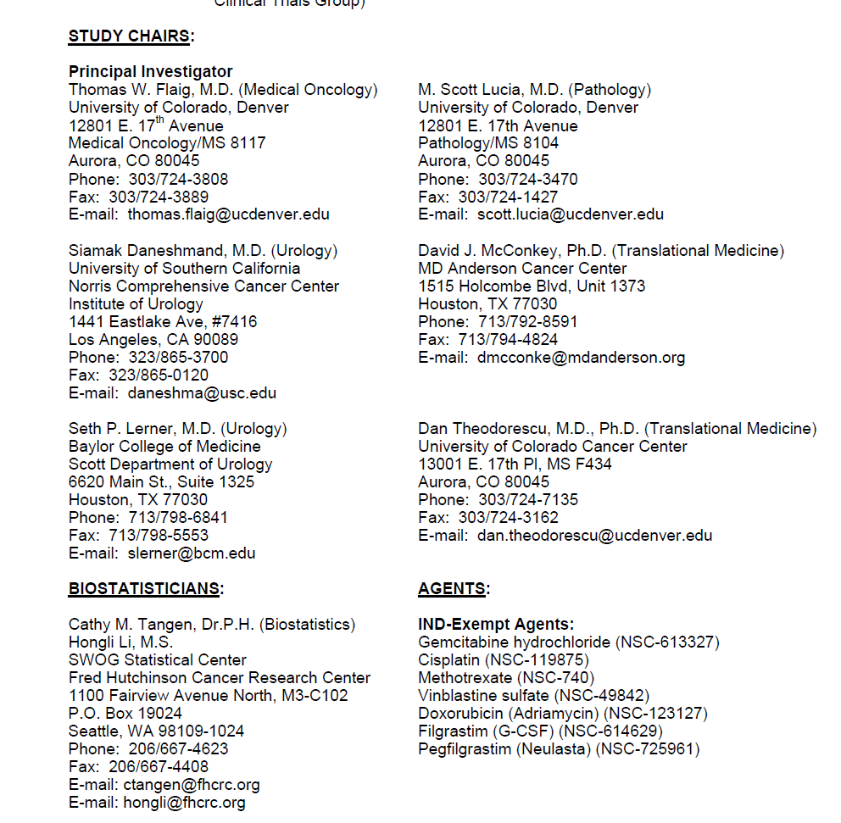

Slide 4
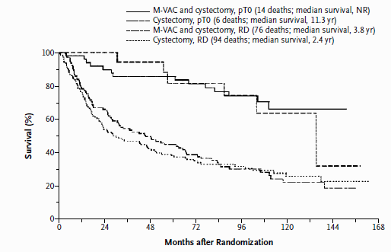
Neoadjuvant chemotherapy in bladder cancer
  SWOG 8710:
  Rate of pT0 was 38% with chemo and 15% without
  8 year survival with pT0 ~75% vs. ~30% if > pT0
Despite this, current use of neoadjuvant chemotherapy in bladder cancer is low
One concern is losing the therapeutic window of curability by giving chemotherapy in insensitive patient, needlessly delaying surgery
Personalized determination of patient’s likelihood of responding to specific chemotherapy regimens has the potential to improve the use of this therapy

Slide 5
Rationale
COXEN is a Gene Expression Model (GEM) approach to predict individual patient’s likelihood of responding to a specific chemotherapy regimen
It has been applied to bladder, breast, ovarian, lung, etc. cancers successfully.
  Largely been tested on prospectively gathered data, but COXEN analysis was retrospective
Feasibility of using COXEN on TURBT samples in Cooperative group setting has not been tested prospectively
S1314 will prospectively examine the application of COXEN in a non-directive manner

Slide 6
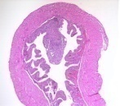
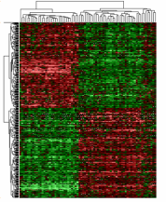
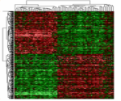
COXEN prediction of treatment outcome in patients treated with GC or MVAC
MVAC (N=16)
MSKCC & UVA
p = 0.039
Proportion Surviving
COXEN
Gene Expression Model
Evaluation of Model on Human Tumors
GC (N=14)
Als (Denmark)
NCI-60 Panel
Cisplatin
Gemcitabine
Methotrexate
Doxorubicin
Vinblastine
Proportion Surviving
Ref: Clin Can Res 2007;4407 13(15):4407
Tx: MVAC (N=16) or GC (N=14)
Pts: Advanced patients, no other therapy
Outcome: Overall survival
p = 0.030

Slide 7
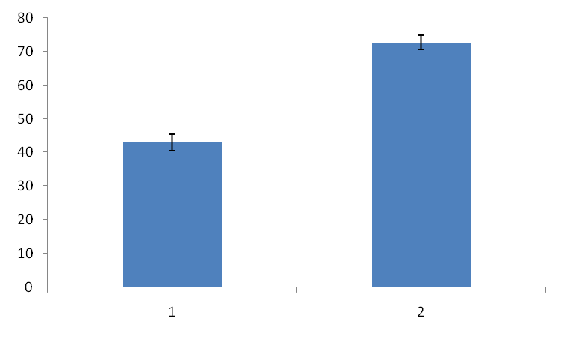
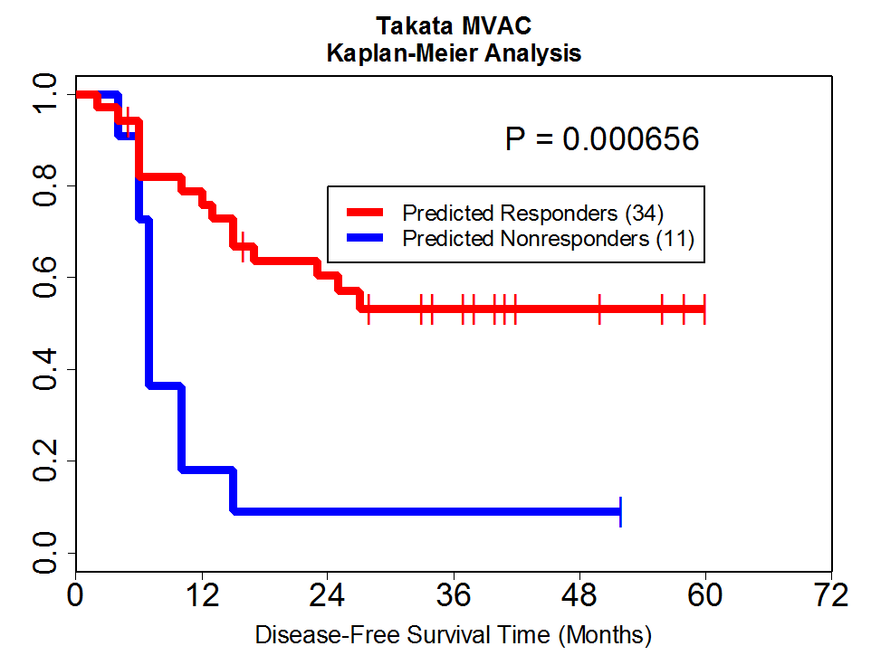
COXEN prediction of treatment outcome in patients treated with neoadjuvant MVAC
Downstaging vs. COXEN Score
MSKCC & UVA
NCI-60 Panel
COXEN Score
Methotrexate
Vinblastine
Doxorubicin
Cisplatin
COXEN
NO Downstage
Downstaged
Downstaging defined as ≤pT1 or ≤T1 after two courses of MVAC
Gene Expression Model
Evaluation of Model on Human Tumors
Takata (Japan)
Proportion Surviving
Ref: Clin Can Res 2005;11(7): 2625
Tx: Neoadjuvant MVAC (N=45) + surgery or XRT
Outcome: Downstaging, Overall survival

Slide 8
COXEN Objectives
To characterize the relationship of DDMVAC- and Gemcitabine-Cisplatin (GC)-specific COXEN scores by pT0 rate at cystectomy in patients treated with neoadjuvant chemotherapy
  Assessing whether the treatment-specific COXEN score is prognostic of pT0 rate
In a preliminary fashion whether the COXEN score is a predictive factor distinguishing between these two chemotherapy regimens
  To assess, in a hypothesis generating fashion, the ability of COXEN to select for an individual chemotherapy regimen
  To assess the overall efficacy and toxicity of these two regimens in this setting

Slide 9
Eligibility S1314 - Highlights
Histologic urothelial carcinoma of the bladder (mixed histology is acceptable if component of urothelial carcinoma is present)
cT2-T4a/N0/M0
High risk factors (need at least one):
  At least a 5 mm mass on imaging
  Presence of tumor-related hydronephrosis
TURBT and cystoscopy must be within 56 days of registration
Must be eligible for cisplatin-based chemotherapy
  no sig heart disease since need to give doxorubicin
  Adequate organ function (defined)
  GFR ≥ 60 mL/min

Slide 10
Eligibility S1314 - Highlights
TURBT/Registration
  Tissue (now slides, not block)
  Urine 50 ml
  Whole blood X 2
Cystectomy
  Additional tissue samples if residual tumor

Slide 11
S1314
* Mandatory submission of viable cancer tissue and other specimens for gene expression profiling and COXEN score analysis
** Collect and submit residual tumor (if applicable). Enrollment in S1011 should also be considered

Slide 12
Treatment
184 patients will be randomized to
  Gemcitabine-Cisplatin (GC) (21 day cycle) X 4
  Dose Dense MVAC (14 day cycle) X 4
All patients in the DD-MVAC arm are required to receive filgrastim or pegfilgrastim
  Patients in the GC are given filgrastim or pegfilgrastim at the provider discretion
Patients will be stratified by Clinical Stage (T2 versus T3 or T4a) and Performance Status of 0 versus 1.

Slide 13
Arm 1 - GC

Slide 14
Arm 2 – DD-MVAC

Slide 15
Criteria for removal
Criteria for Removal from Protocol Treatment
  Completion of cystectomy
  Unacceptable toxicity.
  Inability to complete protocol chemotherapy due to the following reasons:
    A continuous treatment delay for any reason > 3 weeks at any time after starting chemotherapy, a cumulative delay in chemotherapy of 4 weeks total, or if CrCl is < 50mL/min for one week despite best supportive care and holding the chemotherapy.
    More than one dose level reduction for cisplatin or more than two dose level reductions for any of the other chemotherapy agents.
    Less than 3 cycles of cisplatin-containing chemotherapy due to toxicity or maximum dose reduction reached.
  The patient may withdraw from the study at any time for any reason.
  Patient is no longer a candidate for cystectomy in the opinion of the physician.

Slide 16
Statistical considerations
From the S8710 neoadjuvant study, pT0 rate was 31% in those receiving surgery
  Data from the 184 (92/arm) patients will be used to evaluate the association of each GEM with pT0
When applying COXEN to DDMVAC-treated patients in the bladder cancer setting, the COXEN GEM has previously yielded a sensitivity and specificity of 83% and 64%, respectively
Secondary survival analysis: We assume median survival (both arms) for those with an unfavorable score will be 40 months
  We expect half the patients will have a favorable GEM score.
  With an additional 3 years of follow-up beyond accrual, and a two-sided alpha=0.05 then we will have 83% power to detect a hazard ratio of 1.90 between those with an unfavorable GEM score relative to the favorable group.

