Slide 1





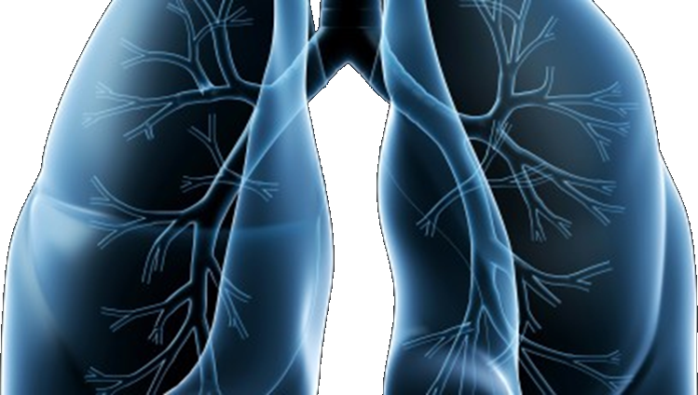

LUNG-MAP
S1400 Lung Master Protocol
SWOG Fall meeting
OCTOBER 9, 2015

Slide 2

Welcome
Alliance
ECOG-ACRIN
NRG
NCIC-CTG
SWOG
S1400 Master Protocol
David R. Gandara, MD
swog lung cancer committee chair

Slide 3
Study Updates
Vassiliki Papadimitrakopoulou, MD
Study Chair, Medical Oncology

Slide 4
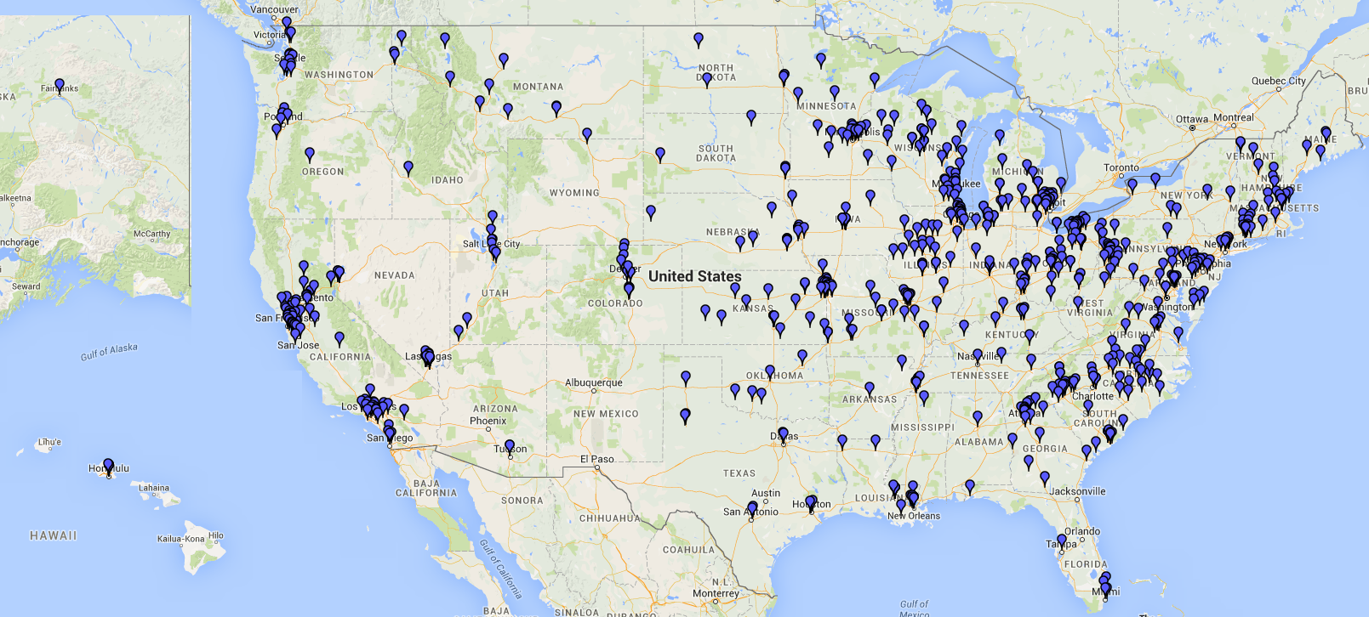
Where are we now?
IRB Approvals:
  816 sites
  190 sites with at least 1 patient accrued
Accruals:
  419 patients registered to S1400
    216 patients from SWOG sites
  321 patients notified of their sub-study assignment
  166 patients registered to a sub-study
S1400A: 99
S1400B: 15
S1400C: 27
S1400D: 16
S1400E: 9 SWOG STATISTICAL CENTER and CTSU AS OF OCTOBER 2, 2015
Notes:
Update

Slide 5
Eligibility/Population Updates
Original (June 2014)/Revision #1 (January 2015):
  2nd line therapy only
  Performance status 0-2
  No pre-screening
  Restricted time to enroll from sub-study assignment
Revision #2 (April 2015):
  2nd and greater lines of therapy
  Removal of time constraint for sub-study registration
  Pre-screening during 1st line treatment
  S1400A single arm study (checkpt naïve only)

Slide 6
Study Design Updates
Revision #3 (Expected November 2015):
  Design Modifications to S1400B, S1400C, S1400D to single arm (targeted therapy only)
    Patients on docetaxel will have the opportunity to re-register to the targeted therapy arm upon progression
  NEW Sub-Study, S1400I: Immunotherapy Non-Match Study
    Combination of nivolumab (anti-PD1) + ipilimumab vs. nivolumab for nivolumab-naïve patients
  Restrict to Performance Status 0-1 (from 0-2)
  Pre-screening during any line of treatment
  Prior docetaxel exclusion removed

Slide 7
Overview of Upcoming Changes
Coming in Early 2016
Two NEW Sub-Studies:
  S1400G: a biomarker-driven study including a PARP inhibitor
  S1400F: a non-match study for patients who have failed prior nivolumab.
Lung-MAP to open in Canada
S1400I: Addition of Patient Reported Outcomes

Slide 8
Upcoming Lung-MAP Trial Schema
Biomarker Driven
Sub-Studies
Non-match
Sub-Study
S1400B
PI3K
S1400C
CDK4/6
S1400D
FGFR
S1400G
HRRD
S1400I
Checkpoint
Naive
S1400F
Checkpoint
Refractory
Single Arm
Phase II
GDC-0032
Palbociclib
AZD4547
BMN 673
Randomized
Phase III
Nivolumab/Ipilimumab
vs. Nivolumab
MEDI4736/ Tremelimumab
GDC-0032
vs. TBD
Palbociclib
vs. TBD
AZD4547
vs. TBD
BMN 673
vs. TBD
NOTE: S1400A (MEDI4736) Non-match sub-study will close and S1400I (Nivolumab vs. Nivolumab/Ipilimumab) will open November 2015

Slide 9
Study Logistics
Mary Redman, PhD
SWOG Lead Biostatistician

Slide 10
S1400 Registration and Sub-study Assignment
Evaluate eligibility, consent patient and confirm evaluable tissue
Register to S1400 in OPEN
Submit tissue to FMI within 1 day
after registration
Pre-Screened prior to progression on current treatment
Screened at progression
Patient will not be registered to a sub-study for any reason
Progression
Within 16 days after S1400 registration
Submit S1400 Notice of Progression within 1 day.
Submit Notice of Intention Not to Register
Form in Rave
Sub-study assignment
Follow-up for 3 years
Sub-study assignment

Slide 11
Post Sub-study Assignment
Sub-study common and specific eligibility criteria
If patient IS eligible for and consents to assigned
sub-study
If patient is assigned to sub-study and meets sub-study common eligibility criteria but does NOT meet study-specific eligibility criteria
If patient is not going to register to a sub-study for any reason
Register to S1400X sub-study in OPEN after receiving sub-study assignment email
Submit Notice of Intention not to Register Form in Rave®
Protocol treatment within 7 working days of sub-study registration
Submit Request for Sub-study Reassignment Form in Rave®
Follow-up, obtain and submit specimens and forms per
sub-study protocol
Follow-up for 3 years
Notes:
Separate out into 3 slides

Slide 12
Images Submissions – TRIAD Up and Running
Submit CT/PET images electronically using TRIAD, or Transfer of Images and Data, a cloud-based image and data transfer platform created by the American College of Radiology.
To submit images:
  Obtain a “TRIAD User” role in the CTSU Roster, which is assigned by your site administrator.
  Install the TRIAD application using the link in protocol Section 15. Log in with your CTEP-IAM username and password.
  Upload images. Contact the TRIAD help desk at 703-390-9858 for assistance if needed.
NOTE: A TRIAD fact sheet is available on the S1400 protocol page at SWOG.org and CTSU.org

Slide 13
Data Submissions
Laboratory Values eCRFs should always report end-of-cycle labs.
  End-of-cycle labs are requested due to possible association with toxicities reported at the end of a cycle. Note that labs done on Day 1 of the next cycle (prior to treatment) are considered end-of-cycle labs for the previous cycle.
AEs should be reported on every cycle in which they are seen.
  To report ongoing events provide the AE start date and mark the AE as “ongoing” on each eCRF until the event is resolved. Ongoing events may span multiple cycles. On the last cycle that the AE is seen, provide the AE end date.
Thoroughly redact patient identifiers from source documents before uploading to Rave.
  Black marker may not fully hide patient’s name. Suggested redaction methods are use of tape, Wite-Out, opaque pencils or crayons, or electronic redaction tools.

Slide 14
Tissue Requirements
Fred Hirsch, MD, PhD
Study Chair, Translational Medicine

Slide 15
Tissue Requirements:
Tissue block (preferred) or at least 12 (4-5-microns) unstained slides (20 slides are strongly recommended).
  Tissue must contain at least 20% viable tumor cells and > 0.2 mm3 tumor volume
  Hematoxilyn-eosin (H&E)-stained slide or Aperio H&E-stained slide. If H&E slide is not available, submit an extra unstained slide. An H&E slide is not required with tissue block submission
  Bone biopsies are not allowed
Local pathology report from initial diagnosis and S1400 Local Pathology Review Form:
  Tumor material must be reviewed by a local pathologist. The local pathologist must review and sign off on the S1400 Local Pathology Review form prior to enrolling patient noting that the tumor meets the requirements noted above.

Slide 16
Quality Assurance and Monitoring
Elaine Armstrong, ms
SWOG Quality Assurance Manager

Slide 17
QA/Monitoring Common Problems
Regulatory: For sites using the CIRB:
  Consent forms deviate from the approved boilerplate language
  Unable to determine when consent versions were implemented
Patient Case Review: Eligibility
  S1400: Failure to confirm ≥ 20% tumor cells by local pathologist
  S1400A & C: No CT scan within 28 days
  S1400C: No triplicate EKGs, taking medication that prolongs QTc interval

Slide 18
QA/Monitoring Common Problems
Patient Case Review: Treatment
  Failure to dose reduce per protocol
  Failure to document compliance to oral drugs
Patient Case Review: Adverse Events
  Failure to report adverse events
Patient Case Review: Data Quality
  Delinquent data
  Failure to collect and submit specimens

Slide 19
Funding Highlights
Casey Dawson
SWOG CTI Project Manager

Slide 20
Funding Highlights
Sites will receive up to $5,869 ($1,079 screening/ $4,790 registration) for each patient on trial
If biopsies are needed, sites will receive $3,000/$6,000 for the biopsies performed at screening and/or progression after initial response on Arm 1
Sites will be reimbursed for additional research based procedures
Sites will be reimbursed $1,333 for on site visits outside the regular audit schedule
PAXgene Tubes for S1400A – Available soon through Nationwide
Notes:
Not sure if everything will be finalized for the PAXgene tube by GM….

Slide 21
Site Perspectives
Roy Herbst, MD, PhD
Study Chair, Medical Oncology
Naomi Hullinger, RN
Supervisor, Oncology Research Group
San Antonio Medical Military Center
Paul Hesketh, M.D.
Chair, Lahey Health Cancer Institute
Director, Sophia Gordon Cancer Center & Thoracic Oncology
Lahey Hospital & Medical Center

Slide 22
SWOG S1400
PHASE II/III BIOMARKER-DRIVEN MASTER PROTOCOL FOR PREVIOUSLY
TREATED SQUAMOUS CELL LUNG CANCER (LUNG-MAP)
One Site’s Perspective
Naomi Hullinger, RN
San Antonio Medical Military Center

Slide 23
OVERALL GOAL
Patients are enrolled onto a sub-study within 28 days from notification of disease progression
Achievable by:
  Identifying institutional barriers and logistics of enrolling a patient
  Pathology Support
  CT and Brain Scans

Slide 24
Identifying institutional barriers and logistics of enrolling a patient
Potential barriers may include decreased tissue collection initially (very common at training hospitals)
Patients who need a re-biopsy are less likely to go onto sub-study treatment because of the delay (they want to start treatment soon), potential changes in PS, and willingness to be re-biopsied.
You may need to have a discussion with your Pathology, Pulmonary and Interventional Radiology team to discuss way in which more tissue is placed in blocks initially to avoid re-biopsy.
b) Sub-Study exams (ie ophthalmology, ECHO/MUGA, CT Brain/CAP):
Know how fast specialty clinics are booked out.
This is KEY to get patients on a sub-study. DO NOT wait to make appointments for a particular sub-study until you receive the sub-study assignment. You are too late! You must be pro-active and schedule patient's for sub-study exams around week 3 (if patient signs a screening consent & you are waiting the 16 days for sub-study assignment).
You can always cancel appointments, but it is hard to schedule them in a timely manner.

Slide 25
Pathology Support
It is very important to become "good friends" with your pathology department. A helpful tip: Engage someone in the pathology department to participate in your study as a sub-investgator. Because of this, they are actively involved in the study and are willing to meet anticipated deadlines, i.e. 24 hour deadline to submit tissue post registration.
Submit the Local Pathology Form when you request your tissue block or slides.
Highly recommend sending a tumor tissue block. I would discourage sending slides because this can lead to further delay in getting patients on a particular sub-study. If you anticipate this is essentially the last treatment your patient's are going to receive, and have no further use for the tissue block, then send it. Patients are anxious to start treatment, so any further delay causes a lot of distress for the patient as well as the provider. If you are actively engaged with your pathology department, they will find sending a block helpful because it saves them time.

Slide 26
CT and Brain Scans
Suggestion: More often than not, the treating physician can tell when patients have progressed based on their PS and symptoms. If the physician suspects disease progression and they are scheduling the CT scan to verify, ask them if they could add the CT of the brain as well.
This will save the patient and facility time and is an eligibility requirement for sub-studies.

Slide 27
Specific Sub-Study Tips
Sub-Study A: Requires 2 CT Scans, one initially and a 2nd 28 days post if there was a 20% increase. Know this and be prepared so you can pre-plan
Sub-Study C: Important to review con meds at the time of progression or screening consent. Therefore the coordinator and MD can discuss when to stop CYP3A4 inhibitors/inducers. They must be stopped 7 days prior to registration.
Sub-Study D: Again review con-meds at the time of progression or screening consent. Because of all the required eligibility tests, it is important these appointments were scheduled prior to sub-study assignment. Ideally, you would want to get you patients in for their ECHO/MUGA, ECG's, and Ophthalmology exam on week 3.

Slide 28
SWOG S1400
PHASE II/III BIOMARKER-DRIVEN MASTER PROTOCOL FOR PREVIOUSLY
TREATED SQUAMOUS CELL LUNG CANCER (LUNG-MAP)
One Investigator’s Perspective
Paul J. Hesketh
Lahey Hospital & Medical Center

Slide 29
S1400 – Scientific Rationale
Molecular genotyping has transformed the management of advanced non squamous cell lung cancer by identifying critical genomic alterations that can be successfully treated with “targeted agents”
Conventional treatment options for stage 4 squamous cell lung cancer very limited
Recent insights into the molecular profiles of squamous cell NSCLC offer the hope that effective new treatments targeting specific “driver” genomic alterations can be identified
The relative infrequency of many of the potential molecular targets requires a new clinical trial paradigm – LUNG -MAP

Slide 30
S1400 – Rationale for the Patient
Stage 4 lung cancer of all histologic types remains an incurable disease with conventional treatment
The goals of therapy are relief of disease-related symptoms and hopefully prolongation of survival
For a significant minority of patients with non-squamous stage 4 NSCLC, especially those with targetable genomic alterations, survival has been extended from an average of less than one year to more than three years
A critical element to extended survival is the ability to identify the maximum number of effective treatment options
Lung- MAP offers the patient with stage 4 squamous NSCLC the potential for “more options”

Slide 31
S 1400 – LHMC Experience
S1400A (unmatched) 3
  Arm 1- MEDI4736
    36 yo M began treatment 11/07/2014 ; still on protocol RX, disease regression (SD) no major AE’s
  Arm 2 - Docetaxel
    57 yo M began treatment 12/19/2014, PD post 3 cycles docetaxel
  No therapy
    61 yo M no relevant genomic alterations; ineligible for sub-study entry due to positive Hep B and C status
S1400C (cyclin D1 amplification) 1
  Arm 2 – Docetaxel
    66 yo M began treatment 08/20/2015; still on protocol, disease regression post 2 cycles (SD)

Slide 32
S 1400 – Practical Suggestions
Expediting retrieval of required pathology specimens

Slide 33
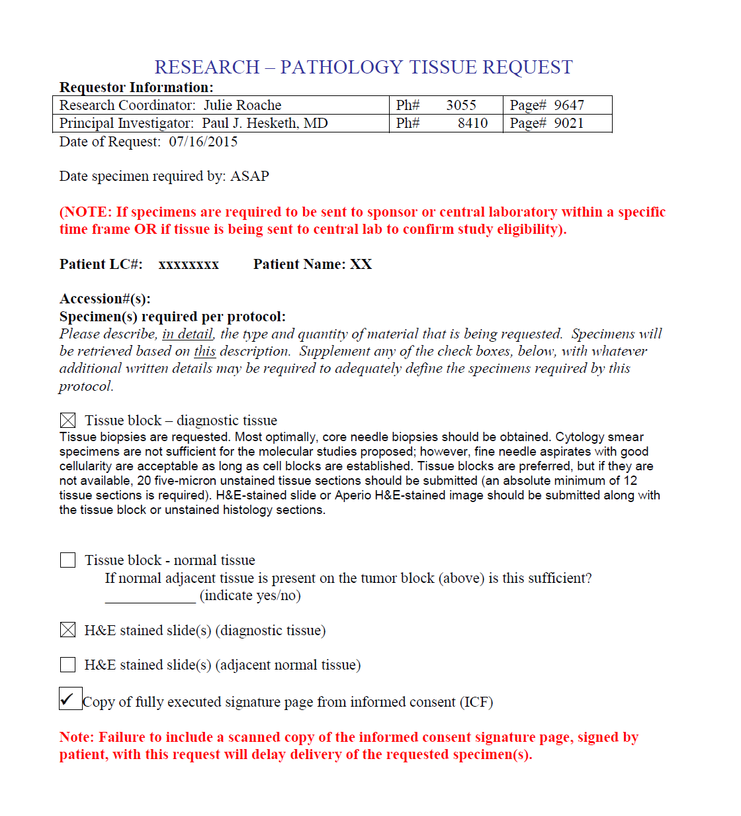

Slide 34
S 1400 – Practical Suggestions
Expediting retrieval of required pathology specimens
Facilitating identification of prohibited medications
  http://crediblemeds.org/

Slide 35
Facilitating identification of prohibited medications (S1400C)
Section 5.2 of the protocol Eligibility
Patients must not be taking within 7 days prior to sub-study registration, nor plan to take while on protocol treatment and for 14 days after the last dose of study treatment, strong CYP3A4 inhibitors and/or strong CYP3A4 inducers. Moderate inhibitors or inducers of isoenzyme CYP3A4 should be avoided, but if necessary can be used with caution (see Section 7.2a).
Patients must not be taking within 7 days prior to sub-study registration, nor plan to take while on protocol treatment, drugs that are known to prolong the QT interval.

Slide 36
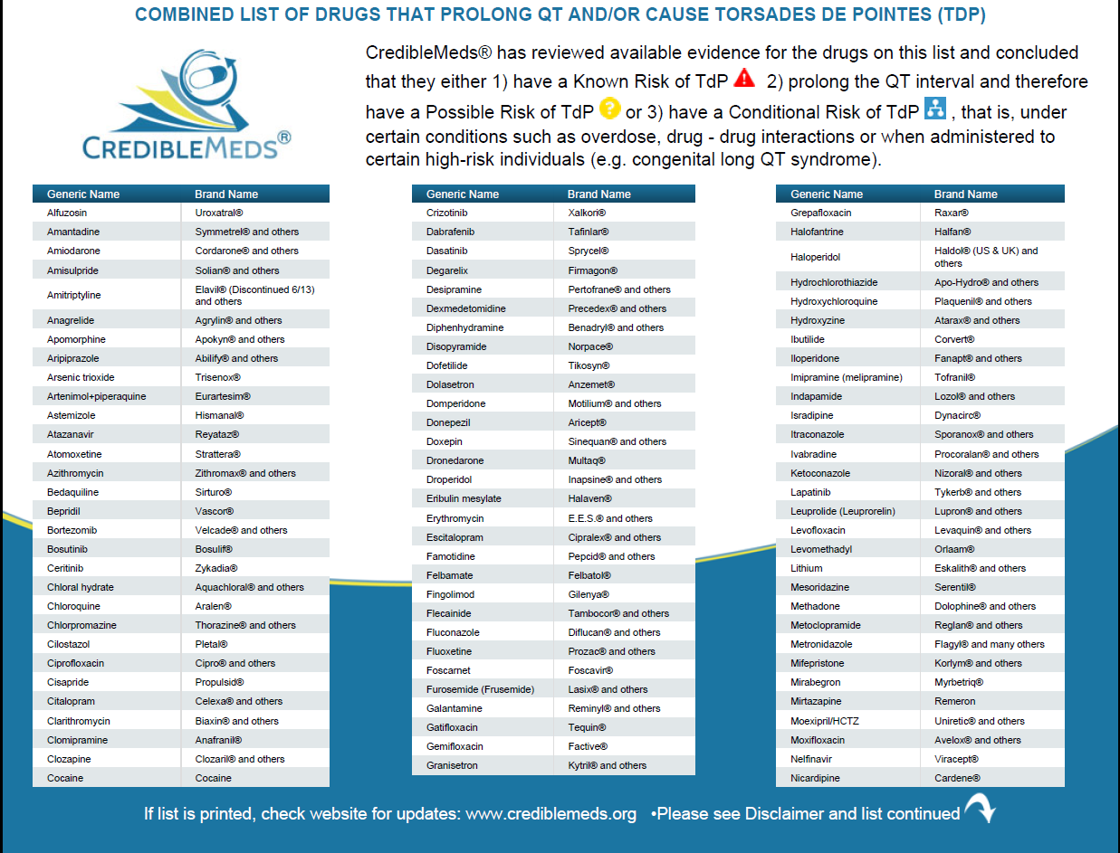

Slide 37
S 1400 – Practical Suggestions
Expediting retrieval of required pathology specimens
Facilitating identification of prohibited medications
  http://crediblemeds.org/
Utilize the CIRB

Slide 38
S 1400 – Practical Suggestions
Expediting retrieval of required pathology specimens
Facilitating identification of prohibited medications
  http://crediblemeds.org/
Utilize the CIRB
Expediting answers to protocol queries
  S1400question@crab.org
  OR
  lungquestion@crab.org

Slide 39
Questions?
Thank you for your time.
The information presented today will be available on the SWOG website under the S1400 Group Meeting Materials.
Notes:
Update

