Slide 1





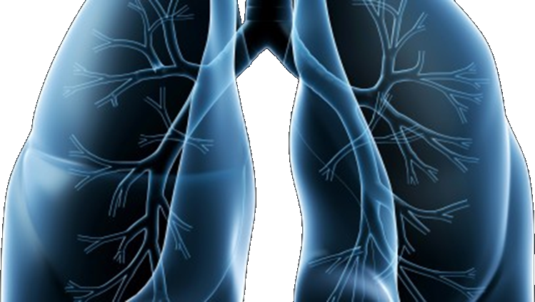

LUNG-MAP
S1400 Lung Master Protocol
SWOG Spring meeting
April 28, 2017

Slide 2

Welcome
SWOG
ECOG-ACRIN
NRG
CCTG
Alliance
S1400 Master Protocol
Karen Kelly, MD
swog lung cancer committee chair
David Gandara, md
Study Co-Chair, Medical Oncology

Slide 3
Study Updates
Vassiliki Papadimitrakopoulou, MD
Study Chair, Medical Oncology

Slide 4
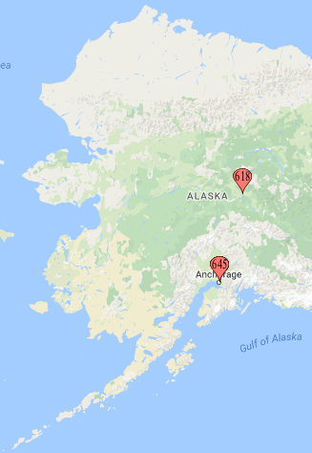
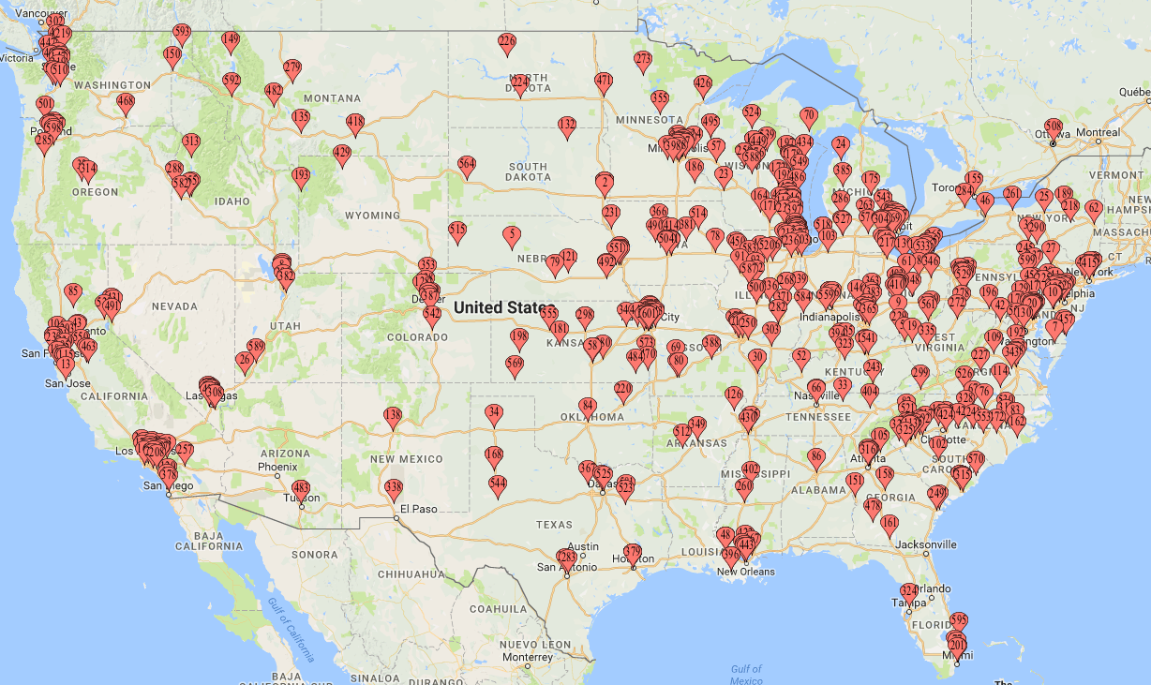
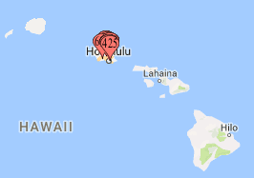
Where are we now?
IRB Approvals:
  740 sites
  365 sites with at least 1 patient
  accrued
Accruals:
  1248 patients registered to S1400
    581 patients from SWOG sites
  956 patients notified of their sub-study assignment
  461 patients registered to a sub-study
S1400G: 7
S1400I: 191 Closed Sub-studies/treatment: 263 SWOG STATISTICAL CENTER and CTSU AS OF 4/87/2017
Notes:
Update

Slide 5
Current Status of Sub-Studies
S1400A [MEDI4736]
  Completed 12/18/2015
S1400B [GDC-0032]
  Completed 12/12/2016
S1400C [Palbociclib]
  Completed 9/1/2016
S1400D [AZD4745]
  Completed 10/31/16
S1400I [Nivolumab/Ipilimumab]
  Actively accruing
S1400G [Talazoparib]
  Actively accruing
Notes:
Suggestions on what to states

Slide 6
Study Design Updates
Revision #6/7 (February 2017)
  New Sub-Study, S1400G: a biomarker-driven study including a PARP inhibitor
  Administrative Closure of S1400C, CDK4/6 – Palbociclib
  S1400B Permanently Closed on 12/12/2016
  S1400C Permanently Closed on 9/1/2016
  S1400D Permanently Closed on 10/31/2016
  S1400I- Rapid Request for Amendment (RRA) for ipilimumab and for nivolumab

Slide 7
Study Design Updates
S1400G - PARP Inhibitor
Patients with homologous recombination DNA repair deficiency (HRRD) may be particularly receptive to treatment with PARP inhibitors.
Sub-study G (S1400G) of Lung-MAP seeks to evaluate the efficacy of talazoparib, a potent PARP inhibitor, in such patients.
S1400G will include patients with alterations in BRCA1/2, ATM, CHEK1 and other HRRD genes.
Talazoparib will be administered orally once daily in 21-day cycles. Treatment will continue in consenting patients until disease progression or intolerable toxicity.
Previously Registered Patients - Patients who have already submitted tumor tissue on Lung-MAP will be assessed for the S1400G biomarker and are potentially eligible for the sub-study upon progression.

Slide 8
Study Design Updates
Revision #8 (April 2017)
  S1400G- Rapid Request for Amendment (RRA) for talazoparib
Revision #9 (Expected June/July 2017)
  New Sub-Study, S1400F: A non-match study with previously treated anti-PD-1/PD-L1 inhibitor resistant disease
  The eligibility criterion regarding patients screened at progression on prior treatment or pre-screened prior to progression has been opened to include checkpoint inhibitor therapy as a line of therapy.

Slide 9
Overview of Upcoming Changes
    Proposed Sub-Studies:
  S1400K: a biomarker-driven study of ABBV-399 in c-MET positive patients
    Concept submitted to CTEP
  S1400GEN: Ancillary Study to Evaluate Patient and Physician Knowledge, Attitudes, and Preferences Related to Return of Genomic Results in S1400
    Pilot study being conducted
    Future Study Re-design:
    To allow all histologies versus just squamous histology to enroll onto Lung-MAP
    To establish a platform within Lung-MAP to evaluate immunotherapy (IO) combinations among patients previously treated with IO monotherapy.
Notes:
Not sure if detailed information should be added. Do we want to show progress on adding new sub-studies?

Slide 10
Future Re-Design
Previously-treated Stage IV or Recurrent
Non-Small Cell Lung Cancer
(all histology)
Immunotherapy or Chemotherapy Relapsed/Refractory Patients
Centralized NGS* Biomarker Profiling
Biomarker-matched* Sub-studies
Non-Matched Sub-studies
Biomarker 1 Positive
…Biomarker n Positive
IO Naïve
(squamous only)
IO Relapsed/Refractory
Sub-study 1
Biomarker-driven
Therapy
…Sub-study n
Biomarker-driven
Therapy
Collect tissue for Immuno Biomarker Profiling
Stage 1:
R
Randomization
Nivolumab + Ipilimumab
V.
Nivolumab
Investigational therapy 1
Investigational therapy n
IO Sub-study 1
IO combo 1
…IO Sub-study m
IO combo m
Common Control
Dealer’s choice
based on histology
Stage 2:
R
R
Investigational therapy 1
Standard of Care
Investigational therapy n
Standard of Care
*Currently, biomarkers are defined by NGS. Though approaches such as c-MET IHC
or Immunotherapy biomarkers may be used

Slide 11
Prior Treatments Allowed for IO-combination Platform
Group 1:
Plat-based Chemotherapy for Stage I-III*
IO as 1st-line therapy for Recurrent disease (Stage IV)
Note: Intervening therapy is allowed
Group 2:
Plat-based Chemotherapy as 1st –line therapy for Stage IV
IO as 2nd-line therapy for Stage IV
Group 3:
Plat-based chemo as 2nd-line therapy for Stage IV
IO as 1st-line therapy for Stage IV
Group 4:
IO and Plat-Based Chemotherapy
as 1st-line therapy for Stage IV
*disease progression on platinum-based chemotherapy must have occurred within one year from the last date that patient received that therapy

Slide 12
S1400I Patient Reported Outcomes
Mary Redman, PhD
Study Lead Biostatistician

Slide 13
S1400I PRO Overview
The Patient Reported Outcomes (PRO) Study will look at capturing the complex symptom profile experienced by patients, which may result from the disease, the therapy, or both. The study will consist of PRO and EQ-5D Questionnaires.
The S1400I trial structure provides an ideal setting for evaluating the information provided by PRO measures and assessing how well PRO measures track with disease symptoms and other clinical outcomes.
The purpose of the EQ-5D is to obtain preliminary survivorship status for this group of patients at the three yearly follow-up assessments for clinical status.

Slide 14
Assessment Schedule
  PRO assessment schedule built on existing clinical assessments:
B
1
2
3
4
5
6
7
8
9
10
11
12
13
25
37
Y 1
Y 2
Y 3
Weeks
PRO
EQ-5D
PRO
PRO
EQ-5D
PRO
EQ-5D
PRO
EQ-5D
PRO
PRO
EQ-5D
PRO
EQ-5D
PRO
EQ-5D
EQ-5D
EQ-5D
EQ-5D
S1400I Clinical Assessment Schedule
S1400I PRO Sub-study Assessment Schedule
S1400I EQ-5D Questionnaire Assessment Schedule

Slide 15
PRO Data Submission
  Data Submission Requirements
    Data must be submitted according to the protocol requirements for patients registered to S1400I after 9/1/2016 and participating in the S1400I PRO study (refer to S1400I Section 14.4)
  Master Forms
    Master forms can be found on the protocol abstract page on the SWOG website (www.swog.org) and CTSU website (www.ctsu.org)
    Data Submission Procedures
    In addition to completing electronic forms, upload the patient-completed questionnaires via the Source Documentation: PRO form in Medidata Rave®. https://login.imedidata.com/selectlogin

Slide 16
PRO Training and Contacts
Staff involved in the collection of quality of life/PRO data in SWOG trials should review the Patient Reported Outcome Training narrated slide program available on the SWOG website (www.swog.org, CRA Training, Tools of the Trade).
Nurse PRO/QOL Study Coordinator
Susan S. Tavernier, PhD, APRN-CNS, AOCN
Assistant Professor
Accelerated Nursing Program Coordinator
Idaho State University School of Nursing
Phone: 208/373-1783
tavesusa@isu.edu

Slide 17
Tissue Submissions
Fred Hirsch, MD, PhD
Study co-Chair, Translational Medicine

Slide 18
Tissue Submission
Lung-MAP Screening Registrations:
N = 1191
Tissue Received at FMI:
N = 1168
Results Reported to SWOG
N = 1157
Median(IQR):
1 (1-2) day(s)
Median(IQR):
9 (8-12) days
Analyzable: 1053 (91%)
Not analyzable: 104 (9%)
Some never had tissue
Submitted or logged as shipped
Go to: http://www.swogstat.org/accrual/lungmap.pdf for current status
As of Mar 15, 2017

Slide 19
Lung-MAP Biomarker Results
Total Screening/Pre-screening registrations: | N=1191
Pre-screened prior to PD* | 410 (34%)
Screened at PD | 781 (66%)
Biomarker testing results: | N=1053
Pi3K+ (S1400B biomarker) | 82 (8%)
CCGA+ (S1400C biomarker) | 197 (19%)
FGFR+ (S1400D biomarker) | 167 (16%)
HRRD+ (S1400G biomarker) | 159 (15%)
At least 2 of the above biomarkers | 103 (10%)
Others (non-eligible biomarkers):
EGFR | 7 (1%)
ALK | 1 (<1%)
* Pre-screening option was included in Rev #2. Since activation % pre-screened/screened at PD has been about 50/50.
As of Mar 15, 2017

Slide 20
New Biopsies vs. Archival
New Biopsies
N = 399 (31%)
Tissue submissions:
N = 1308
(note: pts could have multiple)
763 blocks
643 slides
(note: could have multiple types w a submission)
Archival Tissue
N = 909 (69%)
Initial Tissue inadequate
N = 147
Tissue Resubmission
N = 53 (36%)
Adequate upon Resubmission
N = 43 (81%)
As of Mar 15, 2017

Slide 21
The Tissue is the Issue
~ 13% of tissue submissions are inadequate Reasons for inadequacy (a sample could have multiple reasons):
48% Insufficient amount of tissue
35% Insufficient tumor cells
37% Insufficient DNA
19% Insufficient tumor size
14% Failed Sequencing
5% Other Reasons
When tissue resubmissions are accounted for, 9% of patients had inadequate tissue
As of Mar 15, 2017

Slide 22
Quality Assurance and Monitoring
Elaine Armstrong, ms
SWOG Quality Assurance Manager

Slide 23
QA/Monitoring Common Problems
Regulatory:
  For sites using the CIRB: New 30-day requirement to implement protocol changes
Patient Case Review: Eligibility
  S1400: Failure to confirm ≥ 15% tumor cells by local pathologist

Slide 24
QA/Monitoring Common Problems
Consent forms
  Mixing up the screening consent and the prescreening consent
  Informing patients by the next visit of changes in risks with Revisions
Patient Case Review: Eligibility
  Failure to meet Inc/Exc Criteria
Patient Case Review: TRIAD
  Delay in submission of scans
Patient Case Review: Adverse Events
  Failure to report lab values that are considered not clinically significant
  Failure to report all grade 1 – 5 adverse events

Slide 25
Data Entry Guidelines
The S1400 Data Entry Guidelines are now live on the ORP Manual under Chapter 16e: General Forms and Guidelines-S1400 & Sub-Studies.
https://crawb.crab.org/txwb/CRA_MANUAL/Vol1/chapter%2016e_Data_Entry_Guidelines_S1400_1.30.17.pdf

Slide 26
Site Coordinators Committee (SCC)
Lavinia Dobrea RN, MS, OCN
Site Coordinator Committee co-Chair

Slide 27
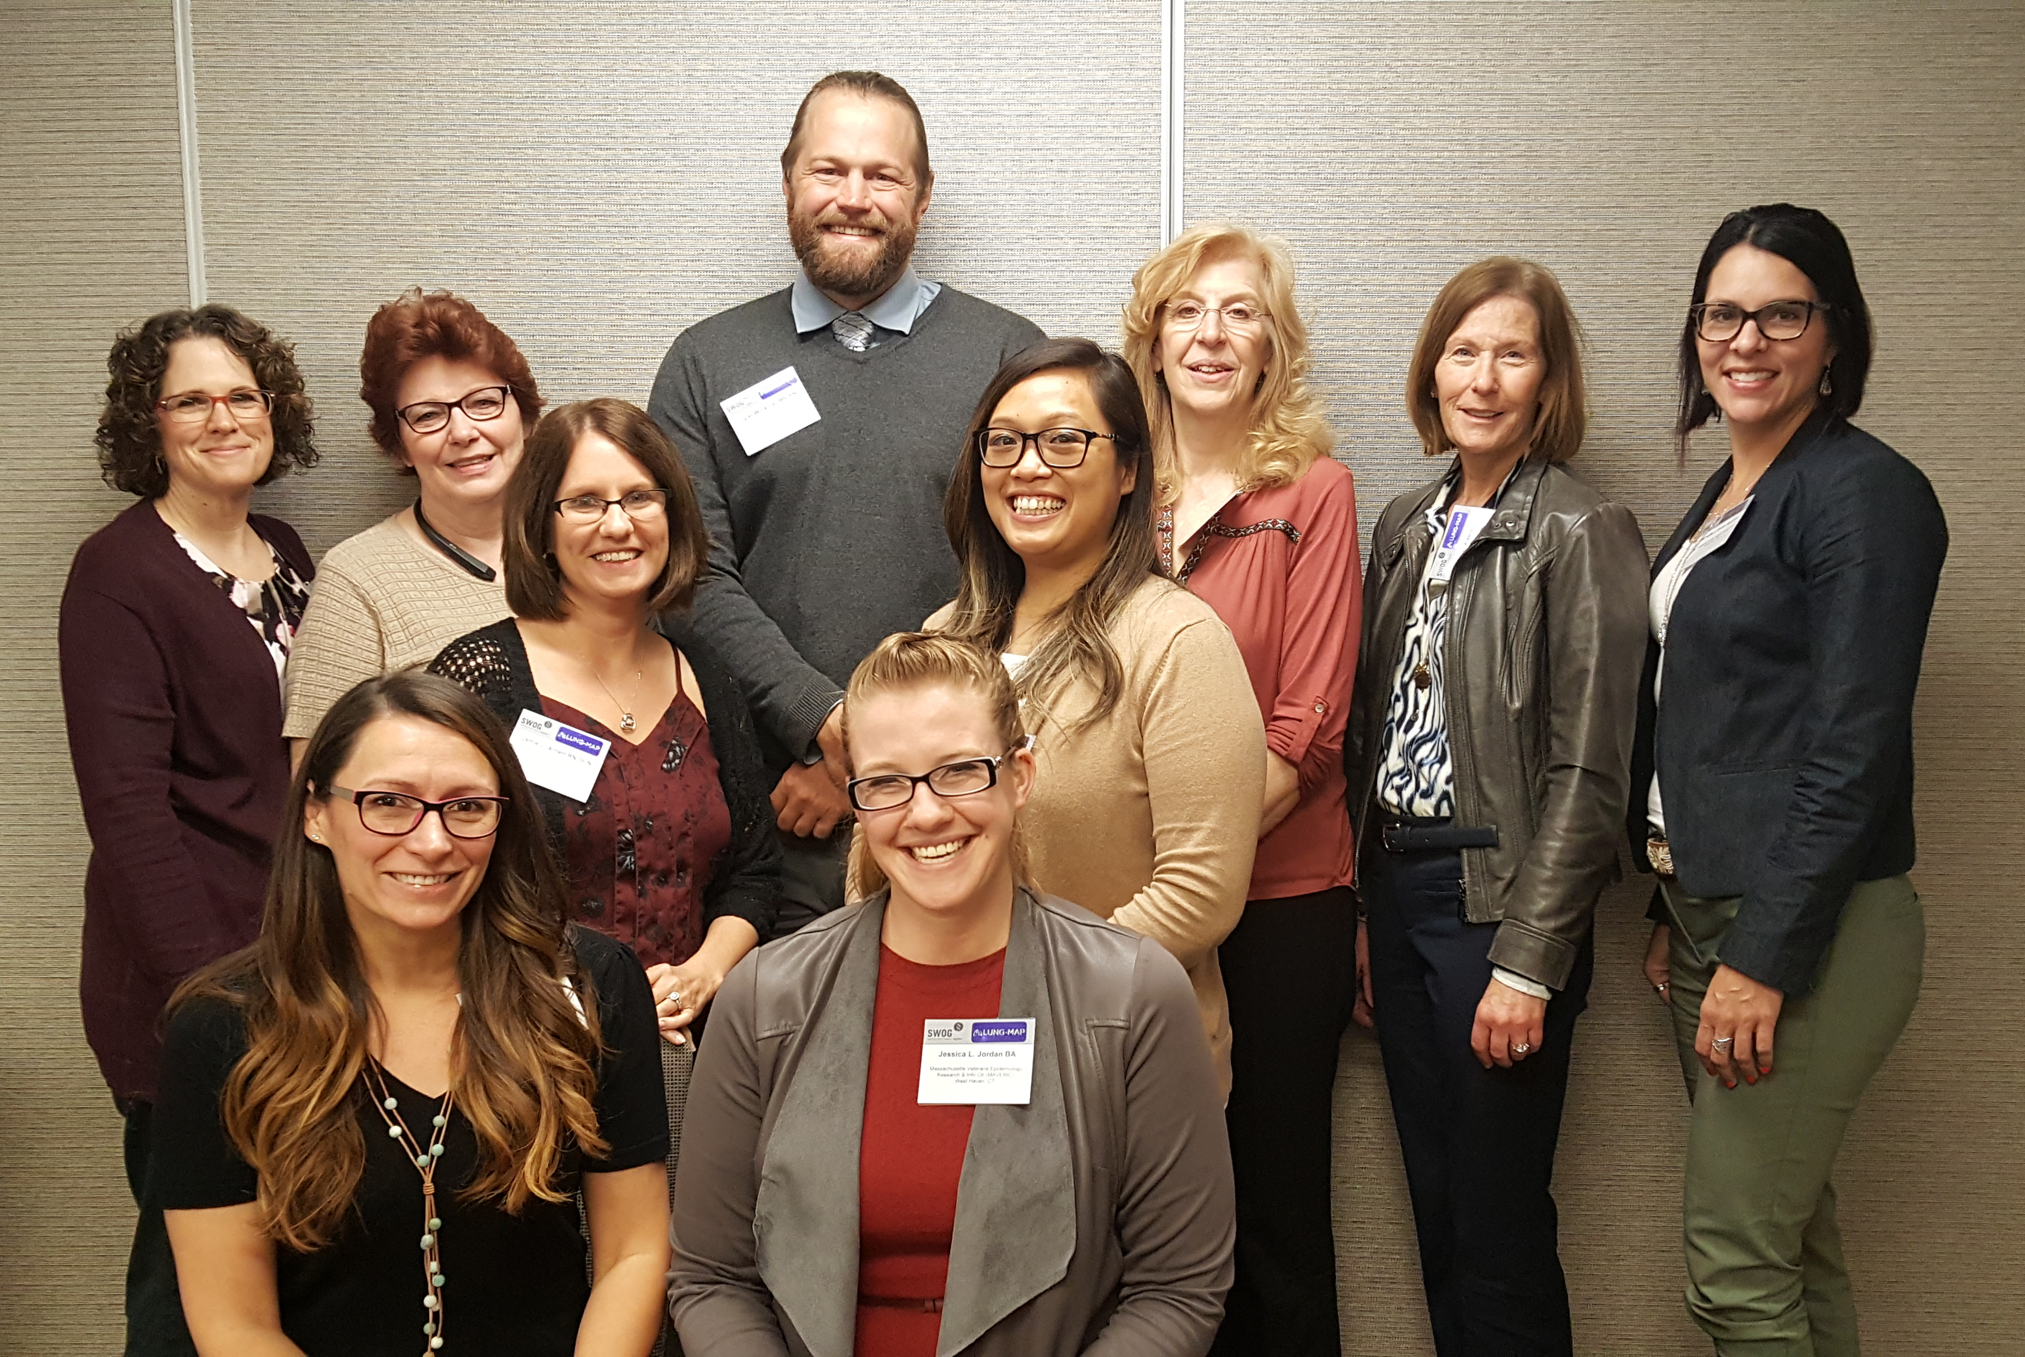
SCC Mission
To represent study site staff at the nursing, CRA, data management, and regulatory levels by providing feedback to and from the study leadership to enhance accrual and improve study management.

Slide 28
SCC Activities:
Review & recommend accrual materials and strategies
Review changes to study procedures and updates to data collection forms
Provide content for the Lung-MAP newsletter
Participate in Update meetings
Assist in promoting the study and encouraging accrual

Slide 29
SCC Activities:
Assist with planning, development, and implementation of staff training tools
  Patient AE Log
  RECIST Tracker
  CT Reminder
  Progress Notes for Pre-Screening, Screening, Progression, Sub-studies
  NOW available on the S1400 Abstract Page under S1400 Resources on the SWOG website (https://swog.org/Visitors/S1400/S1400SampleDocs.asp).

Slide 30
SCC Activities:
Webinar on the management of immune-related AE’s (irAEs)
  To be presented by Dr. Lyudmila Bazhenova, the Co-Chair of S1400I
  Expected this summer
Review & provide insight from a site perspective on the Future Re-Design of S1400

Slide 31



SITE COORDINATORS COMMITTEE
We are seeking applicants for the S1400 Lung-MAP Site Coordinators Committee. Current members represent all types of sites: NCTN, NCORP, CCTG, academic, minority, etc. SWOG has funds to support travel for members to two SCC meetings per year, in conjunction with the SWOG Group Meeting, and funding for up to four conference calls per year. For more information about the committee and to apply:
https://www.surveymonkey.com/r/LM_SCC_2017.

Slide 32
Questions?
Have a concern or question?
Want an opportunity to work with the Site Coordinator Committee members?
Do you have an accrual strategy or materials you would like to share?
Do you have tracking forms or procedures to help you manage Lung-MAP at your site?
Send us the information or materials and
include your name, study site, and contact info.
Contact us at LungmapSCC@crab.org

Slide 33
Questions?
Thank you for your time.
The slides presented today will be available on the SWOG website→ S1400 Protocol Abstract page→ Other Study Materials→ S1400 Group Meeting Materials link
Notes:
Update

