Slide 1

AHRQ R01 HS021491
Prospective Comparative Effectiveness Trial for Malignant Bowel Obstruction
PI: Robert S. Krouse, MD (University of Pennsylvania, Surgical Oncology)
Co-Investigator:
  Garnet Anderson, PhD (Fred Hutchinson, Statistician)
Consultants:
  Marcia Grant, PhD, RN, FAAN (City of Hope, Nursing Research)
  Jeff Sloan, PhD (Mayo Clinic Rochester, Statistician)

Slide 2
S1316 – (The MBO Study)
Prospective Comparative Effectiveness Trial for Malignant Bowel Obstruction
SWOG Study Chairs:
Robert S. Krouse, M.D., University of Pennsylvania, Surgical Oncology
Jeremiah Deneve, D.O., University of Tennessee, Surgical Oncology
Alliance Investigator:
Angeles Secord, M.D., Duke University Medical Center
Nurse Chair:
Virginia Sun, R.N., Ph.D., City of Hope

Slide 3
S1316 Working Group
Katie Arnold, MS, Statistician
Veronica Garcia, Protocol Coordinator
Jennifer Maeser, Recruitment &
Adherence Manager
Roxanne Topacio, Data Coordinator

Slide 4
Malignant Bowel Obstruction (MBO) - Overview
Aggressive non-surgical palliative care options can help avoid an operation
There are many clinical scenarios when an operation is unlikely to benefit MBO patients
Can we test which treatment strategy (surgery vs. “aggressive” palliative management) is optimal in MBO?
Krouse, JACS, 2002

Slide 5
MBO is a common palliative care problem
43% surgical consults (Badgwell, Supp Care Ca, 2009)
64% small bowel obstructions (Badgwell, J Pall Med, 2011)
5-43% of patients with advanced primary or metastatic intra-abdominal malignancy
  5-51% of patients with ovarian cancer (~20,000/yr)
  10-28% of patients with colorectal cancer (~150,000/yr)
  Other intraperitoneal primaries (bladder, cervix, gastric, pseudomyxoma peritonei)
  Non-intraperitoneal primaries (lung, breast, melanoma)

Slide 6
Surgical Consult for Small Bowel MBO- Treatments
Surgical treatment (25%)
Endoscopic or IR procedures (24%)
Nonoperative/Nonprocedural management (52%)
Badgwell BD, et al., J Palliat Med, 2011

Slide 7
MBO and Surgery- Beliefs and Reality
Belief
Probable best modality if patient has “reasonable” expected survival
May spend shorter time in hospital
May relieve possible ischemia/infarction of bowel
May improve survival
Reality
Explorations alone- 3-18%
10-50% chance of recurrence
Morbidity ~42%
May spend longer time in hospital
Mortality 5-32%
QOL improvement variable (42-85%)

Slide 8
When is the optimal approach for MBO unclear?
Ascites
Carcinomatosis
Multiple obstructions
Palpable intra-abdominal mass
Diffuse metastatic disease
Recurrent MBO
Multiple medical problems
History of multiple intra abdominal operations

Slide 9
What is the optimal outcome measure for MBO?
Alleviate nausea/vomiting
Recurrence of obstruction
Ability to have bowel movement/return of bowel function
Allow to go home/leave hospital
Enable to eat/drink
Morbidity and mortality
Improve survival
(Feuer, Gyn Onc, 1999)

Slide 10
There is ample evidence that the primary goal for patients with end stage disease is to be at home/out of the hospital.
Last Acts. 2002. http://hdl.handle.net/1805/822, Accessed March 25, 2013.
Dunlop RJ, Davies RJ, Hockley JM. Palliat Med 3:197-201, 1989.
Higginson IJ, Sen-Gupta GJA. J Palliat Med 3(3):287-300, 2000.
Hays JC, Galanos AN, Palmer TA, McQuoid DR, Flint EP. Gerontologist 41(1):123-128, 2001.
Tang ST. Ca Nurs 26(3):245-251, 2003.
Fried TR, van Doorn C, O’Leary JR, Tinetti ME, Drickamer MA. Ann Int Med 131(2):109-112, 1999.
Hays JC, Gold DT, Flint EP, Winer EP. In: End of life issues: Interdisciplinary and Multidimensional Perspectives, Vries B (ed.), New York: Springer, 1999.

Slide 11
International Conference on Malignant Bowel Obstruction (ICMBO)
PI: Robert S. Krouse, MD
NCI R13 CA110771

Slide 12
ICMBO Objectives
Using MBO as a model, explore clinical, research, ethical, and cultural issues related to implementing prospective studies for patients with advanced cancer.
Develop an integrated methodological framework for prospective, randomized studies of patients with advanced cancer.
Design a prospective randomized trial for patients with MBO.
Disseminate conference findings.
November 12-13, 2004
Pasadena, CA.

Slide 13
Participants
Peter Angelos, MD, PhD (Medical Ethics)
Thomas Anthony, MD (Surg Onc)
Todd Baron, MD (GI)
Ira Byock (HPM)
David Casarett (HPM)
David Cella, PhD (Social Scientist)
Dennis S. Chi, MD (Gyn Onc)
Stephen Connor, PhD (Palliative Care)
Stephen Joel Coons, PhD (QOL Research)
John Cunningham, MD (GI)
Geoffrey Dunn, MD (HPM)
Betty Ferrell, PhD (Nursing Research)
David Feuer, MD (HPM)
Patricia Ganz, MD (Med Onc)
Marcia Grant (Nursing Researcher)
Sylvan Green, MD (Statistician)
Marjorie Kagawa-Singer, PhD (Health Disparities Research)
Martin Karpeh, MD (Surg Onc)
Barry M. Kinzbrunner, MD (HPM)
Ann Kolker (Cancer Survivorship)
Robert Krouse (Surgical Oncologist)
Jean Kutner, MD (HPM)
Joseph Lipscomb, PhD (Public Health Policy)
Sebastiano Mercadante, MD (Anesthesiology)
Thomas Miner, MD (Surg Onc)
Tom Mosich (Cancer Survivor)
Geraldine Padilla, PhD (Nursing Research)
Guadalupe Palos, LMSW, DrPH (Social Work)
Richard Payne, MD (Palliative Care)
Ken Rosenfeld (HPM)
Susan Matsuko Shinagawa (Cancer Advocacy)
Pauline Sieverding, PhD, JD, MPA (Quality Measurement)
Jeff Sloan (Statistician)
Elizabeth Smart (Cancer Survivorship)
Ellen Stovall (Cancer Survivorship)
Julie Swaney, Mdiv (Spiritual Advocacy)
Lawrence Wagman, MD (Surg Onc)
Giles Whalen, MD (Surg Onc)

Slide 14
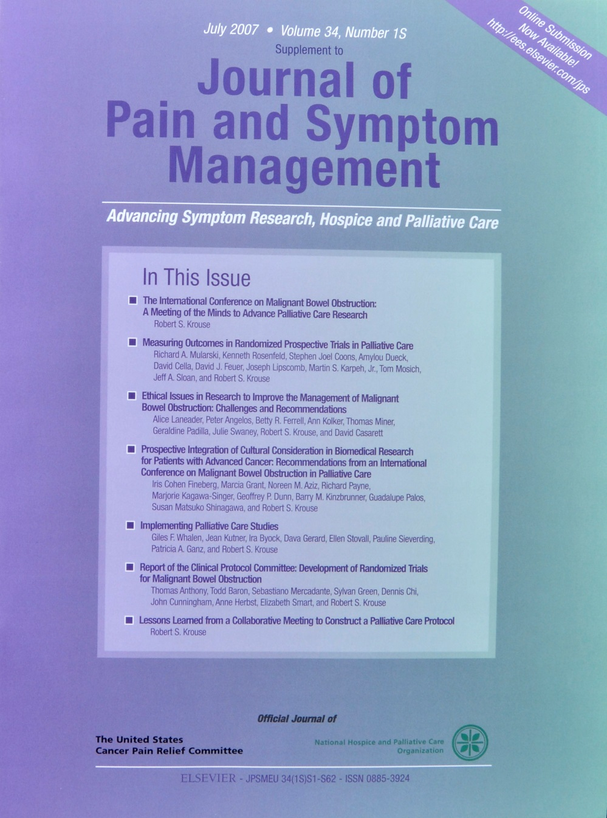

Slide 15
Definition of Malignant Bowel Obstruction
Clinical evidence of a bowel obstruction (via history/physical/radiographic examination)
Bowel obstruction below the ligament of Treitz
Intra abdominal primary cancer with incurable disease
Non-intra abdominal primary cancer with clear evidence of intra-peritoneal disease
Anthony, T. J Pain Symp Manag, 2007.

Slide 16
S1316 - Prospective Comparative Effectiveness Trial for Malignant Bowel Obstruction
Schema
Surgery (50%) (Arm 1)
Consents to randomization
(N=55)
Non-surgical management (50%) (Arm 2)*
Meets all
eligibility
requirements (N=220)
Surgery (Arm 3)
Consents to non-randomized treatment
(N=165)
Non-surgical management (Arm 4)*
Primary Outcome: “Good days” = days out of the hospital and alive in the first 91 days (13 weeks) after registration
*Recommend a trial of somatostatin analog
Notes:
Arms 1 and 3: Surgery
Patients on surgical management will undergo abdominal surgery as defined by the treating physician. Surgery is defined as an operative procedure. Information regarding patient treatment will be collected.
While randomization to Arm 1 will determine a patient’s initial care, the treating physician will take changes in their clinical course or other circumstances into account in determining the ongoing care plan.
Arms 2 and 4: Non-surgical Management
Patients on non-surgical management will be offered non-surgical management as determined by the treating physician. Information regarding patient treatment will be collected.
While the research team believes there is sufficient equipoise to randomize to such a trial, it is likely infeasible to accrue the entire population to a RCT at this time. Therefore, this study proposes to accrue a large number (n=180) and randomize a subset of these (n=50) accruing at selected institutions demonstrating substantial interest in and commitment to this question. This combined approach builds on the strengths of each design to give more reliable results. While the RCT component of this hybrid design could be considered a pilot trial, by embedding this trial in a larger non-randomized component, we believe we will have stronger inference than could be achieved by either alone.

Slide 17
MBO Grant Submissions and Presentations
AAHPM/NPCRC 1/16/07
ACOSOG GI Comm 1/14/05
NCCTG GI, QOL, Surgery Comm 9/21-22/05
CALGB GI Comm Surgical Subcomm 3/4/05
SWOG Surgery, GI Comm 9/30/05-10/02/05
Am Ca Soc 10/13/06
VA CSP Planning Mtg 6/6/06
SWOG Survivorship Comm 10/17/12
VA Coop. Studies 2/1/06
SWOG Survivorship Comm 10/19/10
ACOSOG GI Comm 6/23/05
SWOG Surgery Comm 4/11/12
ACOSOG QOL Comm 1/8/04
GOG QOL , CPC Comm 1/20/06
SWOG Patient Advocate Comm 5/2/13
CALGB GI Comm 6/18/05
NIH/NCI R01 10/5/10
GOG CPC Comm 7/8/05
R13 CA110771 12/15/03
GOG CPC Comm 7/14/06
ACOSOG April 2002
AAHPM/NPCRC 1/15/08
Novartis 12/21/05
AHRQ R01 10/5/11
AHRQ R01 3/25/13
2002
2003
2004
2005
2006
2007
2008
2010
2011
2012
2013

Slide 18
Major Study Concerns
Accrual
Primary outcome measure
Patient heterogeneity
  Diagnosis (Ovarian, CRC, other)
  Disease status (ascites, carcinomatosis, CT evidence)

