Slide 1
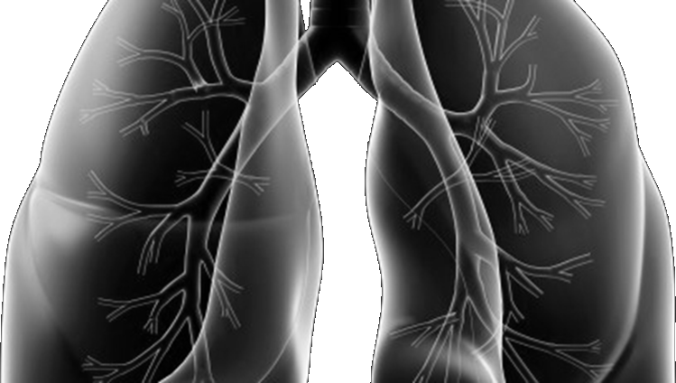






Celebrating 4 Years
of Lung-MAP
Where We’ve Been &
Where We’re Going
Karen Kelly, MD
swog lung cancer committee chair
SWOG Fall meeting
October 5, 2018
Notes:
Dr. Kelly – To provide the “Welcome” and an overview of the presentation.
We are celebrating Lung-MAP being active for over 4 years.
Show casing the impact this study has from a Global level to the patient level.
Excitement on the upcoming changes.

Slide 2
Where We’ve Been
Vassiliki Papadimitrakopoulou, MD
David Gandara, md
Study Chairs, Medical Oncology

Slide 3

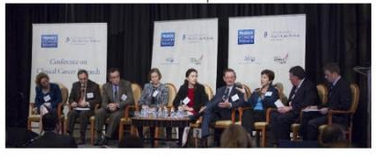
The Story of Lung-MAP
  October 2011 – Creativity Inspiration motivated by TCGA and Battle trials at the
  SWOG Group Meeting
  February 2012 – NCI TMSC, FDA, Leading Academicians, Clinicians, Industry, Government representatives
  November 2012 – Lung Master Protocol Trial Design Proposal hosted by Friends of Cancer Research
  March 2013 – Development of the Lung Master Protocol
  Public/Private Partnerships, SWOG Sponsor
  Primary Objective: Overall survival of biomarker-selected patients treated with standard of care (SoC) versus the experimental targeted therapy.
  Drugs and Biomarkers:
    Steering Committee to evaluate each applicant
  Study Design:
    Phase II/III in patients with advanced squamous cell carcinoma as the un-met need
    Foundation Medicine as the central lab for biomarker testing
    Targeted treatment based on biomarker results
L-R: M. Redman, J. Abrams, V. Miller, A. Ashby,
V. Papadimitrakopoulou, D. Gandara, J. Woodcock, R. Herbst, J. Allen
NCI: National Cancer Institute;
TMSC: Thoracic Malignancies Steering Committee
TCGA: The Cancer Genome Atlas
Notes:
Drug Information Sub-Committee-
Drugs: must demonstrate activity in a responsive patient group
Biomarker: Platform that has been analytically validated and suitable for a pivotal trial
https://www.focr.org/sites/default/files/CCCR12MasterProtocol.pdf

Slide 4
Original Schema
CT*
Biomarker
Profiling (NGS/CLIA)
Biomarker
Non-Match
Non-Match
Drug
Multiple Phase II- III Sub-studies with “Rolling Opening & Closure”
Biomarker A
Biomarker Β
Biomarker C
Biomarker D
TT A
CT*
TT B
CT*
TT C+CT
CT*
TT D+E
E*
Primary Endpoint
PFS/OS
Primary Endpoint
PFS/OS
Primary Endpoint
PFS/OS
Primary Endpoint
PFS/OS
TT=Targeted therapy, CT=chemotherapy (docetaxel or gemcitabine), E=erlotinib
Each Sub-Study independent of the others.
Each Sub-study designed for registration of a drug-biomarker combination.
Self-sustaining with new Sub-studies in planning stages.

Slide 5
The Story of Lung-MAP
  June 16, 2014 - ACTIVATION
  Lung Master protocol with an “umbrella” trial design
    Evaluation of multiple investigational therapies in independently conducted therapeutic studies
    Under a single infrastructure
    “One-stop-shop”
    Ability to screen large number of patients
  Opened with 5 treatment sub-studies
    4 biomarker-driven, 1 non-matched
Notes:
http://cco.amegroups.com/article/view/7845/8606

Slide 6
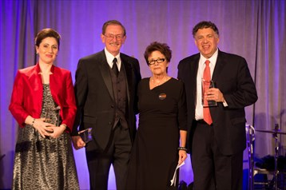
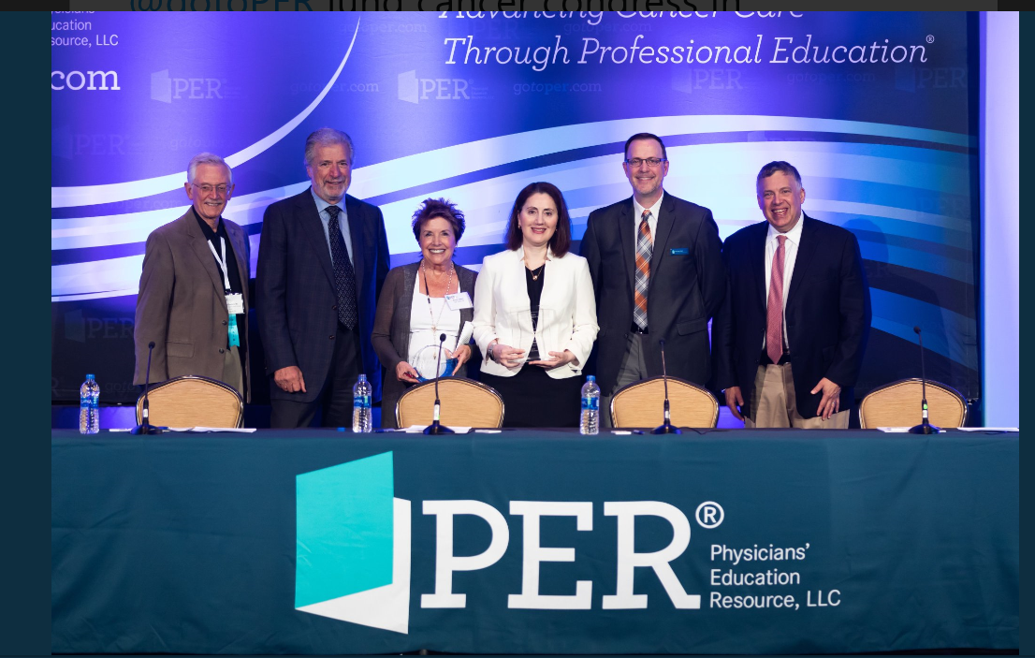
What We’ve Achieved Along the Way
November 2014 - Drs. Papadimitrakopoulou, Herbst, and Gandara received the Bonnie J. Addario Lung Cancer Foundation “Excellence in Collaboration & Innovation Award” for Lung-MAP
AWARDS
July 2018 - Dr. Vali Papadimitrakopoulou received the Addario Lectureship at International Lung Cancer Congress
Notes:
https://twitter.com/drroyherbstyale/status/1022896945059119105?s=12
https://medicine.yale.edu/urology/article.aspx?id=8362
https://cdn.rallybound.org/content/images/img/3928/Gala_past_honorees_8.15.17.pdf

Slide 7
Global Impact
This is the text for the next slide
Over 50 Publications and Abstracts
Lung-MAP has created a “blue-print” for which others follow
Over 15 trials using the blueprint, including non-Cancer trials
Almost every major pharmaceutical company has initiated a “master protocol”. Some have actually completely emulated the design and nomenclature (Match, non-match etc.)
Sept 28, 2018: The FDA released guidance on Master Protocols

Slide 8
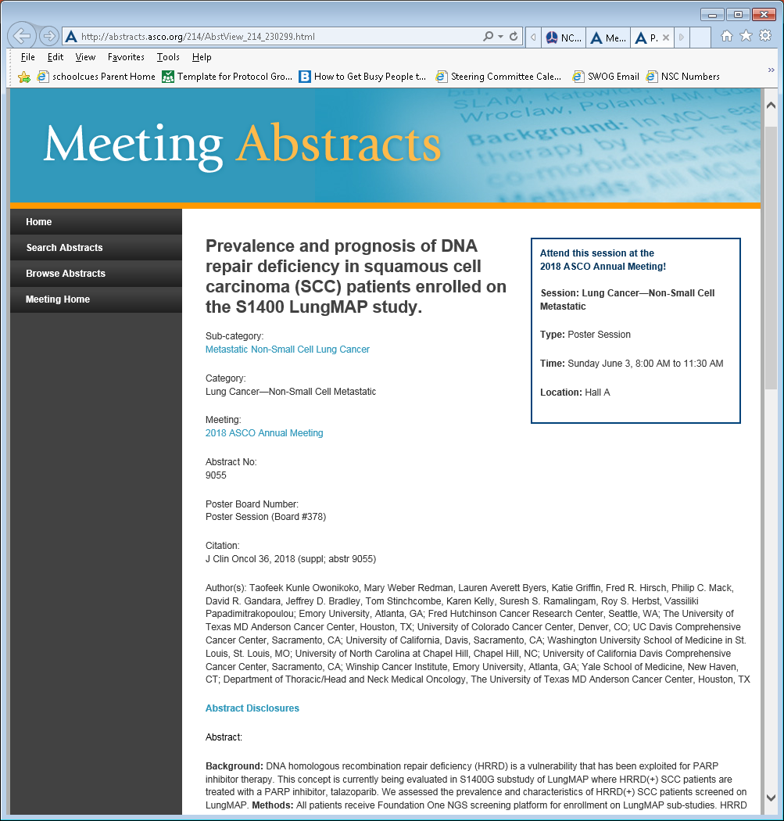
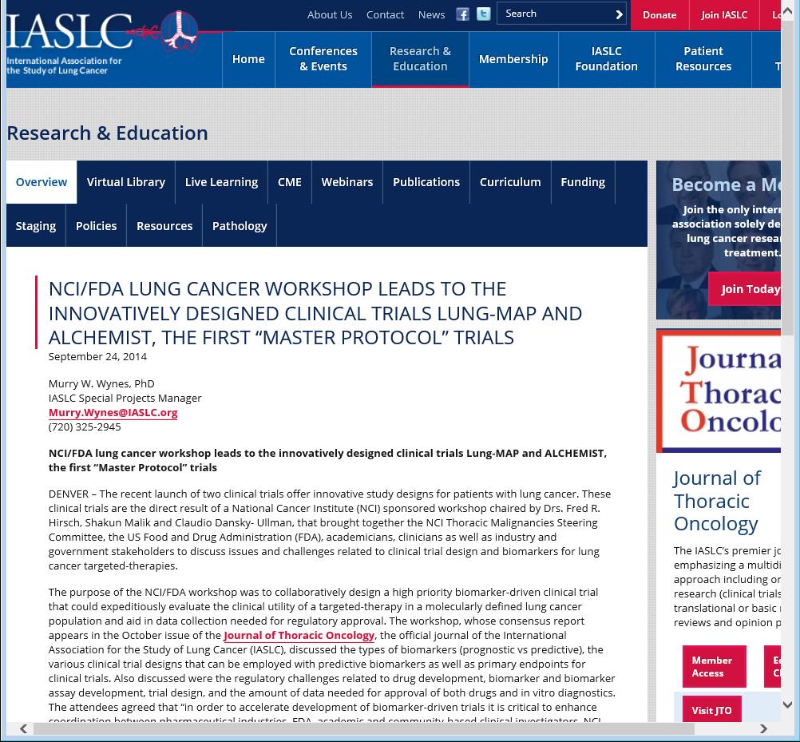
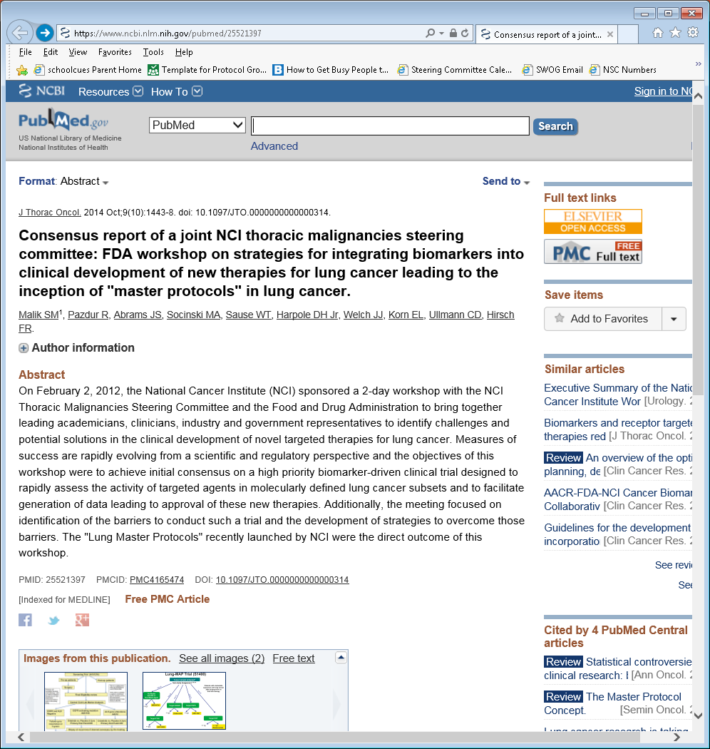
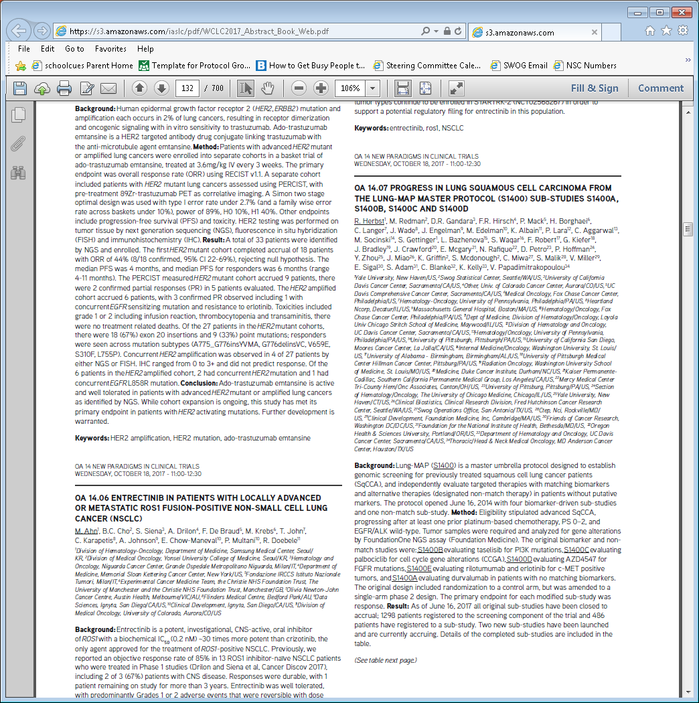
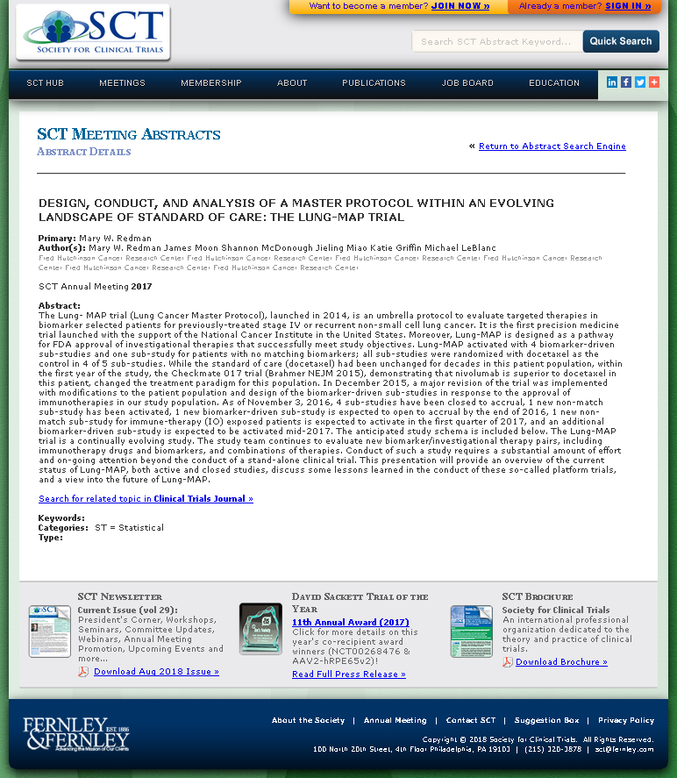
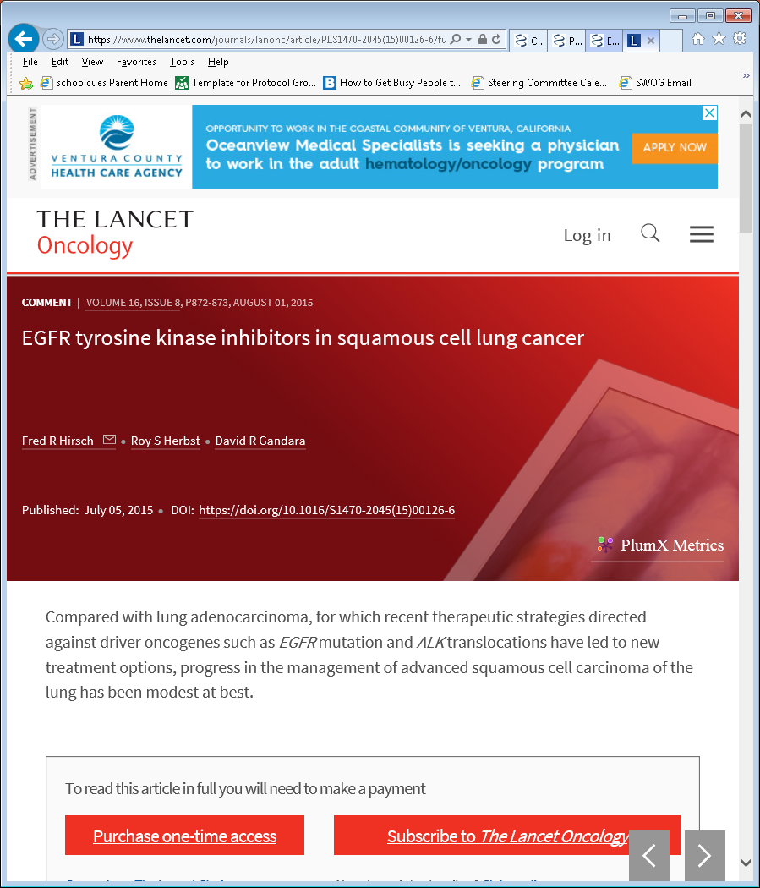

Global Impact
Over 50 Publications and Abstracts
Lung-MAP has created a “blue-print” for which others follow
Over 15 trials using the blueprint, including non-Cancer trials
Almost every major pharmaceutical company has initiated a “master protocol”. Some have actually completely emulated the design and nomenclature (Match, non-match e.t.c)
Sept 28, 2018: The FDA released guidance on Master Protocols

Slide 9
Biomarker Impact
Philip C. Mack, phd
Fred Hirsch, MD, PhD

Slide 10
Biomarker Impact – Foundation Medicine
Almost 1900 specimens received since study inception for the NGS testing
2104 ~150 specimens received
2015 ~400 specimens received
2016 ~650 specimens received
2017 ~350 specimens received
2018 ~ 350 specimens received (so far)

Slide 11
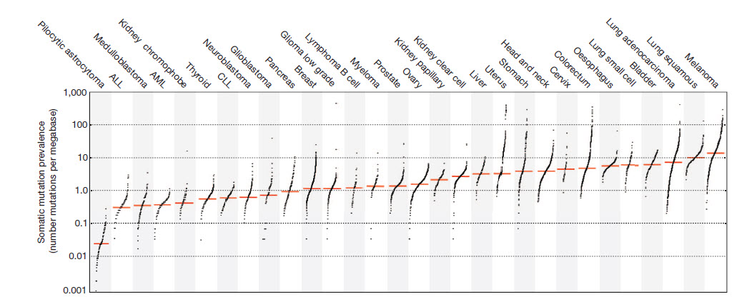
Squamous Cell Carcinoma of the Lung
One of the most genomically complex of all cancer types
Lung Adeno
Lung Squam
Density of Mutations →
Non-smoking associated lung cancers

Slide 12
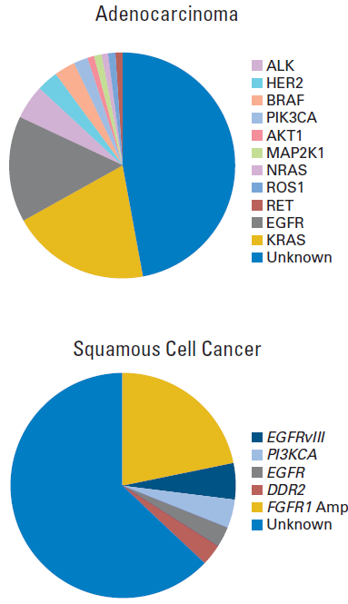
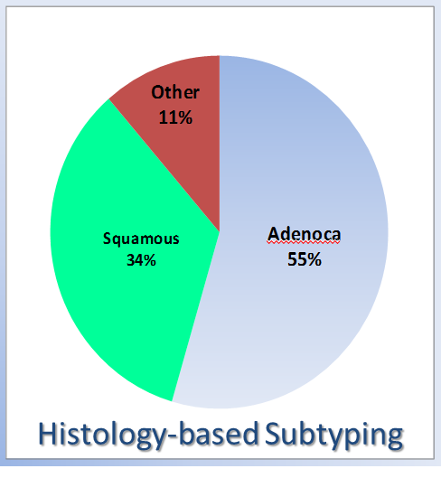

Precision Medicine for Squamous Carcinomas
Enormous Genomic Complexity
  lots of mutations, chromosomal rearrangements, polyploidy etc
Compromised DNA repair capacity
  It can evolve and adapt VERY FAST
But there are patterns to the abnormalities
NSCLC
as one disease

Slide 13
LungMAP – Precision Medicine Goals
LungMAP was originally designed to understand and exploit molecular signatures endemic to squamous cell carcinoma
  Identify “Achilles’ Heel” of this disease
  Predict activity of targeted therapies in molecular subgroups
  These goals are retained as we expand to all NSCLC histologies
Aspirational goals of LungMAP:
  Identify patterns of genomic abnormalities that influence IO effectiveness
  Evaluate IO combinations in biomarker-selected populations
  Incorporate liquid biopsies in our comprehensive analysis

Slide 14
The ever-expanding LungMAP molecular database
Number of patients with comprehensive mutation profiling: >1,500
Number of cancer-associated somatic alterations detected: 9,819
  >32,000 if include those of unknown significance
Number of genes with a detected alteration: 300
Comprehensive genome sequencing plus full patient annotation and treatment outcomes is an impressive resource for data mining.

Slide 15
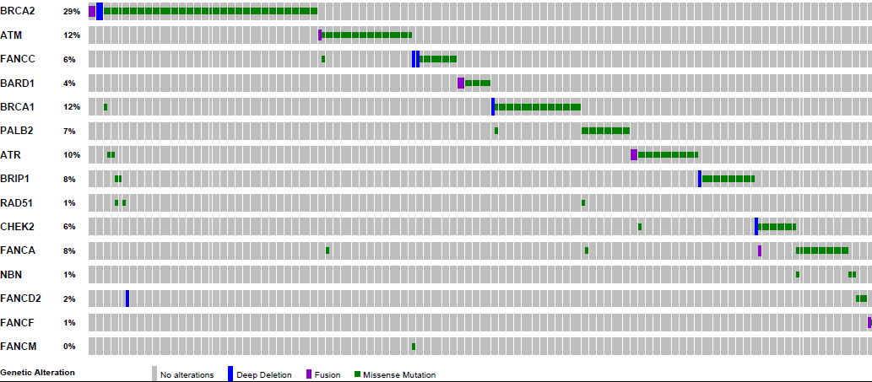
DNA Repair Gene Abnormalities in Pts Screened for S1400G (Talazoparib)

Slide 16
Local Impact
Jessica Jordan, Chair
Stephanie Smith, SCC Member
Site Coordinator Committee

Slide 17
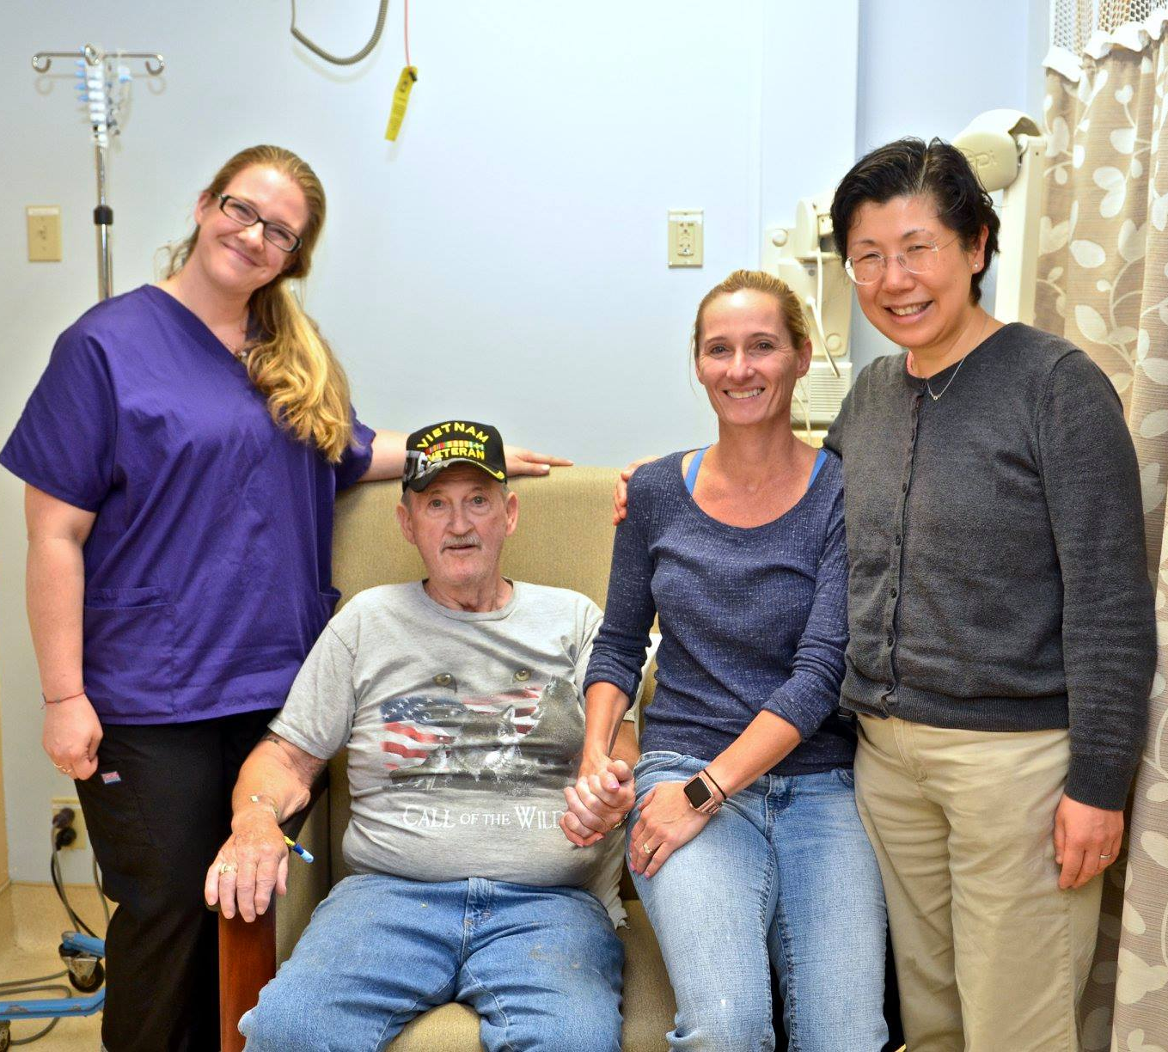

Patient and Site Impact
PI Perspective:
  The biomarker screening is incredibly efficient
  Unlike other trials in which we exhaust the biopsy specimen just screening for one or two studies, Lung-MAP offers a large array of studies that are currently available, and saves the data for future studies.
  The operational set-up is fantastic! As soon as a patient progresses on one arm, he or she can be evaluated for a new study arm on Lung-MAP.
Clifford C.’s Story
  “I feel as though this study and this drug has kept me alive.”
  “I am more confident than I have been in a long time. Lung-MAP gave me my life back.”
  ~ Clifford C.
Living!

Slide 18
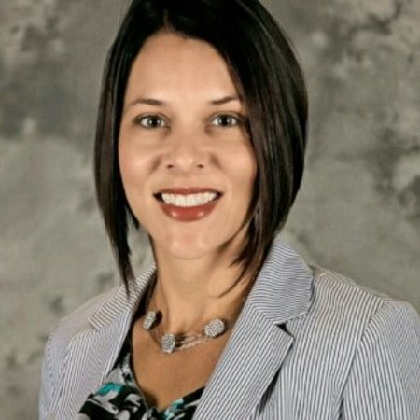

Site Impact
Lung-MAP Patients enrolled: 4 at LCRP / 50 GA NCORP; 50% of patients are enrolled onto a LungMAP sub-study
Treatment options in Lung-MAP:
More treatment options, advance medicine
Less toxicities
Value and hope in Lung-MAP:
Stage IV Lung Cancer considered a “Death Sentence”
NOW patients are living much longer; Mending relationships with family members
Seeing my patients live again
Annie B.’s Story
Pre-screened for Lung-MAP in Jan 2016
Assigned to S1400I in Nov 2016
Completed 48th cycle
Stephanie Smith, RN, MSN, OCN
20+ yrs of oncology effort

Slide 19
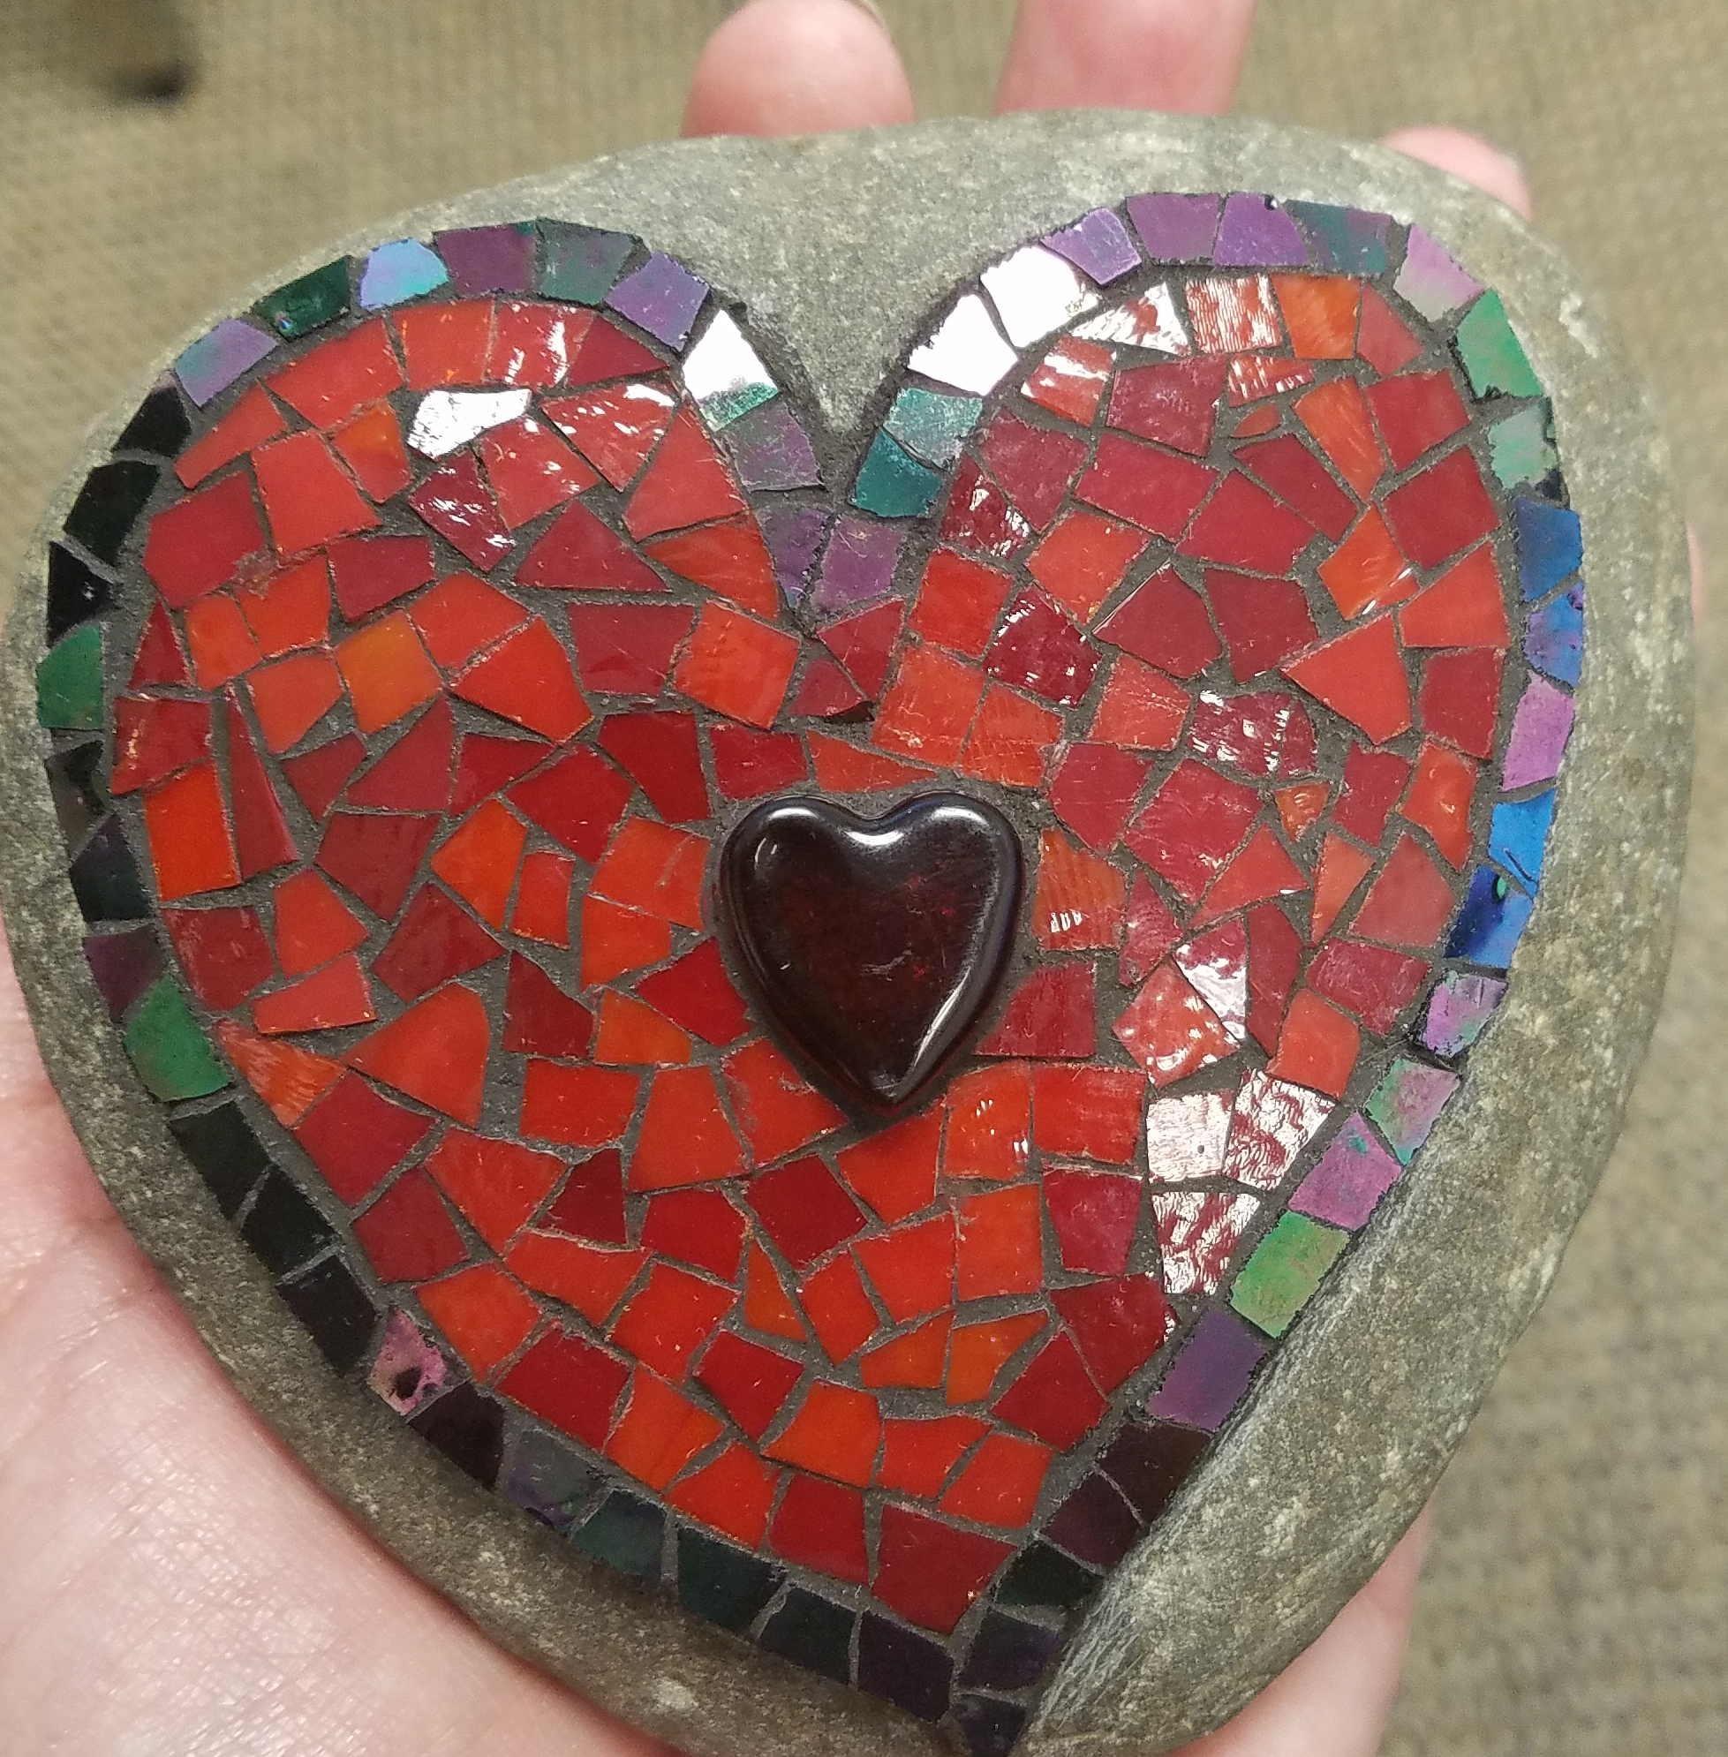

Patient Impact
Hi, I’m Annie B.
[Age 59 yrs, Diagnosed in Fall 2015, Stage IV Squamous NSCLC]
My first months of treatments were radiation and the chemo drugs Carboplatin and Abraxane. I handled them well with minor symptoms until the final appointments. I knew I didn't want to do that ever again. We entered into a time where I was stable and the tumors were still shrinking. Feeling like a true warrior, I went on with my life.
Then I had a seizure, Brain tumors had settled in to stay. BUT I then qualified for a clinical trial. I will be forever grateful to my team for knowing what to do to save my life. I have few symptoms. My life goes on. I'm a bit slower but I haven't given up anything. And I have hair!
I continue to be so grateful for everyone involved. Even after 48 visits for my opdivo infusion!
~ Annie B.
Notes:
Pre-screened for LungMAP in Jan 2016
Assigned to S1400I in Nov 2016
BENEFITS:
Mobility has increased, Desire to on home returned, Still struggling to get back to creating (mosaic artist)

Slide 20
Lessons Learned
Mary Redman, PhD
Lead Biostatistician

Slide 21
Lessons Learned
Master Protocols are Feasible – though it takes a village!
Unique public-private partnership has been key
  A true NCTN effort in both leadership and study conduct (accrual from 427 sites to date)
  FNIH as the “purse-holder” and contractor is an asset
  Active engagement of 10 different companies
  Advocacy partnerships have been essential (Friends as lead)
Flexibility & adaptability to changes in the therapeutic landscape are essential.
“Umbrella” infrastructure :
  facilitates opening-closing of new sub-studies quickly (“Self-Sustaining”)
  facilitates major design changes (e.g. with change of immunotherapy emergence)
Notes:
Drug Information Sub-Committee-
Drugs: must demonstrate activity in a responsive patient group
Biomarker: Platform that has been analytically validated and suitable for a pivotal trial
https://www.focr.org/sites/default/files/CCCR12MasterProtocol.pdf

Slide 22
Lessons Learned
4. Matched & unmatched sub-study design is attractive to both physicians & patients
  “Something for everyone” with a therapeutic option for every patient regardless of genotypic status
5. Pre-Screening/Screening process provides access to a large number of patients
  Broad NGS testing is feasible with acceptable turn-around-time
  (12 days median) & 90% analyzable
6. Since day 1, the goal of Lung-MAP has been to always put the patient first
  When critics said that Lung-MAP was “impossible”
  Our responses:
    “no longer business as usual”
    “keep your eyes on the prize”
    “the future is now”
→
Notes:
Dr. Gandara’s slides LLSv3

Slide 23
Where We’re Going
Crystal Miwa
Clinical Trials Project Manager

Slide 24
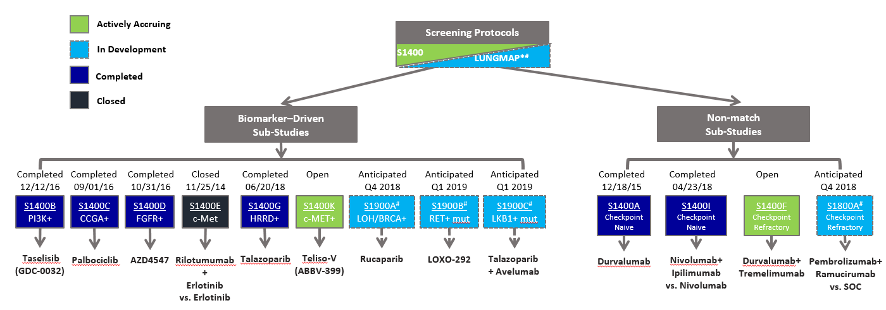
Where We’re Going – Current Schema
*The new umbrella screening protocol will simply be referred to as LungMAP. It will allow the trial to expand to include all NSCLC histologies and include more patients.
#Only new sub-studies will be open to all NSCLC histologies. The current sub-studies are only for patients with squamous cell carcinoma.

Slide 25
Where We’re Going
Lung Master protocol continues to show its flexibility & adaptation to changes in the therapeutic landscape and study structure
Unique Public-Private Partnership:
Through the NCTN, all of the Cooperative Groups contribute to the science and direction of Lung-MAP is stronger than ever.
A new screening protocol, “LungMAP”
A new CIRB mandate
Two new sub-study protocols
  S1900A testing a PARP inhibitor
  S1800A testing a PD-L1 and VEGF inhibitor in combination.
Activating in Q4 2018
Two new sub-study concepts
  S1900B testing RET mutated tumors
  S1900C testing STK11/LKB1 mutated tumors

Slide 26
Where We’re Going
New Screening Protocol, “LungMAP”
LungMAP has been reviewed and approved by CTEP and CIRB. Awaiting approval of sub-study S1900A.
  S1400 will close to accrual when LungMAP activates
  addition of liquid biopsies
  streamlined informed consent form that combines screening and prescreening – a step that will make it easier to enroll patients.
CIRB Membership mandate to comply with the NIH Policy on the Use of a Single Institutional Review Board for Multi-Site Research.
  another move to speed the process of opening the trial at sites and registering patients.

Slide 27
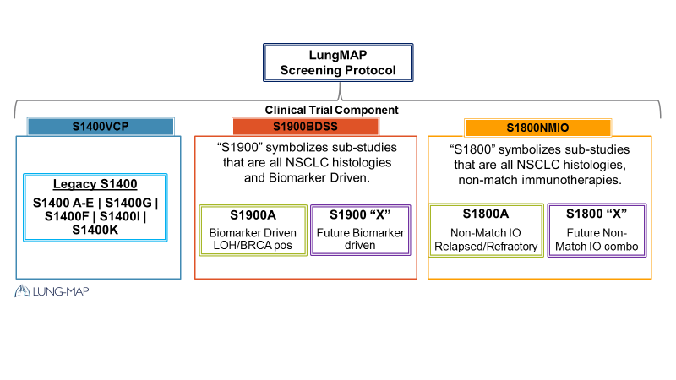
Where We’re Going – Protocol Infrastructure
The structure of Lung-MAP has been improved with the expansion
Standalone Protocols
Set within a defined module
  Legacy
  Biomarker-Driven
  Non-Match
Notes:
The LungMAP screening protocol will have 2 version control protocols:
S1900BDSS – Biomarker Driven Sub-Studies
S1800NMIO – Non-Match Immunotherapies
This allows NCI/CIRB to more easily manage the regulatory aspects of the umbrella study.

Slide 28
NCI CIRB Implementation at
LungMAP Activation
Site Status Suspended
No enrollment of new patients to ANY trial is allowed, but treatment and follow-up data on previously enrolled patients will continue to be provided. A site may enroll new patients to trials once it becomes a member of the NCI CIRB
Is Site a Member of the NCI CIRB?
No
Yes
Sub-Study Activated Prior to LungMAP Activation
Trial reviewed by NCI CIRB & opened by site prior to LungMAP Activation
Trial reviewed by NCI CIRB but opened by site on/after LungMAP Activation
Sub-Study Activated On/After LungMAP Activation
Site should continue to use the existing IRB of Record
(Local or NCI CIRB)
Site must use the NCI CIRB as the IRB of Record
Site must use the NCI CIRB as the IRB of Record
Notes:
NIH Policy on Single Institutional Review Board (NCI CIRB) for US Sites Participating in the NCTN & NCORP Clinical Trials Networks
March 1, 2019

Slide 29
S1900A
A PHASE II STUDY OF RUCAPARIB IN PATIENTS WITH GENOMIC LOH HIGH AND/OR DELETERIOUS BRCA1/2 MUTATION STAGE IV OR RECURRENT NON-SMALL CELL LUNG CANCER (LUNG-MAP SUB-STUDY)
Jonathan W. Riess, M.D.
S1900A Study Chair, Medical oncology

Slide 30
S1900A: Overview
Rucaparib is a potent small-molecule inhibitor of poly (ADP-ribose) polymerase (PARP) proteins (PARP-1, PARP-2 and PARP-3) that play an important role in repairing DNA damage and maintaining genomic stability.
The FDA recently approved rucaparib as maintenance treatment for ovarian, fallopian tube and primary peritoneal cancer following response to platinum-based chemotherapy.
The FDA also concurrently approved the complementary diagnostic test, FoundationFocusTM CDx BRCA LOH, for tumor samples to determine HRD status.
We seek to study rucaparib in recurrent/metastatic NSCLC harboring deleterious BRCA1/2 mutations and/or loss of heterozygosity (phenotypic biomarker for HRD).
Overall Objective: To evaluate the overall response rate (ORR) associated with rucaparib in metastatic NSCLC patients with genomic LOH high and/or deleterious BRCA1/2 mutations

Slide 31
S1900A: Schema
Deleterious BRCA1/2 mutation and/or LOH high by Foundation Medicine Assay
Cohort 1:
Squamous NSCLC
Treat with Rucaparib
continued till progression or intolerable toxicity
Sub-Study Assignment and Registration to S1900A
Lung-MAP Screening/ Prescreening Registration
Cohort 2:
Non-Squamous NSCLC
Accrual goal: 44 patients per cohort (88 total)
Activated: TBD (CIRB review – 10/4/18)
Goal: >10 responses per cohort
Go to: http://www.swogstat.org/accrual/lungmap.pdf for current status

Slide 32
S1900A: Objectives
Primary Objective
To evaluate the overall response rate (ORR) associated with rucaparib in patients with genomic LOH high and/or deleterious BRCA1/2 mutations within:
  Cohort 1: Patients with squamous cell histology.
  Cohort 2: Patients with non-squamous histology.
Secondary Objectives
  To evaluate investigator assessed progression-free survival (IA-PFS) and overall survival (OS) associated with rucaparib within each cohort.
  To evaluate duration of response among responders within each cohort.
  To evaluate the frequency and severity of toxicities associated with rucaparib among all patients enrolled on the study (combining cohorts).

Slide 33
S1900A: Rucaparib Mechanism of Action
Rucaparib is a potent small-molecule inhibitor of poly (ADP-ribose) polymerase (PARP) proteins (PARP-1, PARP-2 and PARP-3) that play an important role in repairing DNA damage and maintaining genomic stability.

Slide 34
S1900A: Rucaparib Administration
Route: Rucaparib is to be administered orally
Dose: 600 mg PO bid with at least 8 oz. water (with or without food)
Cycle duration: 21 days
Supportive care: Patients should use common precautions when going outside, such as applying sunscreen and/or covering exposed skin with clothing and wearing a hat and sunglasses, as photosensitivity has been observed.
Disease assessment: Every 6 weeks ± 7 days
Prohibited Because rucaparib is a strong BCRP inhibitor, concomitant use of drugs that medications: are BCRP substrates (e.g., rosuvastatin) are not allowed during the treatment study.
(https://www.fda.gov/Drugs/DevelopmentApprovalProcess/DevelopmentResources/DrugInteractionsLabeling/ucm093664.htm#table5-2)

Slide 35
S1900A: Biomarker
FoundationFocusTM CDx BRCA LOH, for tumor samples to determine HRD status.
FDA approved complementary diagnostic for Rucaparib maintenance in ovarian cancer
Deleterious BRCA1/2 mutations – activity in breast, ovarian, prostate and pancreatic cancer
LOH High – OS benefit to platinum based chemotherapy in Squamous NSCLC
Activity of rucaparib (improved PFS) BRCA-WT, LOH high ovarian, fallopian tube, primary peritoneal caracinoma.
Foundation Medicine - Lung MAP Assay – Genome Wide LOH. (21% cutpoint for ovarian cancer).
LOH as phenotypic marker for HRD.
Estimated Prevalence by Histologic Lung Cancer Subtype
Histology | BRCA1/2 | LOH HIGH
Squamous | 5.8% | 16%
Adeno- carcinoma | 2% | 9%

Slide 36
S1900A: Substudy Specific Eligibility Criteria
Deleterious BRCA1/2 mutations and/or LOH high score determined by Foundation Medicine Assay.
Patients must not have a ≥ Grade 3 hypercholesterolaemia (defined by NCI CTCAE v5) within 28 days prior to sub-study registration. Peripheral neuropathy Grade 1 or less.
Patient must be able to take oral medications.
Patients must not have had prior treatment with any PARP inhibitor, including rucaparib, talazoparib, veliparib, olaparib, or niraparib

Slide 37
S1900A: Dose Modifications/Holds – Cytopenias and Marrow Suppression
MDS/AML occurred in patients exposed to rucaparib, including one fatal event of AML. Monitor patients for hematological toxicity at baseline and monthly thereafter. Discontinue if MDS/AML is confirmed.
If a Grade ≥3 anemia, neutropenia, or thrombocytopenia occurs and after 28 days of interruption of rucaparib, these cytopenias have not improved to CTCAE Grade ≤ 2, then patient should be referred to a hematologist and analysis of the bone marrow with cytogenetic studies are recommended according to standard hematologic practice.

Slide 38
S1900A: Dose Modifications/Holds
Hypercholesterolaemia

Slide 39
S1900A: Dose Modifications/Holds
Elevated Liver Function Tests

Slide 40
S1900A: Ready to Launch
Questions?
Please contact
Dr. Jonathan W. Riess and
Dr. Paul Wheatley-Price at
S1900AMedicalQuery@swog.org

Slide 41
S1800A
A Phase II Randomized Study of Ramucirumab plus MK3475 (Pembrolizumab) versus Standard of Care for Patients Previously Treated with Immunotherapy for Stage IV or Recurrent Non-Small Cell Lung Cancer (Lung-MAP Non-Matched Sub-Study)
Roy Herbst, MD, PhD
Study Co-Chair, Medical oncology

Slide 42
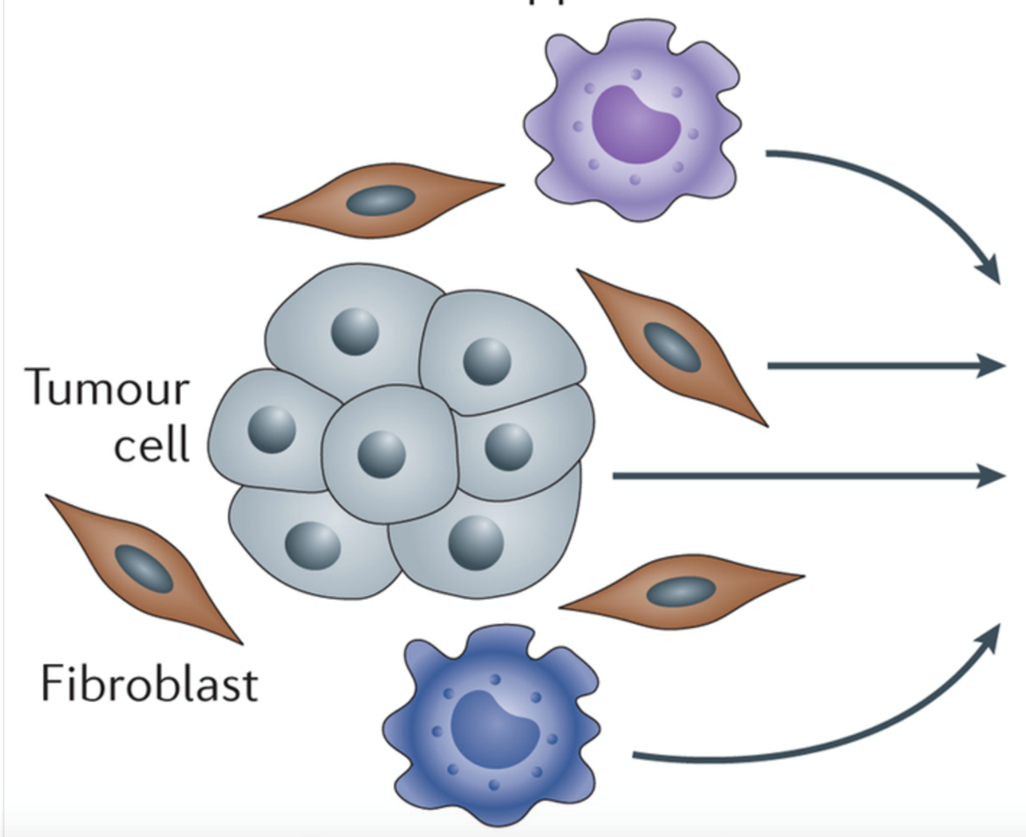
S1800A: Rationale for Combination Trials
Targeting the Immunosuppressive Microenvironment
MDSC
VEGF
IDO1
Arginase 1
Adenosine (A2a)
IL10
TGFβ
CSF-1/MCSF
Tumor
Fibroblast
TAM

Slide 43
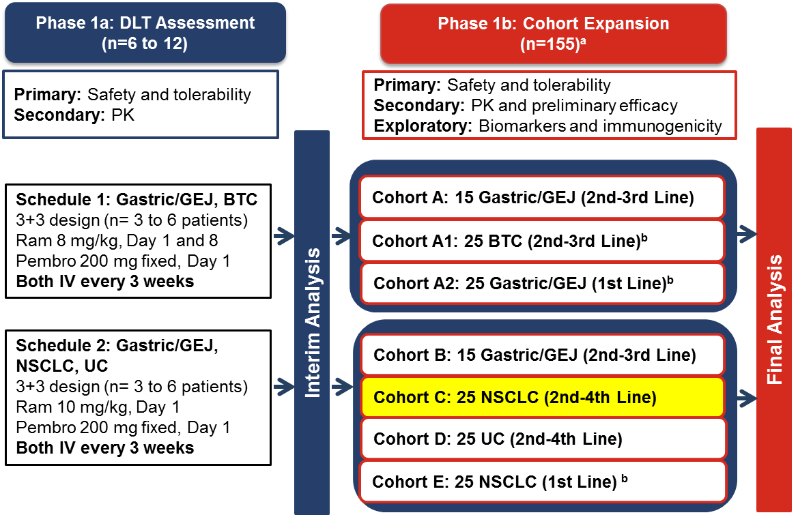
S1800A: Phase 1 Background for Trial
Pembrolizumab
plus
Ramucirumab
ª Patients may continue treatment for up to 35 cycles, until confirmed progressive disease or discontinuation for any other reason.
^{b} Protocol was recently amended to add cohorts A1, A2 and E; cohorts are currently enrolling. DLT dose-limiting toxicity; PK pharmacokinetics; Ram ramucirumab; Pembro pembrolizumab
Chau I. et al. Journal of Clinical Oncology 36, no. 4_suppl (February 1 2018) 101-101. ; Herbst et al. (Lung results) Manuscript submitted

Slide 44
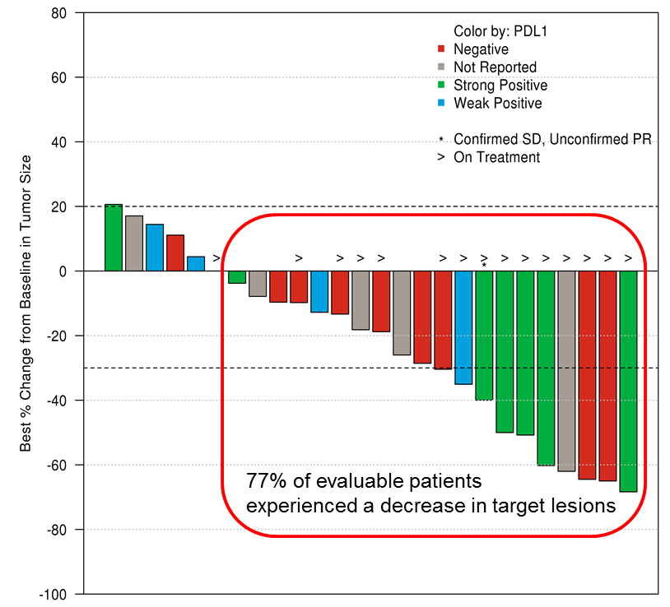
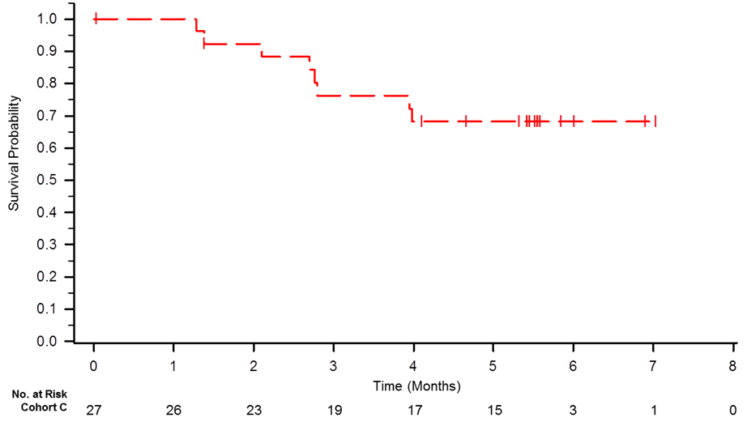
S1800A: Using VEGF Inhibitors to Enhance T Cell Activity
Cohort C: Interim clinical activity Ramucirumab + Pembrolizumab
NSCLC
Progression-free survival
Median: 9.69 (4.63-NR)
PD-L1 Status | Patients | Events | Median PFS, Mo (95% CI)
All Patients | 27 | 8 | NR (3.98, --)
Negative | 10 | 2 | NR
Weak positive | 4 | 2 | 3.98 (2.76, --)
Strong positive | 7 | 2 | NR
Not reported | 6 | 2 | NR
ITT Population | Cohort C NSCLC (n=27)
Objective response rate, n (%) | 8 (30%)
Disease control rate, n (%) | 23 (85%)
Herbst et al, Presented at EMSO 2016; Manuscript submitted

Slide 45
S1800A - Schema
Registration to S1400/LUNGMAP
Eligibility Criteria
NSCLC
Stage IV or Recurrent
Previously treated with chemo and immunotherapy
Anticipated Open
Q4 2018
Screening study to determine sub-study assignment
Primary Objective
Compare overall survival in patients randomized to ramucirumab and MK3475 vs. standard of care
Randomization
ARM A
Investigator’s Choice
Standard of Care
ARM B
Ramucirumab plus MK-3475 (Pembrolizumab)

Slide 46
Awards
Roy Herbst, MD, PHD
Study Co-Chair, Medical Oncology

Slide 47
Q & A Session
S1400 Study Chairs

Slide 48

Questions?
Thank you for your time.
The slides presented today will be available on the SWOG website→ S1400 Protocol Abstract page→ Other Study Materials→ S1400 Group Meeting Materials link

