Slide 1
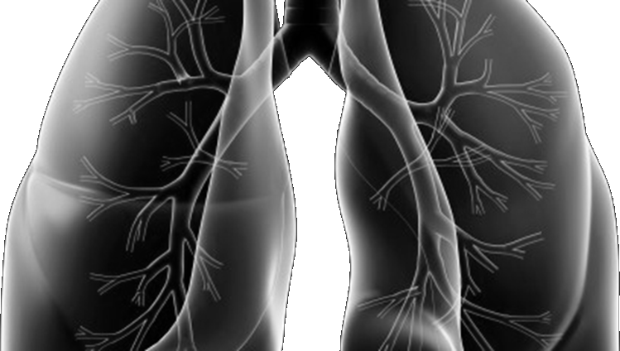




Lung-MAP Update Meeting
Karen Kelly, MD
swog lung cancer committee chair
SWOG Fall meeting
October 4, 2019

Slide 2
Agenda
Opening Remarks
Study Updates
Summary of Anticipated Sub-Studies
Delegation Task Log Updates from QA
Presentations of Results
  S1400GEN
  S1400G
  S1400I
  S1400K
Closing Announcements & Q & A
There will be a Q & A session at the end of the presentation.

Slide 3
Opening Remarks
Roy Herbst, MD, PHD
Lung-MAP Study Chair
Medical Oncology

Slide 4

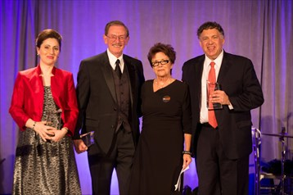
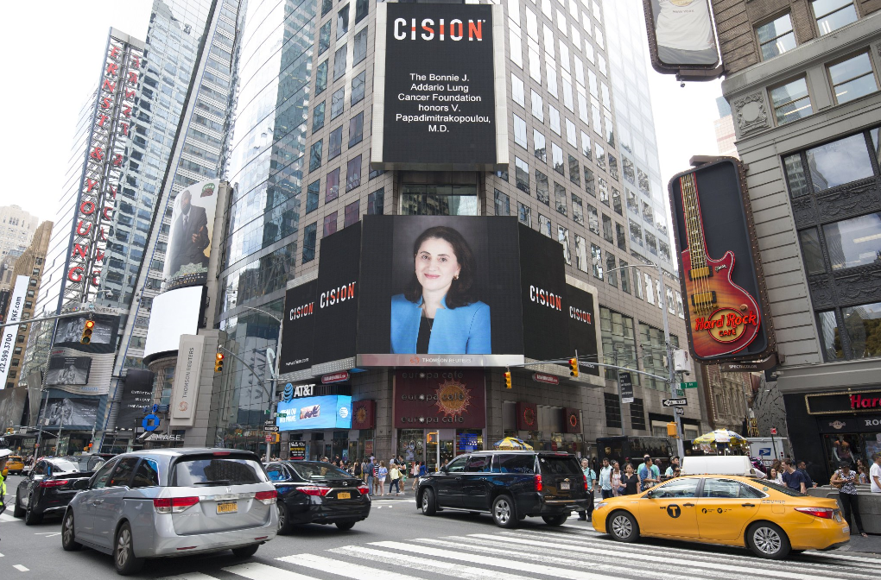
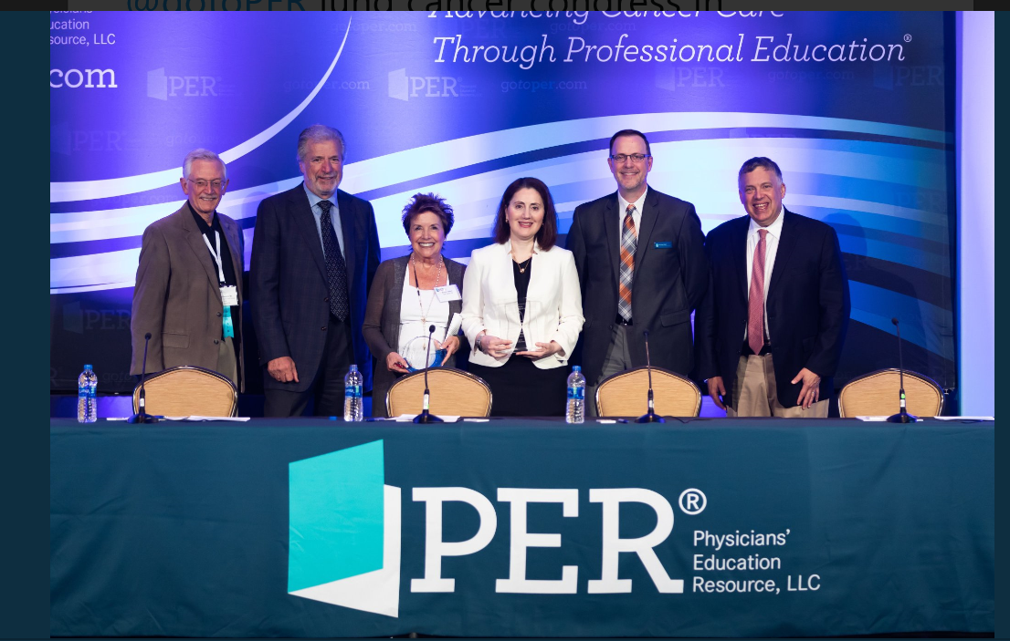
Thank You!
Vassiliki A. Papadimitrakopoulou, M.D.
November 2014 Drs. Papadimitrakopoulou, Herbst, and Gandara received the Bonnie J. Addario Lung Cancer Foundation “Excellence in Collaboration & Innovation Award” for Lung-MAP
L-R: M. Redman, J. Abrams, V. Miller, A. Ashby,
V. Papadimitrakopoulou, D. Gandara, J. Woodcock, R. Herbst, J. Allen
November 2012 Lung Master Protocol Trial Design Proposal hosted by FOCR
July 2018 Dr. Vali Papadimitrakopoulou received the Addario Lectureship at International Lung Cancer Congress
Times Square New York

Slide 5
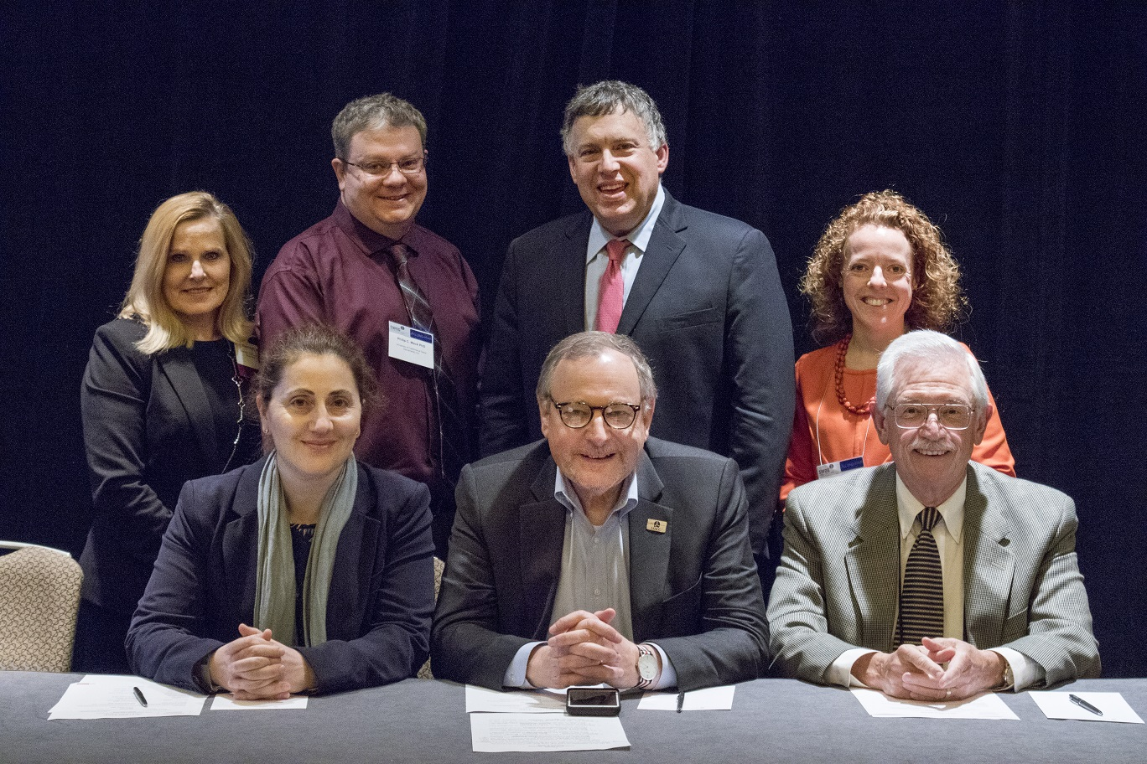
Thank You!
Vassiliki A. Papadimitrakopoulou, M.D.

Slide 6
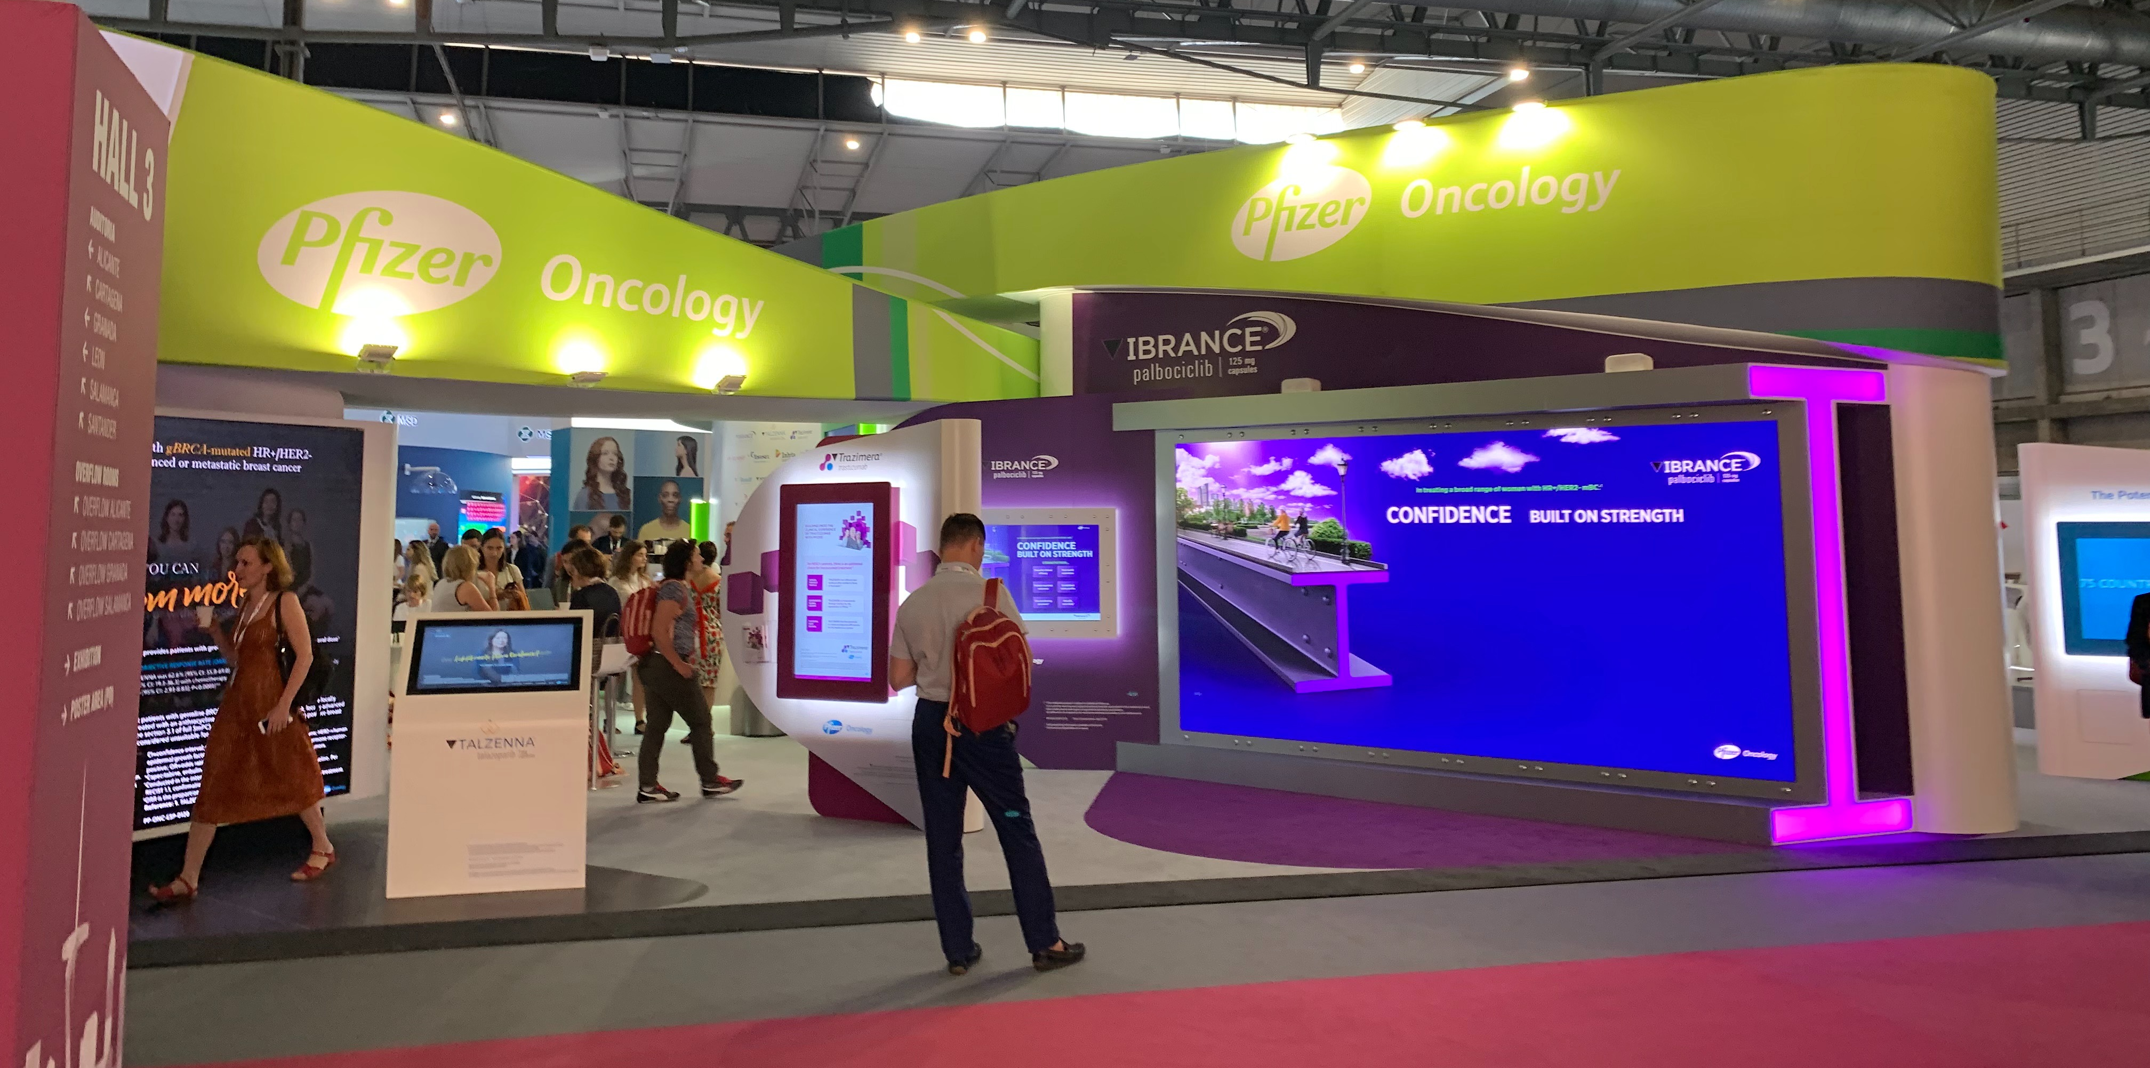

Slide 7



Study
Updates
SWOG
ECOG-ACRIN
NRG
Alliance
Lung-MAP Master Protocol
Roy Herbst, MD, PHD
Lung-MAP Study Chair
Medical Oncology

Slide 8
Goals for LUNG-MAP
Demonstrate to patients, physicians, and the community the impact and power of LUNG-MAP
Continue to have state-of-the-art sub-studies with targeted, IO, and combination options for patients
Work seamlessly with LUNG-MAP partners and all cooperative groups to have true unity and collaboration
Publish our results quickly
Mine the data and tissue resources for more discoveries and to move
the science forward
Bring the right drug to the right patient at the right time, in their own communities

Slide 9
Where We’ve Been
  What We’ve Achieved Along the Way
  S1400 Screening Protocol
  Opened 6/16/14
  1864 patients enrolled (737 pre-screening, 1127 screened)
  Closed on 1/28/19 to expand to all histologies of NSCLC with the new LUNGMAP screening protocol
Oct 2011
Inspiration from TCGA & battle trials at SWOG Group Meeting
Nov 2012
Lung Master Protocol Trial Design Proposal hosted by FOCR
June 2014
Lung-MAP opened w/ 5 treatment sub-studies
Over 50 publications & abstracts
January 2019
Expanded to reach more patients with new screening protocol

Slide 10
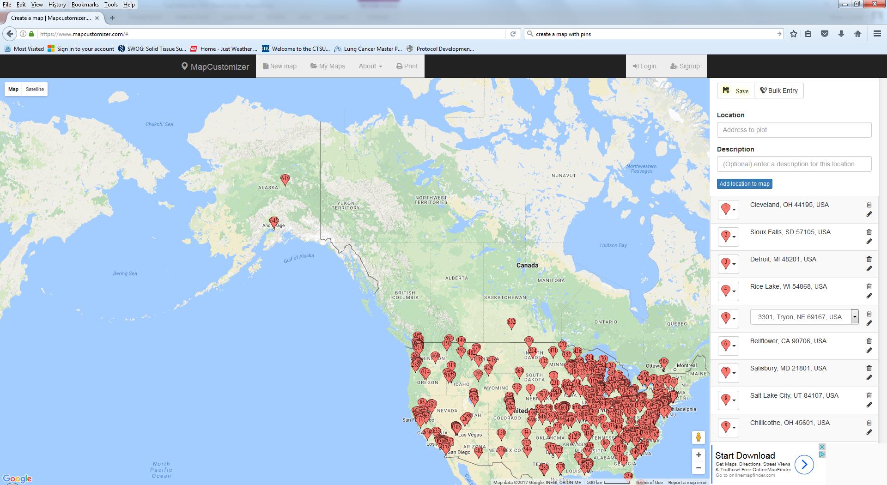
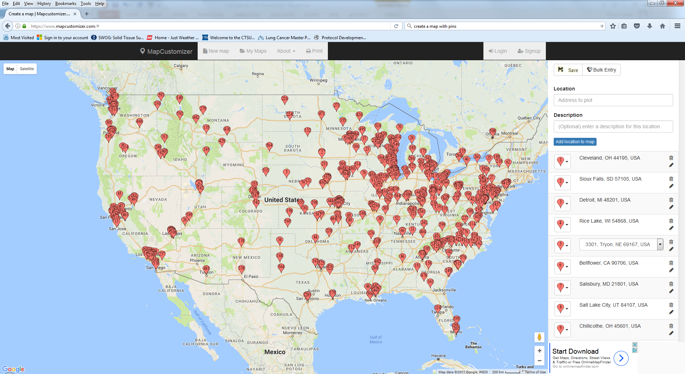
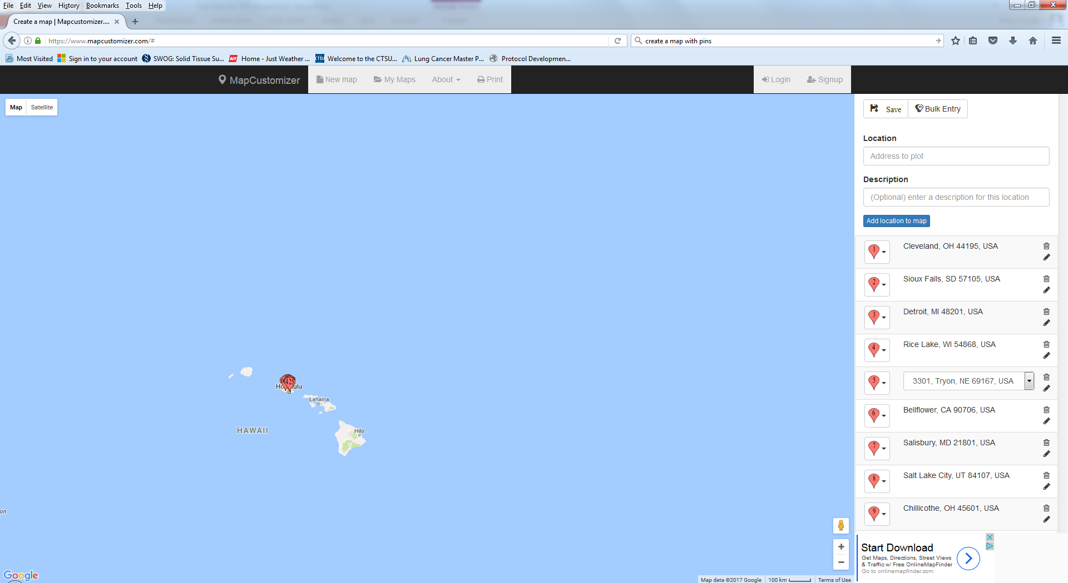
Where are we now?
Accrual as of 9/26/19
  LUNGMAP Screening Protocol
  Opened 1/28/19
  648 sites with IRB approval
  592 patients enrolled*
  390 non-squamous
  185 squamous
  17 mixed histology
  41 patients registered to a sub-study
  348 patients from SWOG sites
Notes:
*now over 600 pts screened as of this week

Slide 11
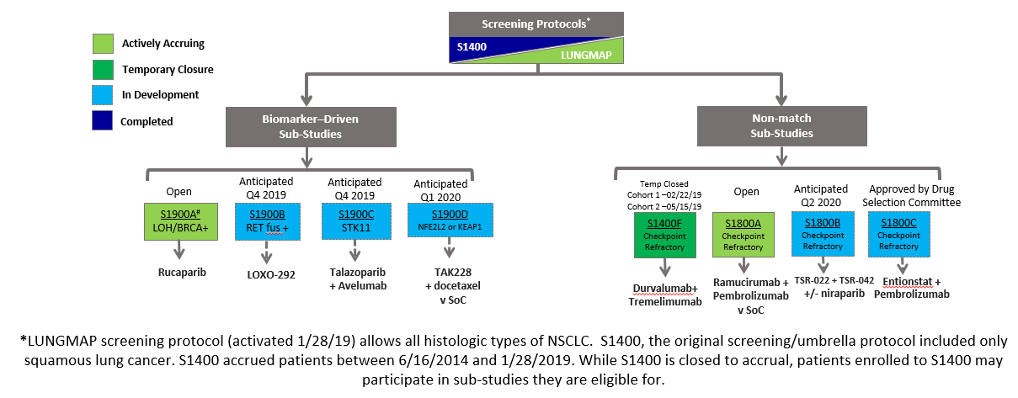
Lung-MAP Status – Active & Anticipated Studies
A current sub-study status schema is available on CTSU → LUNGMAP → Education & Promotion

Slide 12
Current Sub-Study Status
Accrual as of 9/26/19
Biomarker-Driven
  S1900A (LOH/BRCA 1/2 +, rucaparib)
  Opened 1/28/19
  22 patients enrolled (9 squamous, 13 non-squamous or mixed)
  Ancillary Studies
  S1400GEN
  Opened 2/5/18. Closed 6/30/19.
  207/goal of 200 patient surveys & 33/goal of 30 PI surveys
Non-Match
  S1400F (MEDI4736 + tremelimumab)
  Opened 10/2/17
  Cohort 1 (acquired resistance) & Cohort 2 (primary resistance) temp closed to accrual 2/22/19 & 5/15/19 while data matures for interim analysis.
  64 patients enrolled (30 acquired, 34 primary resistance)
  S1800A (ramucirumab + pembrolizumab v SOC)
  Opened 5/17/19
  23 patients enrolled*
Notes:
*S1800A - now 27 pts enrolled as of 9/30

Slide 13
Anticipated Sub-Studies
Sub-Study Protocols in Development
S1900B (LOXO-292)
Biomarker-driven, RET fusion +, all NSCLC
Anticipated Q4 2019
S1900C (talazoparib + avelumab)
Biomarker-driven, STK11, non-squamous
Anticipated Q4 2019
S1900D (mTOR inhibitor + docetaxel v SOC)
Biomarker-driven, NFE2L2 or KEAP1, squamous
Anticipated Q1 2020
Sub-Study Concepts in Development
S1800B (anti-TIM3 antibody + anti-PD-1 antibody +/- PARP inhibitor)
Non-match, all NSCLC
Anticipated Q2 2020
S1800C (HDAC inhibitor + pembrolizumab)
Non-match, all NSCLC
Recently approved by Drug Selection Committee
- Confidential -

Slide 14
S1900B
A Registration-intent Phase II Study of LOXO-292 in Patients with Previously-Treated RET Fusion-Positive Stage IV or Recurrent Non-Small Cell Lung Cancer
Mary REdman, PHD, Lung-MAP Lead Biostatistician
Study Chairs: Yasir Elamin, MD & Jhanelle E. Gray, MD (SWOG)

Slide 15
S1900B Overview
Primary Objective: To evaluate the response rate by Blinded Independent Centralized Review in patients with previously-treated Stage IV or recurrent RET fusion-positive non-small cell lung cancer (NSCLC) treated with LOXO-292.
RET is a receptor tyrosine kinase (RTK) with critical roles in normal organogenesis and in the maintenance of several adult tissue types, including neural, neuroendocrine, hematopoietic, and male germ cell. Genetic alterations in the RET gene are implicated in the pathogenesis of several human cancers.
RET fusions occur in a variety of malignancies, including 1-2% of non-small cell lung cancers (NSCLC).
LOXO-292 is a novel, highly selective, ATP-competitive small molecule RET inhibitor.

Slide 16
S1900B Study Design
RET-Fusion Positive Stage IV/
Recurrent NSCLC
(SQCLC or Non-SQCLC)
Prior chemotherapy is required
Prior IT is allowed
Primary Endpoint: Response by BICR
Secondary Endpoints:
  DoR by BICR
  Response by IA
  PFS by BICR and IA
  OS
  IA-DOR
  CNS response and DOR
  Toxicity
N: 91-175
Loxo-292 160mg PO BID
Every 28 Days
RET-FUSION POSITIVE
  Any FMI tissue-based assay
    (FoundationOne CDx, previous versions FMI, FoundationOne Heme)
  Other tumor-based CLIA Assay
  ctDNA
  FISH
IT: immunotherapy; IA: investigator assessed; BICR: blinded independent central review; DOR: Duration of response.

Slide 17
S1900B Schema
No prior RET testing
RET-fusion-positive
by on-study FMI or confirmation of outside results
Registration to Screening Study
Assignment to S1900B
Prior test indicating
RET fusions*
Submit RET documentation
Registration to S1900B
Allowable tests:
Any FMI tissue-assay,
Other tumor-based assays such as NGS, PCR, or FISH
By cfDNA blood assay
Patients with RET fusions detected by IHC alone are not eligible.
LOXO-292 160mg PO BID
Every 28 Days
continued to off treatment reasons met
Accrual Goal: 175 patients

Slide 18
S1900C
A Phase II Study of Talazoparib plus Avelumab in Patients with Stage IV Non-Squamous Cell Lung Cancer Bearing Pathogenic STK11 Genomic Alterations
Mary REdman, PHD, Lung-MAP Lead Biostatistician
Study ChairS: Ferdinandos Skoulidis, MD, PhD, MRCP, & J. Marie Suga, MD, MPH (SWOG)

Slide 19
S1900C Overview
Primary Objective: To evaluate the response rate with talazoparib plus avelumab in patients with Stage IV or recurrent non-squamous NSCLC bearing pathogenic STK11 genomic alterations that were previously treated with anti-PD-1/PD-L1 therapy and platinum-based chemotherapy.
STK11 mutations are one of the most commonly seen alterations in NSCLC, estimated in ~ 17% of all lung adenocarcinomas
PARP-inhibitors have been demonstrated to help enhance anti-tumor immune activity and therefore makes it an ideal candidate to add to anti-PD-1/PD-L1 immunotherapy in this particularly immuno-resistant patient population

Slide 20
S1900C Schema
PATHOGENIC STK11 GENOMIC ALTERATIONS (testing by FoundationMedicine One assay)
Registration to Screening Study
Assignment to S1900C
Registration to S1900C
Talazoparib + Avelumab continued to off treatment reasons met
Accrual Goal: 44 patients

Slide 21
S1900D
A Randomized Phase II Study of mTOR inhibitor Plus Docetaxel Versus Standard of Care in Patients with Previously-Treated NFE2L2 or KEAP1 Positive Stage IV or Recurrent Squamous Cell Lung Cancer
Mary REdman, PHD, Lung-MAP Lead Biostatistician
Study ChairS: Paul Paik, MD & Martin Edelman (ECOG-ACRIN)

Slide 22
S1900D Overview
Primary Objective: To compare the progression-free survival between patients with NFE2L2 or KEAP1-positive Stage IV or recurrent squamous cell lung cancer randomized to an mTOR inhibitor + docetaxel versus standard of care therapy.
The prevalence in this population is 4% for KEAP1 and 12% for NFE2L2, with 16% of patients having either detected.
The addition of taxane to an mTOR inhibitor has the potential to increase anti-tumor activity in a synergistic fashion in a biomarker-select group of NSCLC patients whose tumors are marked by alterations that upregulate Nr2 activity.

Slide 23
S1900D Schema
Registration to Screening Study
Squamous NFE2L2 or KEAP1 +
(testing by FoundationMedicine One assay)
ARM A (Investigational)
mTOR inhibitor
4 mg PO D2-4, 9-11, 16-18
+
docetaxel 35mg IV D1 & 8
Assignment to S1900D
ARM B (SoC)
Investigator’s Choice
Standard of Care
*docetaxel or docetaxel + ramucirumab
*Patients may receive mTOR inhibitor at progression
S1900D
Registration/
Randomization

Slide 24
S1800B
A Phase II Study of (anti-TIM-3) Plus (anti-PD-1) or (anti-TIM-3), (anti-PD-1), and PARP inhibitor in Patients with Previously Treated Stage IV or Recurrent Non-Small Cell Lung Cancer
Mary REdman, PHD, Lung-MAP Lead Biostatistician
Study ChairS: Jose Pacheco, MD & Sandip Patel, MD (SWOG)

Slide 25
S1800B Objectives
Primary Objectives:
  To evaluate the response rate (confirmed and unconfirmed, complete and partial) per RECISTv1.1.
  To evaluate the disease control rate (CR, PR, UCR, UPR, SD) per RECIST 1.1 at 12 weeks (DCR12) after randomization.
  To select between the arms, if both investigational arms meet the criteria based on both response rate and disease control rate at 12 weeks to be considered for future evaluation.

Slide 26
S1800B Schema
Registration to Screening Study
Accrual Goal: 88 patients
Not eligible for biomarker-driven sub-studies
Acquired or Primary Resistance to
Anti-PD-1/PD-L1
Assignment to S1800B
(via randomization)
ARM 1 (Investigational)
anti-TIM3 antibody + anti-PD-1 antibody
900mg IV D1 Q21 days
500mg IV D1 Q21 days
ARM 2 (Investigational)
anti-TIM3 antibody + anti-PD-1 antibody + PARP inhibitor
900mg IV D1 Q21 days
500mg IV D1 Q21 days
200mg PO continuous
S1800B Registration/
Randomization

Slide 27
Delegation Task Log
Elaine Armstrong, M.S.
SWOG QA Manager

Slide 28
New Delegation of Task Log (DTL) Requirement for S1800A
Effective 9/15/19 with distribution of Revision #1
For sites that have not yet activated S1800A, the DTL must be complete prior to obtaining an approved site registration status.
For sites currently approved to register patients on S1800A, registered sites have 60 calendar days to complete the DTL to retain an approved site registration status. If a site fails to sign the DTL within the 60-day period, the site’s registration status will revert to “Pending.”

Slide 29
DTL Task Registration Types
Investigator (physician with active CTEP-IAM account)
Clinical Investigator: responsible for signing the DTL, with overall responsibility for the study conduct at the site
Enrolling/treating investigator: responsible for subject treatment
IND prescribing: responsible for writing orders for investigational agents
Eligibility assessment: final verification of eligibility
Endpoint assessment: assesses study end points

Slide 30
DTL Task Registration Types
Non-physician investigator (non-physician with advanced degree such as nurse practitioner or physician assistant)
History and Physical (H&P) Assessments: conducts physical exams and assessments
Toxicity assessments: assesses and signs off on adverse events

Slide 31
DTL Task Registration Types
Associate Plus
Consenting person: Responsible for consenting patients
OPEN registrar: OPEN registration write access
Rave CRA: Rave write access; responsible for data management and uploads of Central Monitoring documents; and using Rave CTEP-AERS safety reporting tools
Study related interventions: Responsible for coordinating and/or administering study-related interventions and procedures (i.e., vital signs, administering questionnaires, etc.)
RT/Imaging support: RT/imaging support (e.g., TRIAD)
DTL Administrator: Person assigned by the CI to manage the DTL

Slide 32
DTL Task Registration Types
Associate
Investigational Product Accountability: Tracking of distribution and return of investigational product

Slide 33
Site Authority Log
Required for S1400 sub-studies (i.e., S1400A, B, C, D, E, F, G, I, K)
Element of the Trial Master File
Form can be downloaded from the SWOG website/Quality Assurance and Audits page
Recommend a master log be maintained even for sub-studies with a DTL to provide handwriting samples

Slide 34



S1400GEN
Patient Preferences Related to Return of Genomic Results in a Biomarker-Driven Clinical Trial:
A Survey of Patients Enrolled in Lung-MAP
Joshua A. Roth, Meghna S. Trivedi, Stacy Gray, Donald Patrick, Debbie Delaney, Kate Watabayashi, Paul Litwin, Parth Shah, Katherine D. Crew, Monica Yee, Mary Redman,
Vassiliki Papadimitrakopoulou, Karen Kelly, David Gandara, Dawn L. Hershman, Scott D. Ramsey

Slide 35
S1400GEN Background & Objective
‘Biomarker-driven’ clinical trials that are guided by genomic results are rapidly increasing in number and represent a new paradigm in clinical trial research in oncology
Are patients & physicians informed about the nuances of return of genomic results?
What types of genomic results do patients prefer to have returned?
No studies have evaluated knowledge, attitudes, and preferences about genomic profiling in biomarker-driven clinical trials.
Overall Objective: Evaluate patient & physician knowledge, attitudes, and preferences about return of genomic results in Lung-MAP (S1400).

Slide 36
S1400GEN Methods
    Inclusion Criteria: 1) Enrolled in Lung-MAP, 2) Age 18 or older, 3) Able to complete telephone survey in English
    38-Question telephone survey: Items adapted from prior return of results studies
    Questions adapted from prior return of genomic results studies, structured as:
  5-level scale: Strongly Agree [5] to Strongly Disagree [1]
  True/False/Don’t Know
Includes questions about hypothetical uses of test results, including germline results
Statistics: Mean, Proportions, Chi-Square, Odds Ratios from Logistic Regression

Slide 37
S1400GEN Background: Knowledge Results Reported at Spring Meeting
In S1400GEN sample enrolled through April 1, 2019 (n=123)
Majority of the sample reported ‘strongly/somewhat’ agreeing with ‘enough info to understand study benefits (82.9%) and risks (73.2%)’
Deficits in knowledge about key aspects of return of genomic results in S1400:
  89.2% correctly reported that test results are used to select cancer treatments
  8.8% correctly reported that results will not tell them if family members have increased risk of developing cancer
  11.8% correctly reported that results will not tell them if they have increased risk of diseases other than cancer.
Findings demonstrate need for new ways to discuss biomarker-driven trial benefits & risks to enhance patient knowledge
Similar proportions in the final sample evaluated here (n=207)

Slide 38
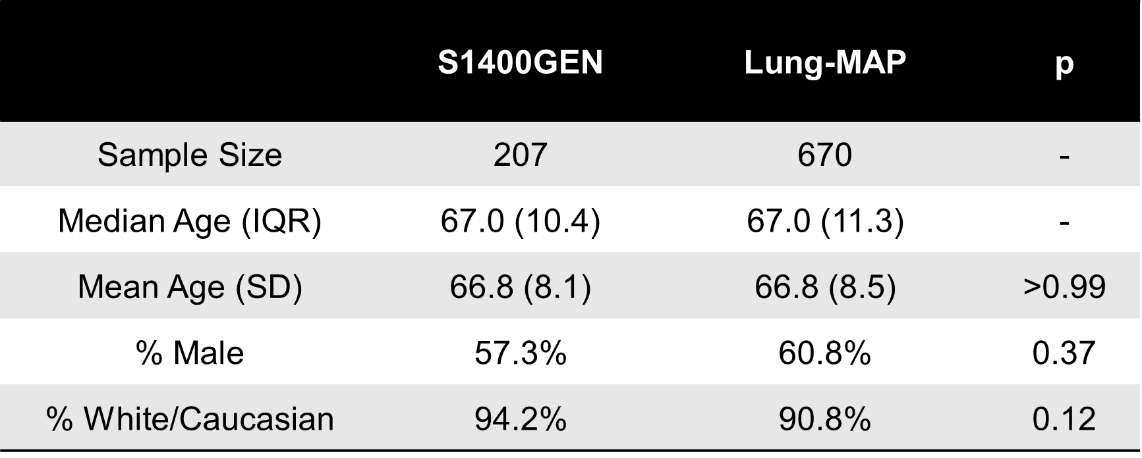
S1400GEN Sample vs Master Protocol Sample 2/22/2018 – 6/30/2019

Slide 39
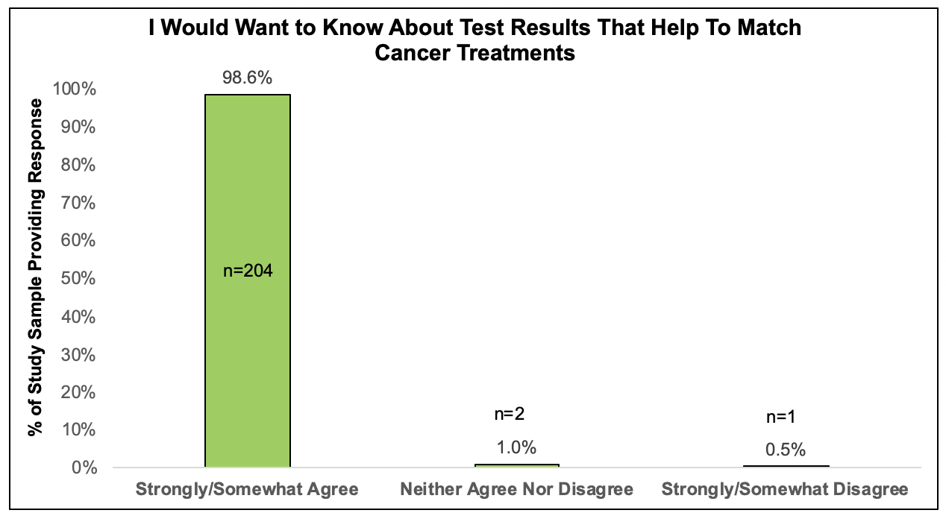
S1400GEN Results: Match Cancer Treatments

Slide 40
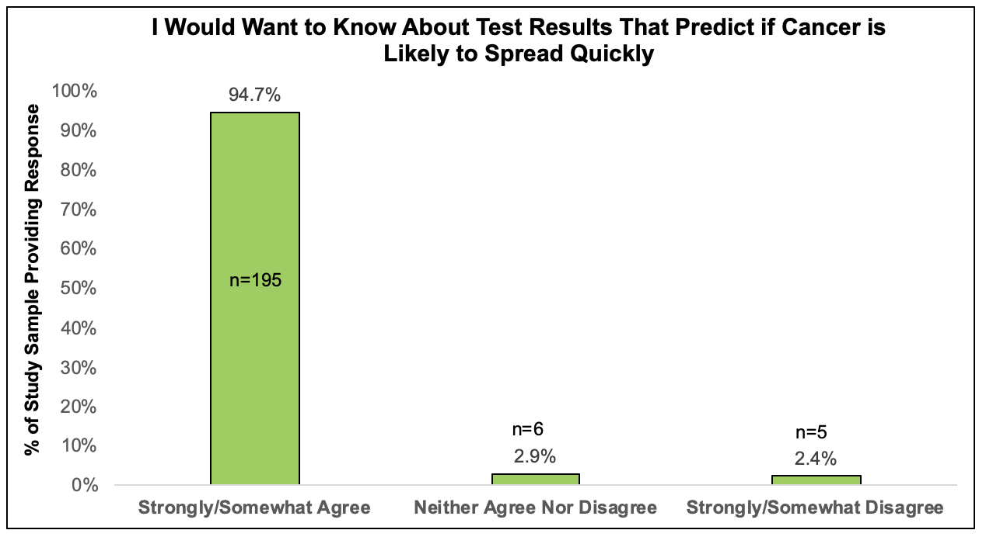
S1400GEN Results: Predict Cancer Spread

Slide 41
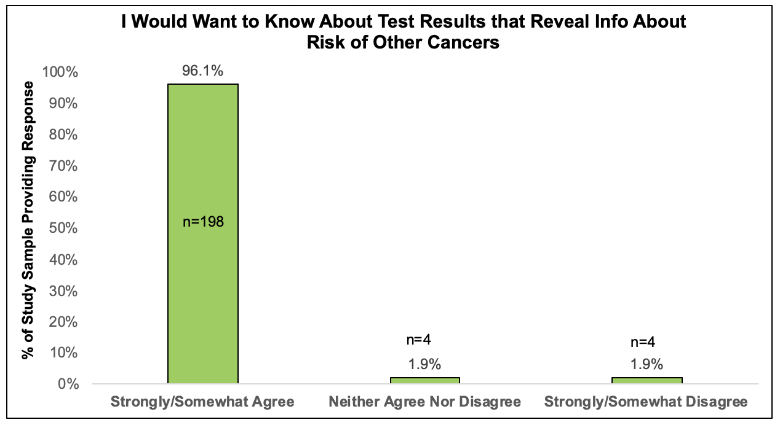
S1400GEN Results: Risk of Other Cancers

Slide 42
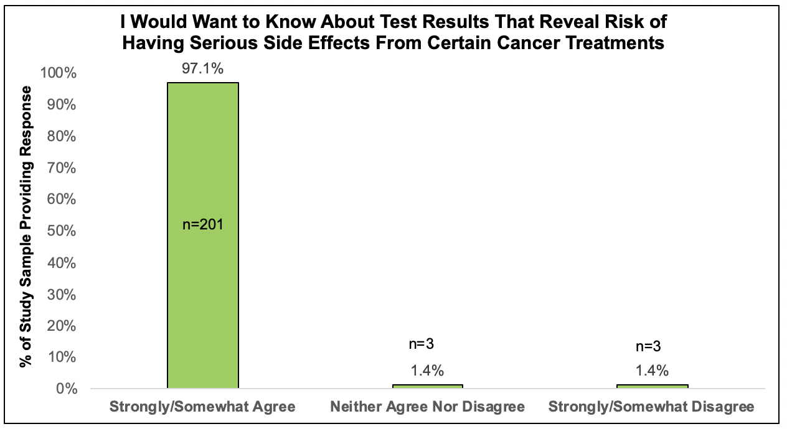
S1400GEN Results: Risk of Serious Side Effects

Slide 43
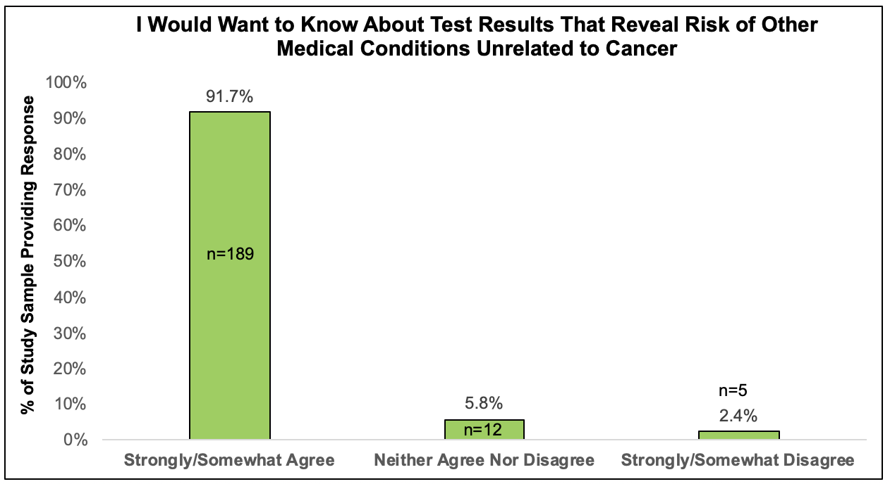
S1400GEN Results: Risk of Other Medical Conditions

Slide 44
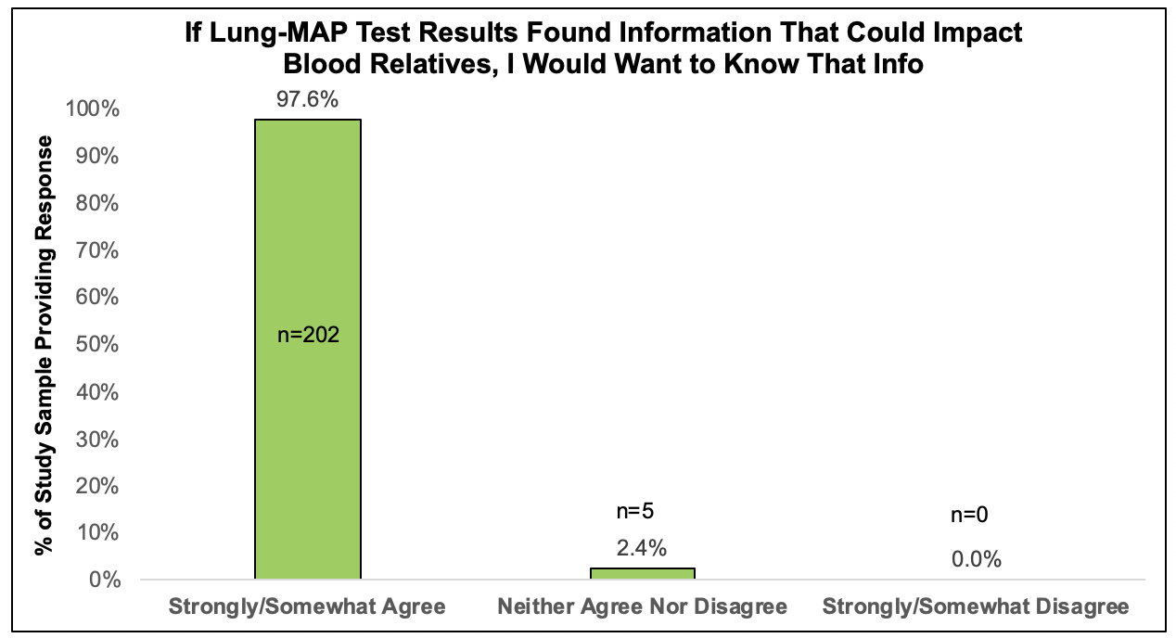
S1400GEN Results: Know About Blood Relative Impacts

Slide 45
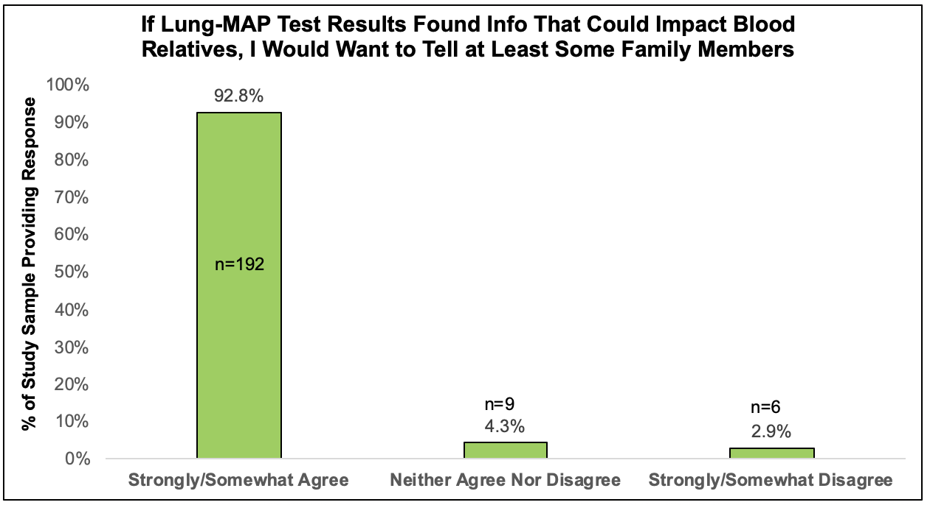
S1400GEN Results: Want to Tell Blood Relatives About Impacts

Slide 46
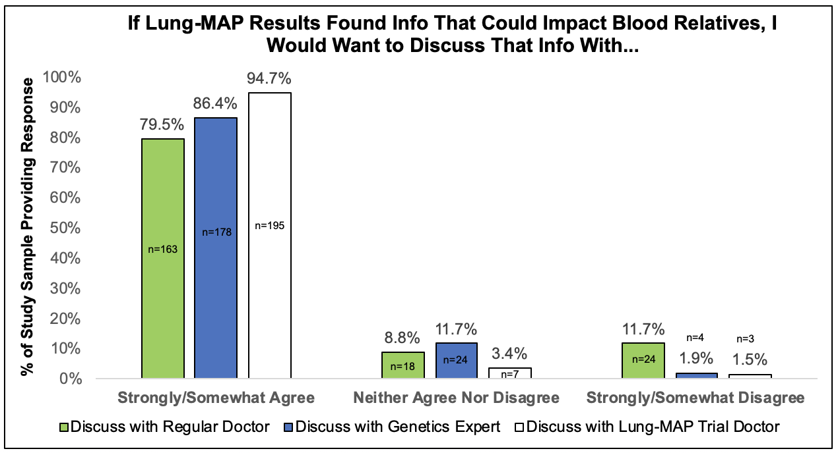
S1400GEN Results: Discuss with Experts

Slide 47
S1400GEN Conclusions
>91% of participants ‘strongly/somewhat’ agreed with statements about wanting genomic test results that give information about:
  Matching the most effective cancer treatments
  Risk of cancer spread
  Risk of developing other cancers
  Risk of serious side effects with certain cancer treatments
  Risk of medical conditions other than cancer
If genomic findings had medical implications for blood relatives:
  >97% of participants ‘strongly/somewhat’ agreed with wanting that information
  >92% of participants ‘strongly/somewhat’ agreed with wanting to share the info with ≧1 family member
Ongoing analyses examine associations between clinical and socio-demographic factors and preferences for return of genomic results
Clear patient preference to receive a range of genomic results in a biomarker-driven clinical trial when posed as hypothetical questions

Slide 48
S1400GEN: Thanks to Participants, Co-Authors, & Study Sponsors
Meghna S. Trivedi, MD
Stacy Gray, MD
Donald Patrick, PhD
Wylie Burke, MD, PhD
Debbie Delaney
Kate Watabayashi
Paul Litwin, MS
Parth Shah, PharmD, PhD
Katherine D. Crew, MD
Monica Yee
Mary Redman, PhD
Vassiliki Papadimitrakopoulou, MD
Karen Kelly, MD
David Gandara, MD
Dawn L. Hershman, MD, MS
Scott D. Ramsey, MD, PhD
This study is supported by NIH/NCI grant UG1CA189974; and Lung-MAP master protocol supported by NIH/NCI grants CA180888, CA180819, CA180820, CA180821, CA180868, and in part by AbbieVie, Amgen, AstraZeneca, Bristol-Myers Squibb Company, Genentech and Pfizer through the Foundation for the National Institutes of Health, in partnership with Friends of Cancer Research. The content is solely the responsibility of the authors and does not necessarily represent the official views of the National Institutes of Health.

Slide 49
S1400G
A Phase II Study of Talazoparib (BMN 673) in Patients with Homologous Recombination Repair Deficiency (HRRD) Positive Stage IV Squamous Cell Lung Cancer
David Gandara, MD, Lung-MAP Co-CHair
On behalf of S1400G Study Chairs Taofeek Owonikoko (ECOG-ACRIN), MD, PHD & Lauren Byers, MD (SWOG)

Slide 50
S1400G Background
HRRD sensitizes tumor to PARP inhibitor therapy.
S1400G sub-study [NCT03377556] evaluated the clinical efficacy of a PARP inhibitor, talazoparib, as monotherapy (1mg p.o. daily; cycle=28days), in advanced stage squamous cell lung cancer harboring HRRD.

Slide 51
S1400G Methods
Full eligible subset defined by deleterious mut population (FEP) defined by any deleterious mutation in study-defined HRR genes [ATM, ATR, BARD1, BRCA1, BRCA2, BRIP1, CHEK1, CHEK2, FANCA, FANCC, FANCD2, FANCF, FANCM, NBN (NBS1), PALB2, RAD51, RAD51B (RAD51L1), RAD54L, RPA1 genes] using Foundation One NGS panel.
Primary analysis population (PAP) is patient ation(s) in any of ATM, ATR, BRCA1, BRCA2 or PALB2 genes.
A 2-stage design with exact 93% power and 1-sided 0.07 level type I error required enrollment of 40 patients in the PAP in order to rule out an overall response rate (ORR) ≤15% if the true ORR is 35% or greater.

Slide 52
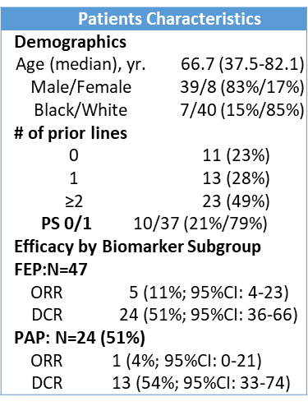
S1400G Patient Characteristics
Frequency of HRRD gene mutations
FANCM*** | 7 | 15%
FANCD2 | 1 | 2%
FANCF | 2 | 4%
FANCA | 4 | 9%
BRCA1 | 6 | 13%
BRCA2* | 9 | 19%
BRIP1 | 2 | 4%
ATM | 3 | 6%
ATR | 4 | 9%
PALB2 | 3 | 6%
CHEK1* | 3 | 6%
CHEK2 | 2 | 4%
RPA1 | 1 | 2%
NBN | 2 | 4%
>1 mutation | 2 | 4%
(* denotes patients with objective response)

Slide 53
S1400G Response

Slide 54
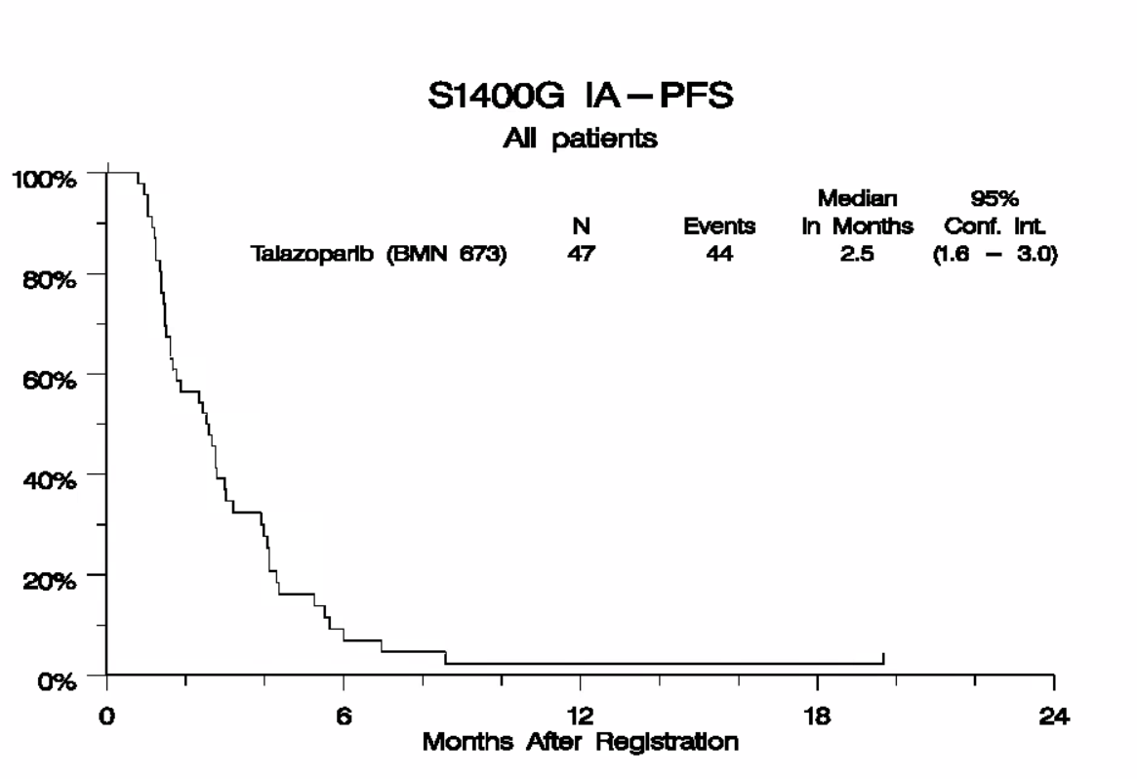
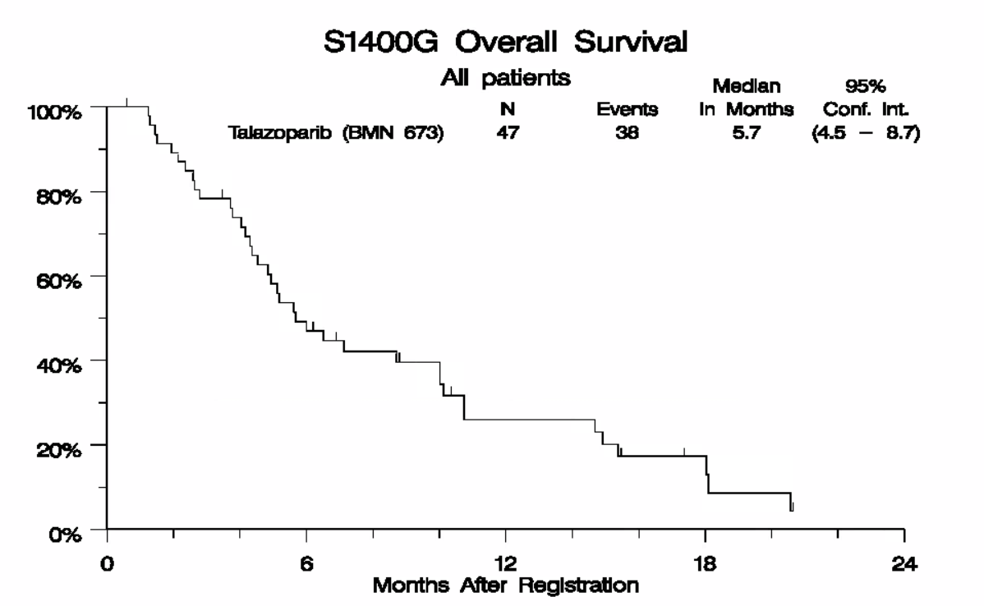
S1400G Results: PFS & OS in FEP Population
FEP: Median OS 5.7 (4.5-8.7)
FEP: Median PFS 2.5 (1.6-3.0
Full Evaluable Population (FEP) with mutation in any study-defined HRRD genes

Slide 55
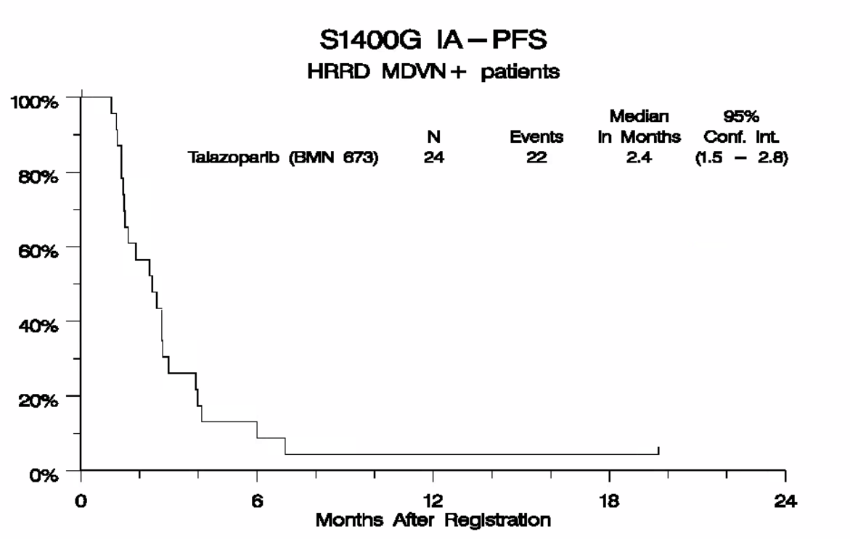
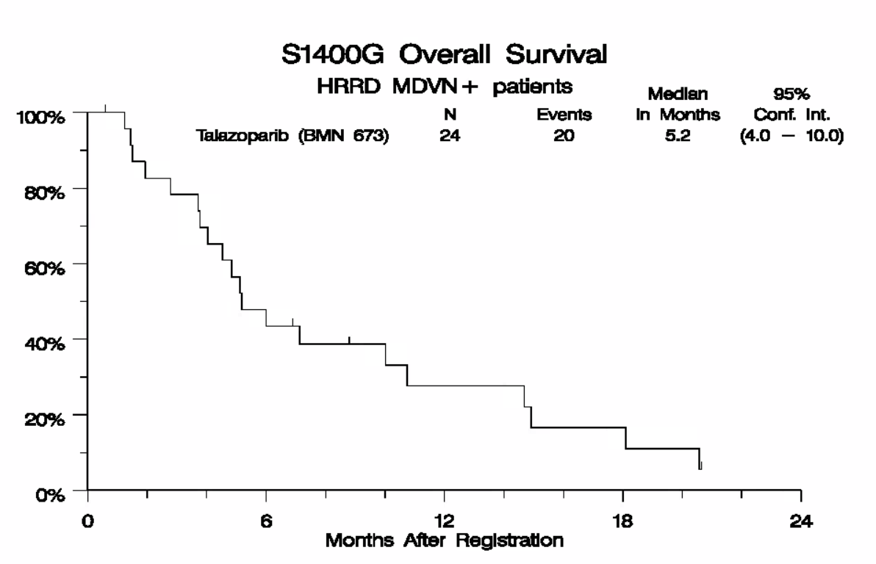
S1400G PFS & OS in PAP
PAP: Median PFS 2.4 (1.5-2.8)
PAP: Median OS 5.2 (4.0-10.0)
Primary Analysis Population (PAP) with mutation in ATM, ATR, BRCA1, BRCA2, PALB2 genes

Slide 56
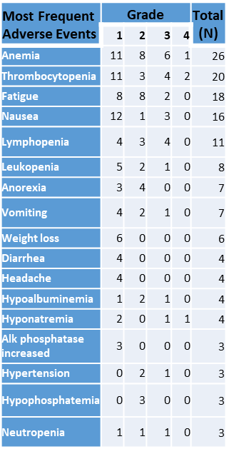
S1400G Adverse Events

Slide 57
S1400G Conclusions
S1400G failed to show sufficient level of efficacy for talazoparib in HRRD(+) squamous lung cancer. Study closure at the end of stage I accrual due to low ORR of 4% in the PAP.
There were no new safety concerns and hematologic toxicities were the most frequent.
Five patients with tumors harboring mutations in BRCA2, FANCM, FANCM, FANCM and FANCC and CHEK1 achieved objective response.

Slide 58
S1400I Results
A Phase III Randomized Study of Nivolumab Plus Ipilimumab versus Nivolumab for Previously Treated Patients with Stage IV Squamous Cell Lung Cancer and No Matching Biomarker
Roy Herbst, MD, Lung-MAP CHair
On behalf of S1400I Study Chairs Lyudmila Bazhenova (Alliance), MD & Scott Gettinger, MD (SWOG)
L Bazhenova¹, M Redman^{2,3}, S Gettinger⁴, F R Hirsch⁵, P Mack⁶, LH Schwartz⁷, D Gandara⁶, JD Bradley⁸, TE Stinchcombe⁹, Natasha Leighl¹⁰, S Ramalingam¹¹, SS Tavernier¹², K Minichiello ^{2,3}, K Kelly⁶, V Papadimitrakopoulou¹³, RS Herbst⁴
¹UC San Diego Moores Cancer Center, La Jolla, CA; ²SWOG Statistical Center; ³Fred Hutchinson Cancer Research Center, Seattle, WA; ⁴Yale University, New Haven, CT; ⁵Mount Sinai Health System, NYC, NY ; ⁶UC Davis Comprehensive Cancer Center, Sacramento, CA; ⁷Columbia University Medical College, New York, NY; ⁸Washington University School of Medicine, St. Louis, MO; ⁹Duke University School of Medicine, Durham, NC; ¹⁰Princess Margaret Cancer Center, Toronto, Ontario, CAN; ¹¹Emory University, Atlanta, GA; ¹²Idaho State University, Pocatello, ID; ¹³The University of Texas MD Anderson Cancer Center, Houston, TX

Slide 59
S1400I Background
  Nivolumab is approved in the U.S. to treat patients with metastatic squamous cell NSCLC with progression on or after platinum-based chemotherapy based on Checkmate 017 trial. ¹
Nivolumab reduced the risk of death by 41% relative to docetaxel (HR = 0.59) : median OS with nivolumab was 9.2 months and with docetaxel was 6.0 months.
          Nivolumab and ipilimumab enhance T-cell antitumor activity through distinct and complementary pathways. ² In theory, combining immunotherapeutic agents with different mechanisms of action offers the possibility of a synergistic response.
          Several multi arm trials in NSCLC employed PD-(L)1 & PD- (L)1/CTLA 4 dual inhibition (CM 227, MYSTIC, NEPTUNE), albeit none were designed to directly compare combination vs. monotherapy IO arms.
          S1400I in second line squamous lung cancer is the first randomized phase III trial designed to directly compare IO monotherapy (nivolumab) vs. combination IO therapy (nivolumab/ipilimumab). The primary results of S1400I were presented at ASCO 2019 (abs 9014). This presentation addresses additional biomarker analyses of TMB and PD-L1.
¹Brahmer J, et al. Nivolumab versus docetaxel in advanced squamous-cell non-small-cell lung cancer. N Engl J Med. 2015;373:123-135
²Callahan MK, et al. CTLA-4 and PD-1 Pathway Blockade: Combinations in the Clinic. Front Oncol 2015:4:385

Slide 60
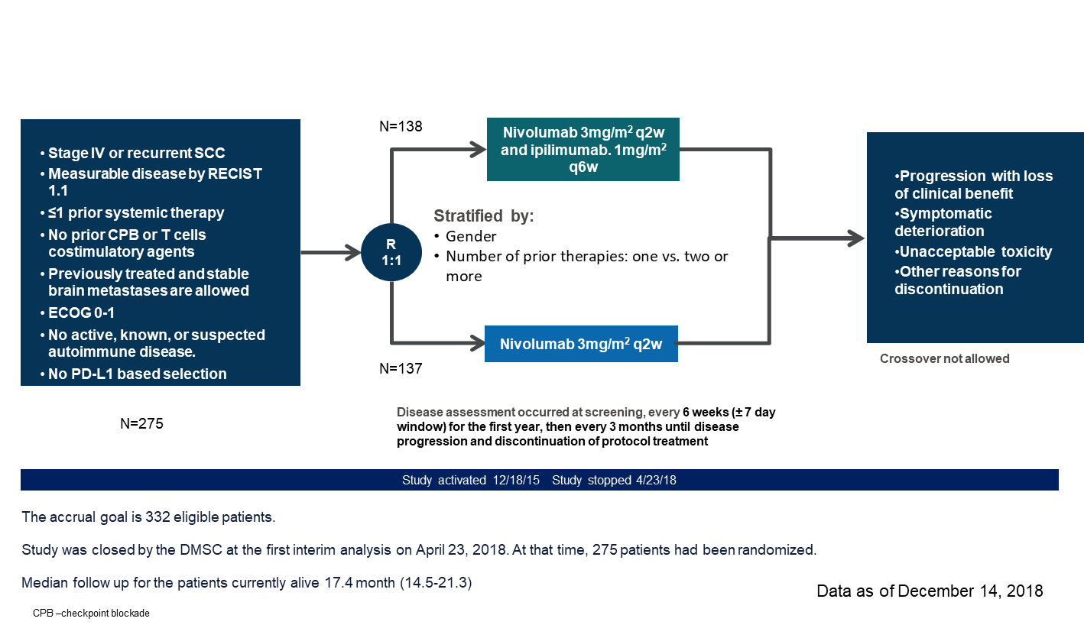
S1400I Study Design
Notes:
What N to add to each arm

Slide 61
Study Objectives
Primary Objective
To compare overall survival (OS) in previously-treated immune-checkpoint inhibitor naïve patients with advanced stage refractory SCCA of the lung randomized to nivolumab plus ipilimumab versus nivolumab.
Secondary Objectives:
To compare investigator-assessed progression-free survival (IA-PFS) between the arms
To compare the response rates (confirmed and unconfirmed, complete and partial) per RECIST 1.1 between the arms
To evaluate the frequency and severity of toxicities associated with nivolumab plus ipilimumab versus nivolumab.
Translational Medicine objectives:
To evaluate if there is a differential treatment effect on OS, IA-PFS, and Response by tumor PD-L1 expression status.
Patient Reported Outcomes (PRO) Objectives

Slide 62
S1400I Statistical Considerations
Primary Endpoint: Overall Survival
Total sample size: 332 eligible (350 total) patients accrued over 27-32 months with 9 months of follow-up
The sample size is based on a design with 90% power to detect a hazard ratio of 0.67 (50% improvement in median OS) at the 1-sided 2.5% type I error rate
Assumptions: median in control arm would be 9 months, OS exponentially distributed
Analyses:
  Final: upon observation of 256 deaths
  Interim analyses: at 128 (50% of expected) and 192 (75% of expected) deaths
Primary analysis: comparison between arms using a 1-sided log-rank test

Slide 63
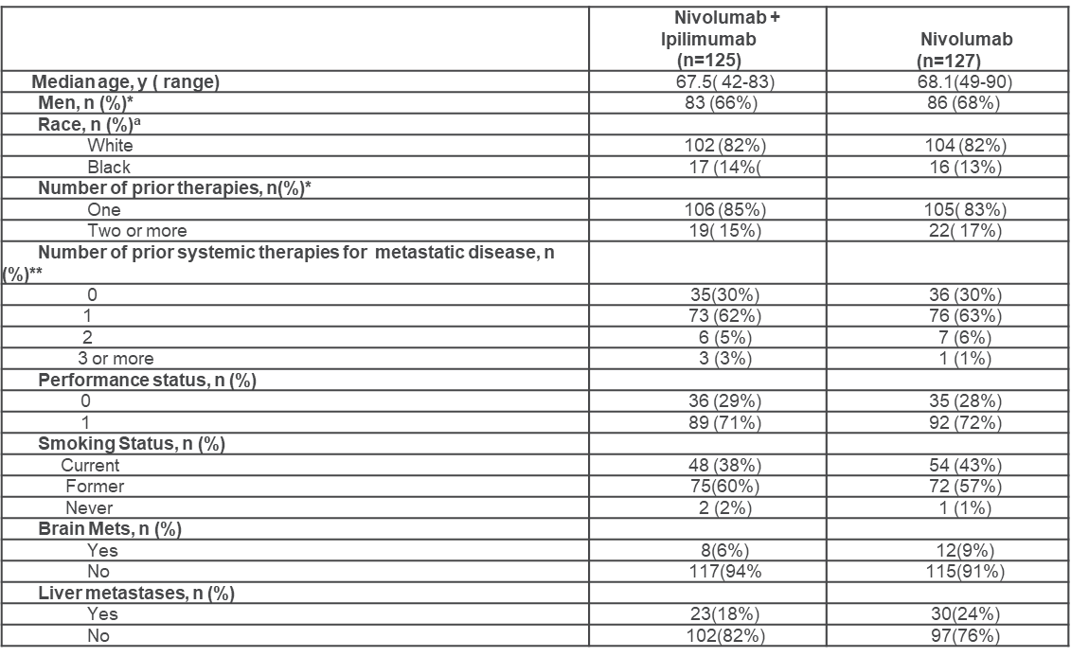
S1400I Baseline Demographics
ªAsian 4, Native American 3, multiracial 1, unknown 4 not included in the table.
*Stratification factor
** data available on N117 with nivo/ipi and N=120 on nivo

Slide 64
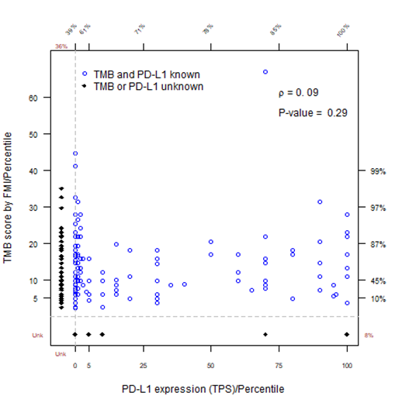
S1400I TMB &
PD-L1 Biomarkers
TMB was performed using Foundation Medicine
PD-L1 IHC was performed using Dako 22C3 antibody
149/252 (59%) had both TMB and PD-L1 data
  21 (8%) missing TMB
  91 (36%) missing PD-L1 (insufficient tissue)
  (9 patients. missing both)
No correlation observed between TMB and PD-L1

Slide 65
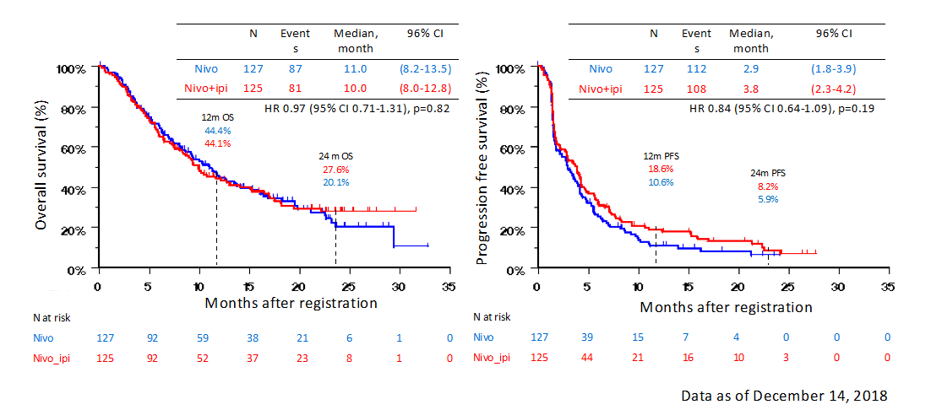
S1400I Overall Survival & Progression Free Survival
No benefit with ipilimumab/nivolumab over nivolumab in unselected patients.
Exploratory subset analysis showed potential OS benefit of ipilimumab/nivolumab over nivolumab in patients with TMB>10 mt/Mb and PD-L1≤ 5%.

Slide 66
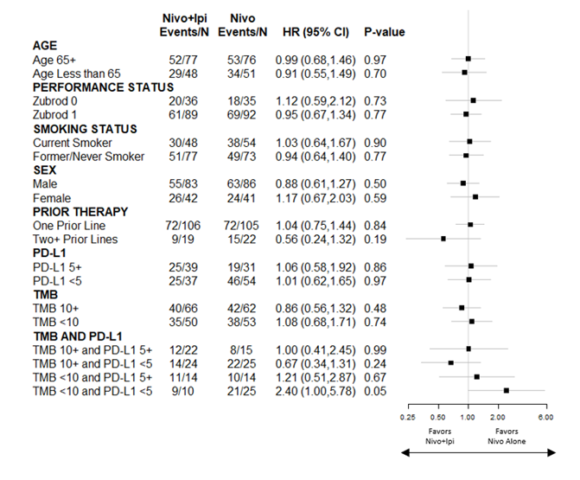
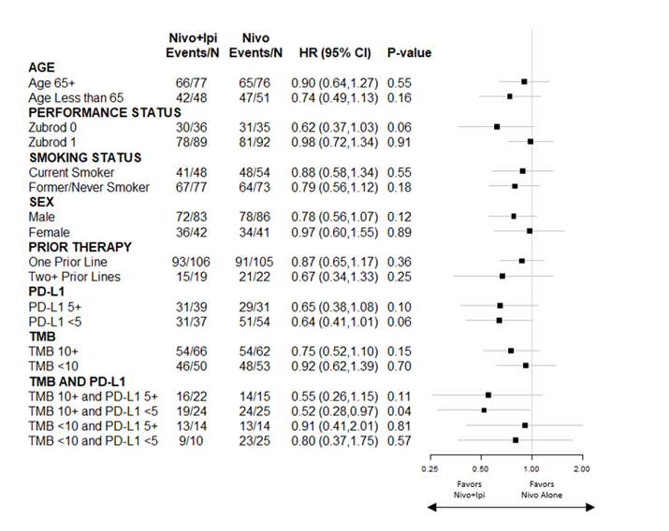
S1400I Outcomes in Key Patient Subgroups
OS
PFS

Slide 67
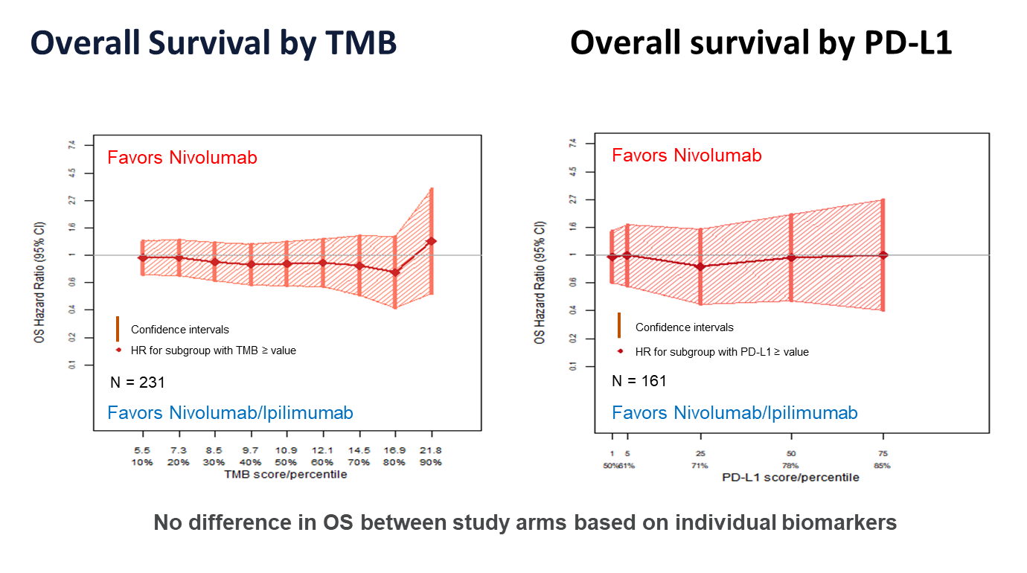

Slide 68
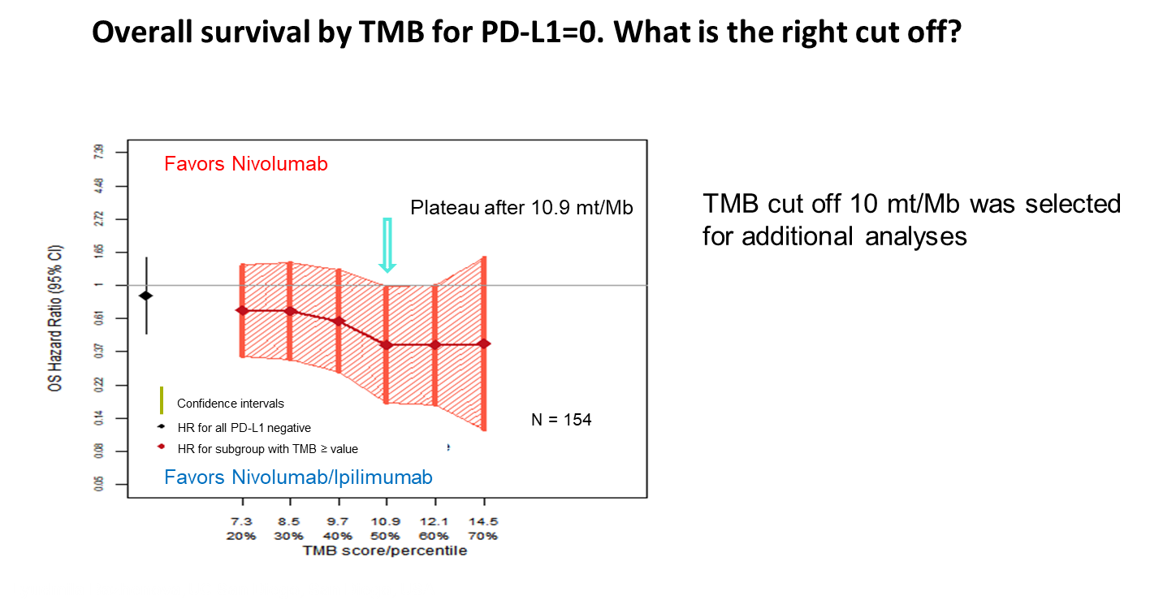

Slide 69
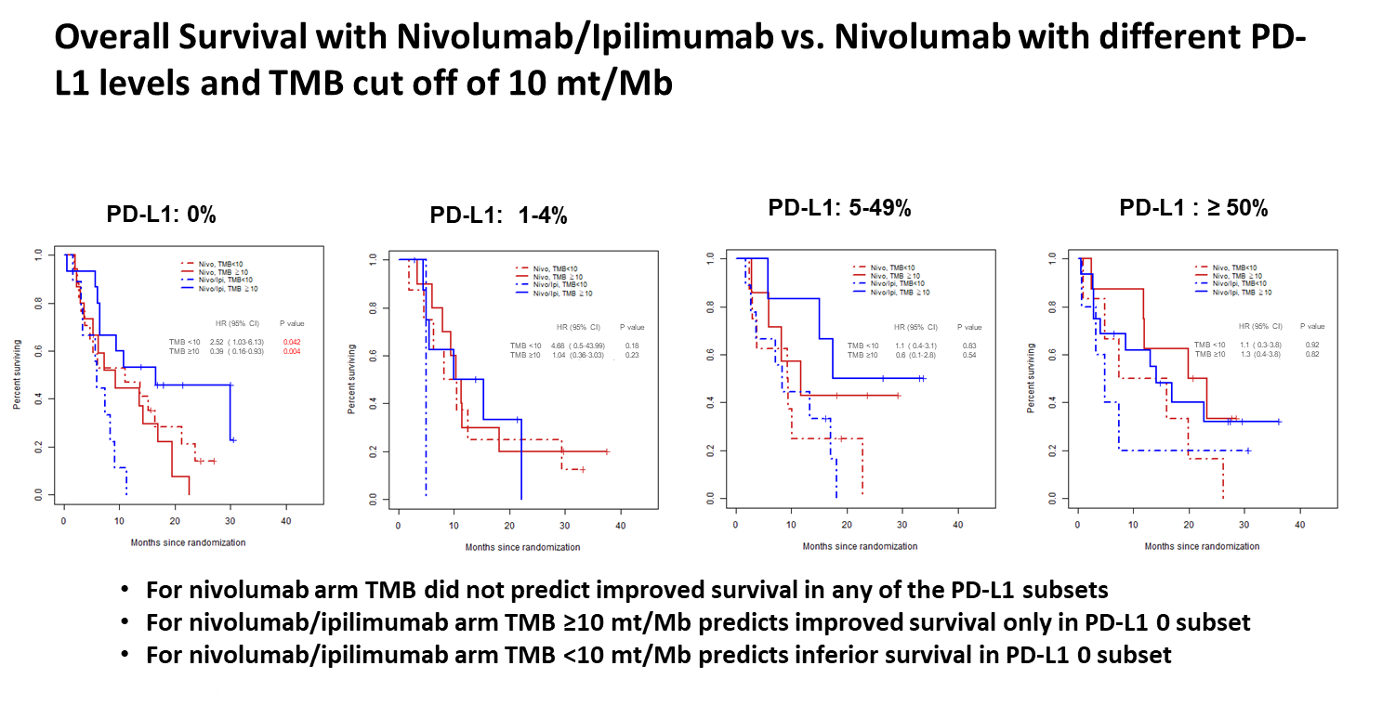

Slide 70
S1400I Summary
S1400I is the first Phase III trial in NSCLC comparing IO monotherapy to a combination IO regimen.
We have previously reported that S1400I failed to show improvement in outcomes with ipilumumab + nivolumab vs nivolumab alone in non biomarker matched, TMB and PD-L1 unselected second line squamous lung cancer.
As a single biomarker neither PD-L1 nor TMB differentiated outcomes of Nivo/Ipi vs. Nivo alone
Exploratory intra-arm analyses for combinatorial PD-L1 and TMB biomarker are of interest and hypothesis generating.
In PD-L1-0 subgroup, nivolumab plus ipilimumab improved outcomes for patients with TMB ≥ 10, ( HR 0.39, 95% CI 0.16-0.93, p=0.004) but was detrimental to patients with TMB <10 ( HR 2.52, 95% CI 1.03-6.13, p=0.042), when compared to nivolumab alone
Gene Array data of top 20 altered genes confirmed association of tp 53 mutations and poor outcomes within nivolumab arm HR (95% CI) = 0.85 (0.10, 1.61), p = 0.027
None of the molecular abnormalities were able to predict outcomes with ipilimumab/nivolumab arm compared to nivolumab alone.

Slide 71
S1400K
Phase II Study of ABBV-399 (Process II) in Patients with c-MET Positive Stage IV/Recurrent Lung Squamous Cell Cancer (SCC)
Dr. Susanne Arnold (Co-PI, SWOG)
University of Kentucky, Markey Cancer Center; Lexington, KY
On behalf of Dr. Saiama Waqar (NRG) and entire S1400K study team
Previously presented at ASCO Annual Meeting 2019 by Dr. Saiama Waqar (PI)

Slide 72
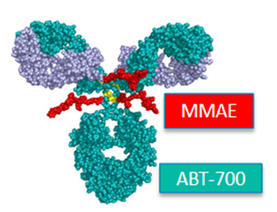
S1400K Background
ABBV-399 is an antibody-drug conjugate comprised of
  ABT-700, a humanized recombinant immunoglobulin G kappa that targets C-MET
  conjugated via a cleavable valine-citulline linker to cytotoxic microtubule inhibitor, monomethylauristatin E (MMAE).
S1400K was a sub-study of Lung-MAP designed to evaluate the response to ABBV-399 in patients with C-Met positive squamous cell carcinoma of the lung.

Slide 73
S1400K Schema, Key Eligibility Criteria
Previously treated SCC in relapse
c-MET positive tumors (H score > 150, Ventana SP44 assay
Zubrod PS 0-1
Adequate organ function
Albumin < grade 2
Edema < grade 2
Hepatic involvement < 50%

Slide 74
S1400K Endpoints and Statistics
Primary Endpoint: Overall Response Rate by RECIST 1.1
Secondary Endpoints: PFS, OS, ORR by cohort, Duration of Response, Toxicities associated with ABBV-299
Accrual goal: 40 response-evaluable patients
Study design provided a 91% power to rule out a RR of 15% at the 1-sided 5% level, if the true rate were 35%.
The observation of 10/40 (25% RR) would be considered evidence to rule out the null hypothesis and evidence to pursue an independent randomized phase III trial.
The design included interim analysis at 20 evaluable patients

Slide 75
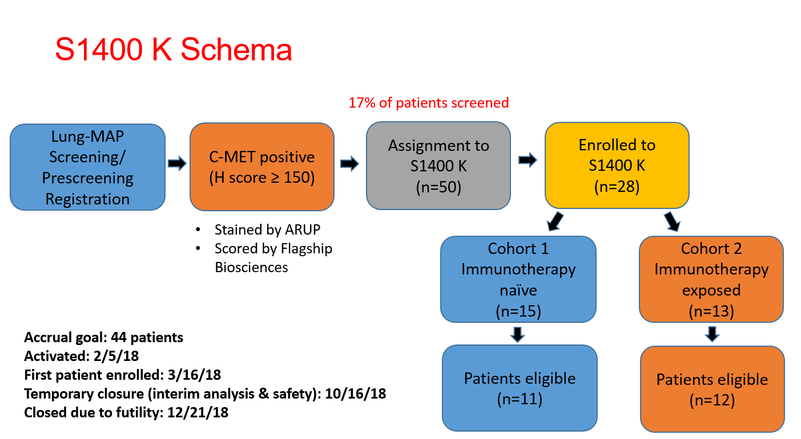
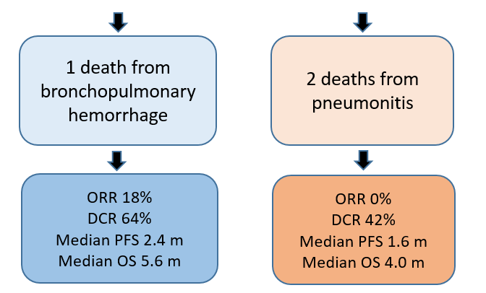
S1400K Schema and Treatment
ABBV-399 2.7 mg/kg intravenously over 30 minutes every 3 weeks until disease progression or unacceptable toxicity.
Response assessments were performed every 6 weeks.

Slide 76
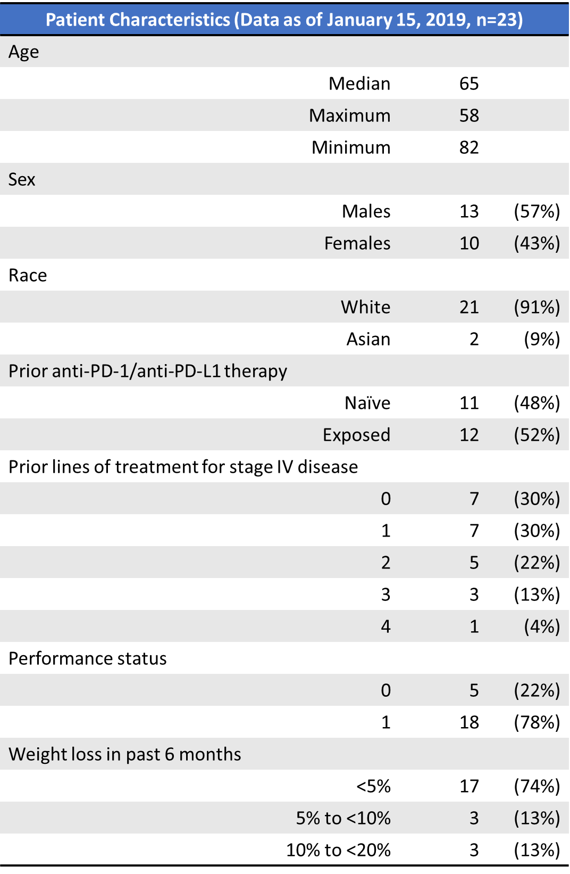
S1400K Patient Characteristics
Data as of January 15, 2019, n=23

Slide 77
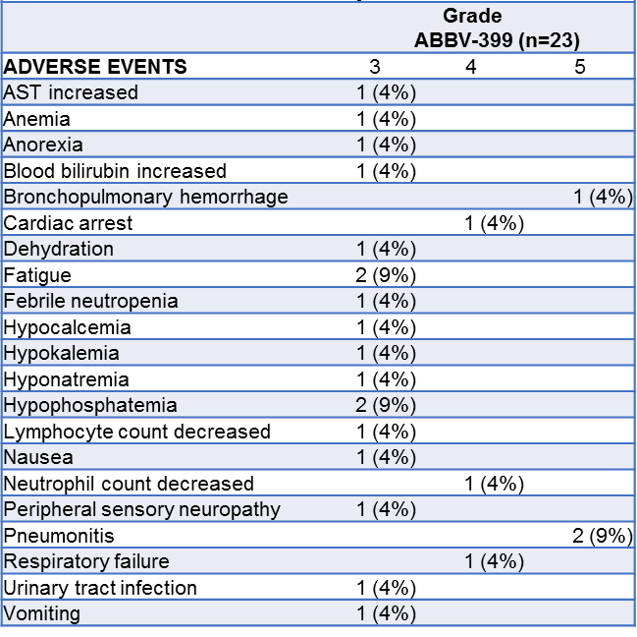
S1400K Adverse events (possibly, probably or definitely related)
Grade 5 AEs:
There were 2 deaths from grade 5 pneumonitis in cohort 2. (IO exposed). One patient had previous history of pneumonitis.
One patient in cohort 1 died from bronchopulmonary hemorrhage. This patient did have a history of previous hemoptysis and had a central tumor.

Slide 78
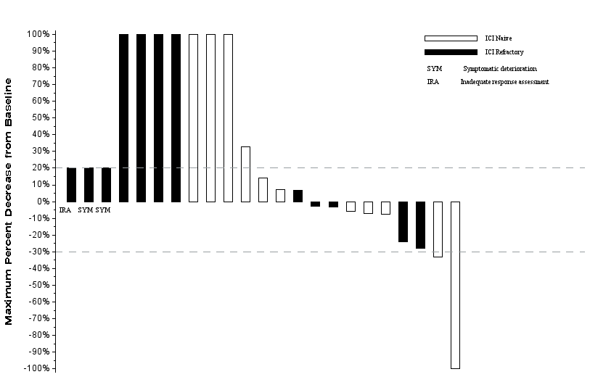
S1400K Waterfall Plot
ORR 9% [0,20%]: 1 CR and 1 UPR (cohort 1)
CR remains on treatment at 4 months
DoR for UPR was 2.3 months.
Ten patients had SD
DCR 52% [3,73%]

Slide 79
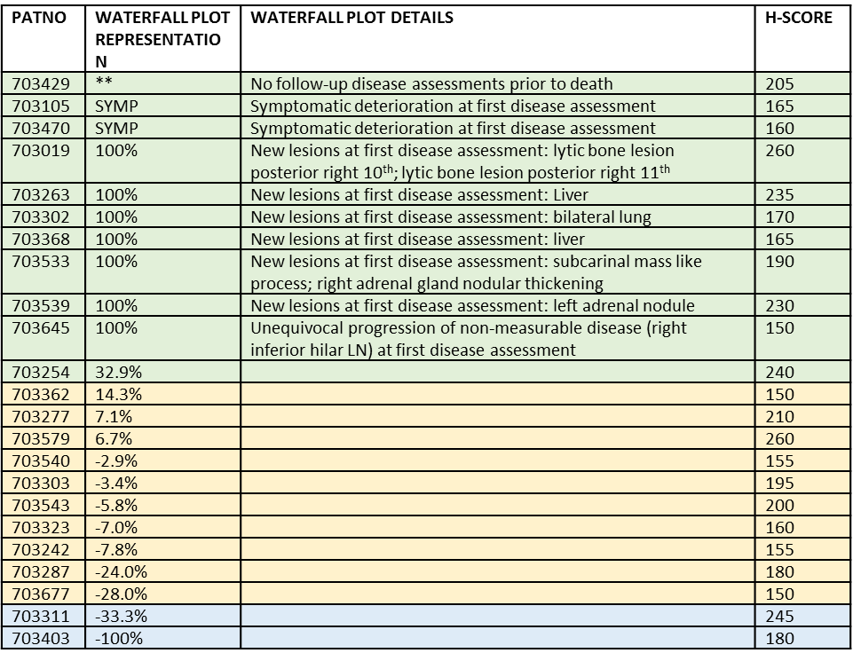
S1400K Depth of Response and H-score
There was no correlation between H-score and depth of response.
The 2 responders did not have MET Exon 14 mutation on molecular testing of their tumor

Slide 80
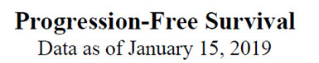
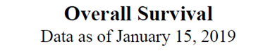


S1400K Results

Slide 81
S1400K Conclusions
At the interim analysis, ABBV-399 failed to meet the pre-specified number of responses needed to justify continuing enrollment.
c-MET expression noted in 17% of SCC patients screened in Lung-MAP.
Pneumonitis was an unanticipated toxicity observed in patients with SCC with previous immunotherapy exposure.
There were three grade 5 study-related AEs (2 pneumonitis, 1 pulmonary hemorrhage).

Slide 82
S1400K Acknowledgements
Lung-MAP trial supported in part by NIH/NCI grants CA180888, CA180819, CA180820, CA180821, CA180868, and by AbbVie Inc., Amgen, AstraZeneca, Bristol-Myers Squibb Company, Genentech and Pfizer through the Foundation for the National Institutes of Health, in partnership with Friends of Cancer Research.
Thank you to the study team, and all of the patients and their families for participating in this trial.

Slide 83
Closing Announcements and Q & A Session
David Gandara, MD
Lung-MAP Co-Chair, Medical Oncology

Slide 84
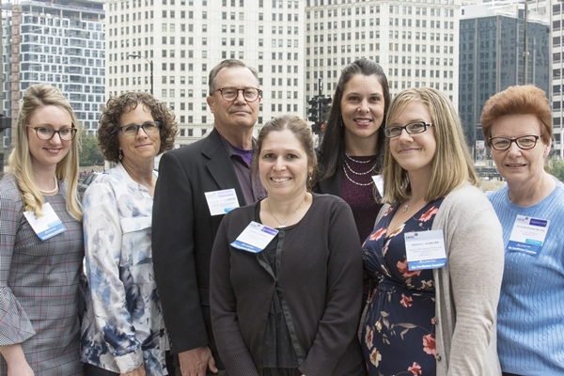
Site Coordinators Committee
Seeking applicants for the Lung-MAP Site Coordinators Committee! Current members represent all types of sites: NCTN, NCORP, academic, minority, etc. SWOG has funds to support travel for members to 2 SWOG Group Meetings per year and participate in quarterly conference calls. For more information about the committee and to apply: https://www.surveymonkey.com/r/VS9K855
SCC Mission: To represent study site staff at the nursing, CRA, data management, and regulatory levels by providing feedback to and from the study leadership to enhance accrual and improve study management.
Questions? Contact LungmapSCC@crab.org

Slide 85
Contact Us
Site Coordinators Committee
  LUNGMAPSCC@crab.org
Protocol & Regulatory
protocols@swog.org
Eligibility & Data Submission
  LUNGMAPQuestion@crab.org
  Central Monitoring
  centralmonitorquestion@crab.org
  Quality Assurance
  QAmail@swog.org
  General Medical Questions
  LUNGMAP@swog.org
  S1900A Medical Questions
  S1900AMedicalQuery@swog.org
  S1800A Medical Questions
  S1800AMedicalQuery@swog.org
  Funding Questions
  Funding@swog.org

Slide 86
Acknowledgements
Thank you for supporting the Lung-MAP Trial!
Patients and Sites
Lung-MAP Site Coordinators Committee
Patient Advocate
Accrual Enhancement Committee
Trial Oversight Committee
Study Chairs
Statistical Team
Pharmaceutical Collaborators
Data Coordinators & Protocol Coordinators
Applications Development Team
Quality Assurance Team
Funding & Contracts Team
NCI, CTEP, CIRB, CTSU
Foundation for the National Institutes of Health
Friends of Cancer Research
CCS Associates Inc.

Slide 87
Q & A Session
David Gandara, MD
Lung-MAP Co-Chair, Medical Oncology
Thank you joining us!
The slides will be available on the SWOG & CTSU websites

